Slide 1

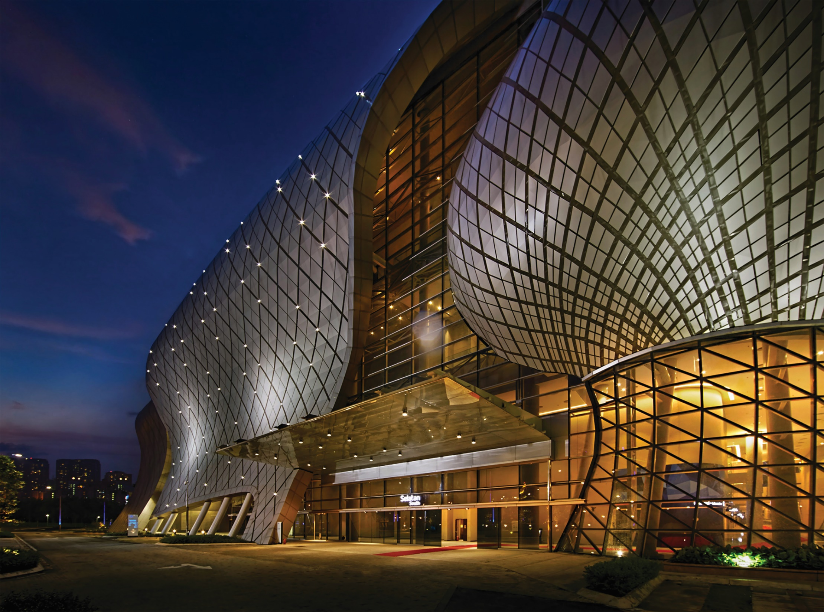




Updates on Preparation of
Malaysia International Halal Showcase (MIHAS) 2020
The 17th
MALAYSIA INTERNATIONAL
HALAL SHOWCASE
1-4 APRIL 2020
MITEC . Kuala Lumpur . Malaysia
Expand Your Halal Horizon
2017 : “Largest Halal Trade Fair in Malaysia by MBR
2019 : “The Best Malaysia Iconic Event” by MACEOS

Slide 2




MIHAS video

Slide 3
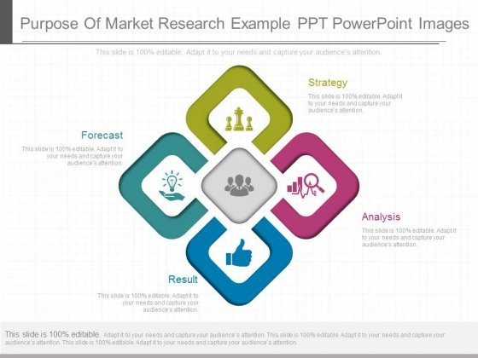
Halal presents tremendous business opportunities globally…
Global Islamic Economy
2018
USD4.76 Trillion
2024
USD6.65 Trillion
Islamic finance
USD2.52 tri
Islamic finance
USD3.47 tri
Food & beverages
USD1.40 tri
Food & beverages
USD1.97 tri
Pharmaceuticals
USD0.09 tri
Pharmaceuticals
USD0.13 tri
Cosmetics
USD0.06 tri
Cosmetics
USD0.10 tri
Halal travel
USD0.19 tri
Halal travel
USD0.27 tri
Modest fashion
USD0.28 tri
Modest Fashion
USD0.40 tri
Halal media & recreation
USD0.22 tri
Halal media & recreation
USD0.31 tri
Global Muslim Population (Statistics of Muslim Worldwide)
GLOBAL
Year 2060
1.8 BILLION
3.0 BILLION
(Source : Pew Research Centre & Thomson Reuters)

Slide 4






























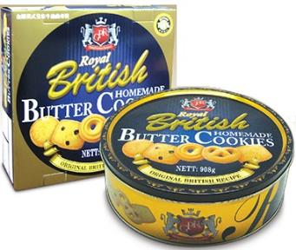
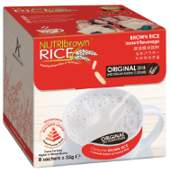
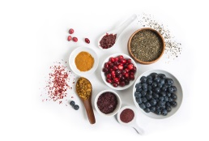



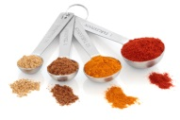

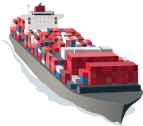
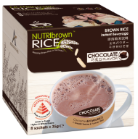

Malaysia’s Halal Ecosystem
Halal Industry Development Council (HIDC)
Halal Industry Masterplan (2008-2020) / Third Industrial Master Plan (2006-2020) / 11th Malaysia Plan (2016 – 2020) / HIMP2.0 (2021-2030)
Government Bodies / GLCs
Policy & Legislation
Research & Development
Standards & Certification
Industrial Infrastructure
Ministry of International Trade & Industry
Ministry of Domestic Trade & Consumer Affairs
Ministry of Economic Affairs
Ministry of Entrepreneur Development
Secretariat of Malaysia Halal Council
State
Governments
Branding & Promotion
Entrepreneurial Development
Incentives & Funding
International Relations
Talent Development
Logistics
e-Commerce
Tourism
Ministry of Transport Malaysia
Ministry of Tourism, Arts and Culture
Association / Chambers of Commerce
Industry Players and Consumers
Processed Food
Ingredients
Cosmetics and Personal Care
Pharmaceutical
Other Products and Services Related to Halal
ISLAMIC FINANCE
E-COMMERCE

Slide 5










Present State of Halal Industry in Malaysia
7.5% contribution to the Country’s GDP (2017)
*7.8% by 2020
RM13.75 billion investment into Halal Parks
(in 2018)
RM40 billion export of halal products
(2018)
12,766 employment generated by Halal Parks
(since 2010)
8,120 Halal certified company
(2018)
1,827 exporting companies
(2018)
  Source: Halal Development Corporation Berhad (HDC)

Slide 6






Malaysia’s Halal Exports Performance 2012-2018
43.3
50
HIMP Halal exports
target in 2020 : RM50 billion
37.7
39.4
42.1
40
32.8
▲4.5%
▲6.9%
▲2.9%
▼7.6%
▲14.8%
▲34.1%
▲2.7%
Contribution of Halal Export to Malaysia’s Total Export (2018) : 4%
Major halal products exports in 2018
Food & beverages
RM19.98 bil (49.9%)
Cosmetics & personal care
RM2.99 bil (7.5%)
Halal ingredients
RM14.53 bil (36.3%)
Industrial chemical
RM0.36 bil (0.9%)
Palm oil derivatives
RM1.79 bil (4.5%)
Pharmaceuticals
RM0.4 bil (1%)
  Source: Halal Development Corporation Berhad (HDC)

Slide 7


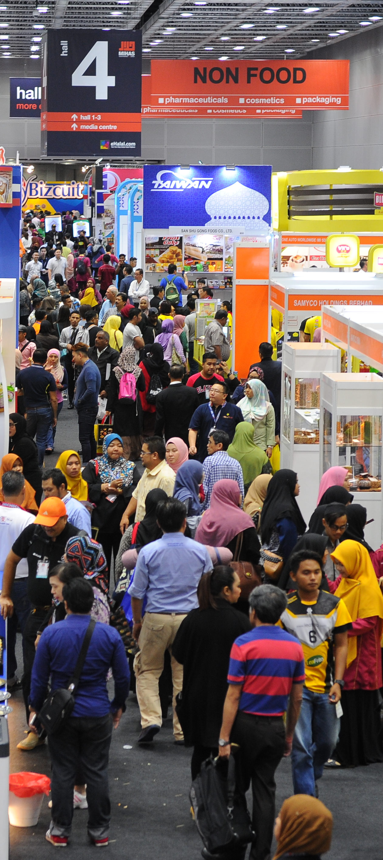
MIHAS’s Contribution to the Halal Industry
  Rebranding of MIHAS
  MIHAS positioned as the leading Halal trade fair
  To use MIHAS as a catalyst to drive the Halal industry
MIHAS’s Milestone
(2005 – 2019)
  MIHAS started in 2004 as a consumer fair initiated by private sector
  MATRADE took over & started to organise MIHAS in 2005
  MIHAS transformed into international trade fair in 2007
  2019
  2017
Cumulative Outcome
  2011
  2005
RM17.24 Bil
Sales
  RM229.9 Mil Sales
  RM588.3 Mil Sales
  RM1.01 Bil Sales
  RM1.6 Bil Sales
8,106
Exhibitors
  332 Exhibitors
  507
  Exhibitors
  576
  Exhibitors
  928
  Exhibitors
  75
  INSP Buyers
  401
  INSP Buyers
  165
  INSP Buyers
  200
  INSP Buyers
4,382
INSP Buyers
  12,431Trade Visitors
  16,089 Trade Visitors
  22,744 Trade Visitors
  29,946 Trade Visitors
396,485
Trade Visitors

Slide 8

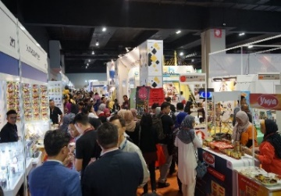
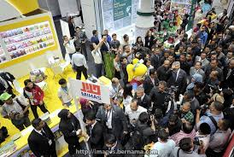
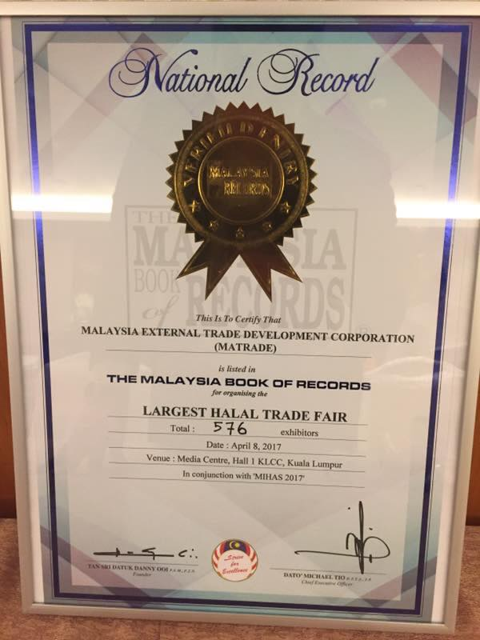
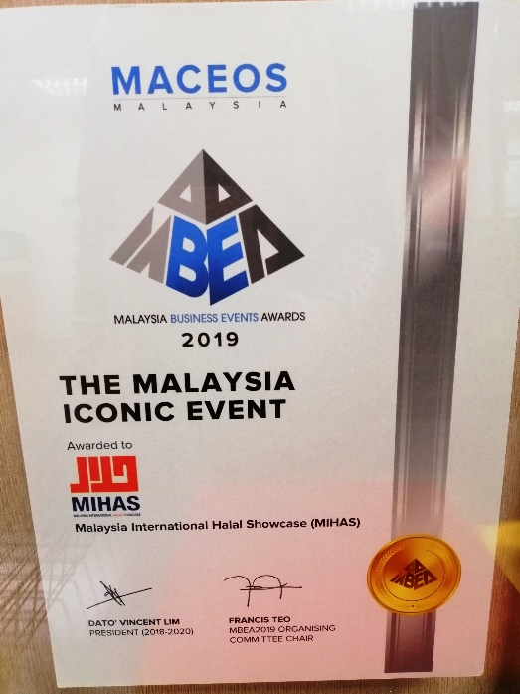
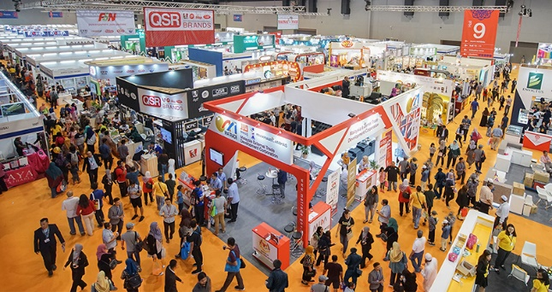
RECOGNITION RECEIVED BY MIHAS
2019 : “The Best Malaysia Iconic Event” @
Malaysia Business Events Award (MBEA)
by Malaysian Association of Convention
and Exhibition Organisers (MACEOS)
2017 : “Largest Halal Trade Fair
in Malaysia” by
Malaysia Book of Records

Slide 9



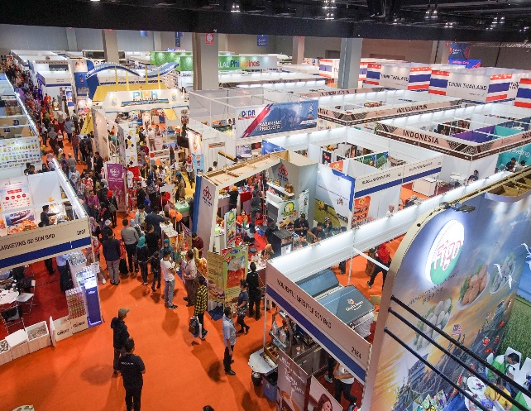
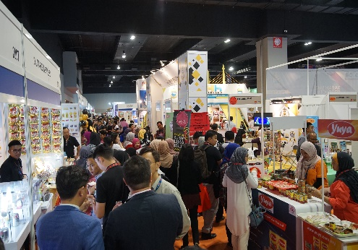





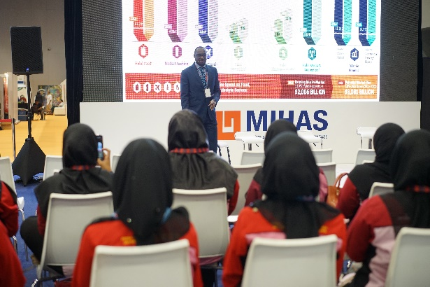

MIHAS 2020 in Brief
DATE
11 INDUSTRY CLUSTERS
Show Days : 1 - 4 April 2020
Trade Days : 1 - 3 April 2020
Public Day : 4 April 2020
VENUE
Malaysia International Trade & Exhibition Centre (MITEC)
F&B
e-Commerce
Franchise
Pharmaceuticals
Finance
Cosmetics
Tourism
Logistics
Food
Technology
Modest
fashion
Education

Slide 10
MIHAS 2020 Knowledge Sharing Session
Talks / Forums / Conferences
TRADE TALKS
HALAL IN TRAVEL
FOOD TECH FORUM
PANEL TALKS ON SUSTAINABILITY IN HALAL
MALAYSIA INSTITUTE OF FOOD TECHNOLOGY CONFERENCE
BREAKFAST / NETWORKING SESSION
HALAL MASTERCLASS
HALAL MARKET INSIGHTS
COUNTRY FOCUS HIGHLIGHTS
ASEAN GROCER TRENDS
HALAL INNOVATION 2.0
HALAL CAREER DAY
HALAL CLINIC SESSION
Demonstrations
FOOD DEMONSTRATION
PRODUCT DEMONSTRATION
RAMLY BURGER BATTLE
PRODUCT LAUNCHING
Fashion Shows
MODEST FASHION SHOW
Awards
MIHAS AWARDS
  * ASEAN GROCER TRENDS : TESCO, FAMILYMART,SEGIFRESH, ISETAN, COLDSTORAGE

Slide 11
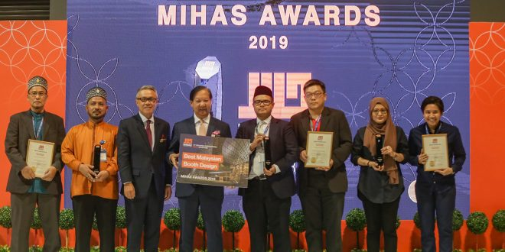

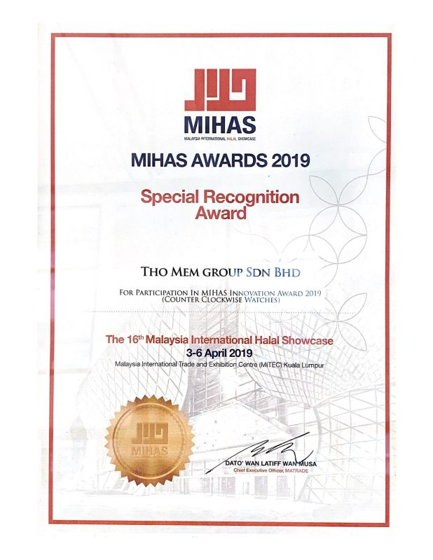
MIHAS Awards 2020
MIHAS Best Innovative Products & Services
F&B
Machinery & Technology
MIHAS Sustainability Excellence
Modest Fashion
Personal Care & Cosmetics
Services
Best Country Pavilion
MIHAS Best Booth/ Pavilion Design
Best Malaysian Booth Design
Best International Booth Design
2 winners for each category (Local and International)
*Total awards: 12 Awards
1 Winner for each category
*Total awards: 2 Awards

Slide 12
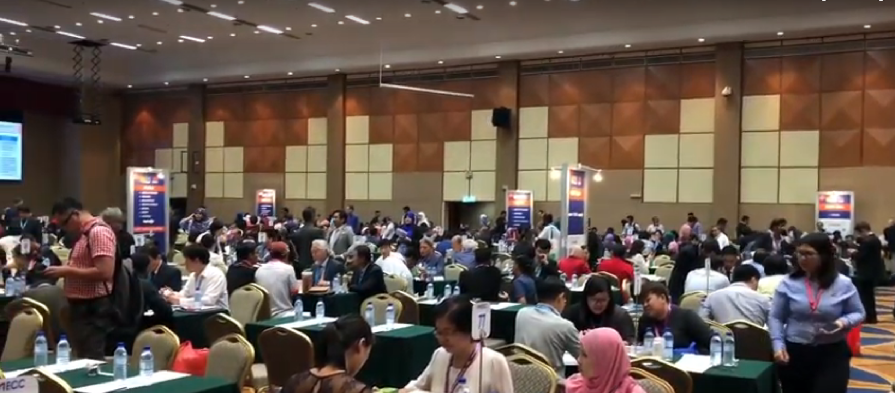
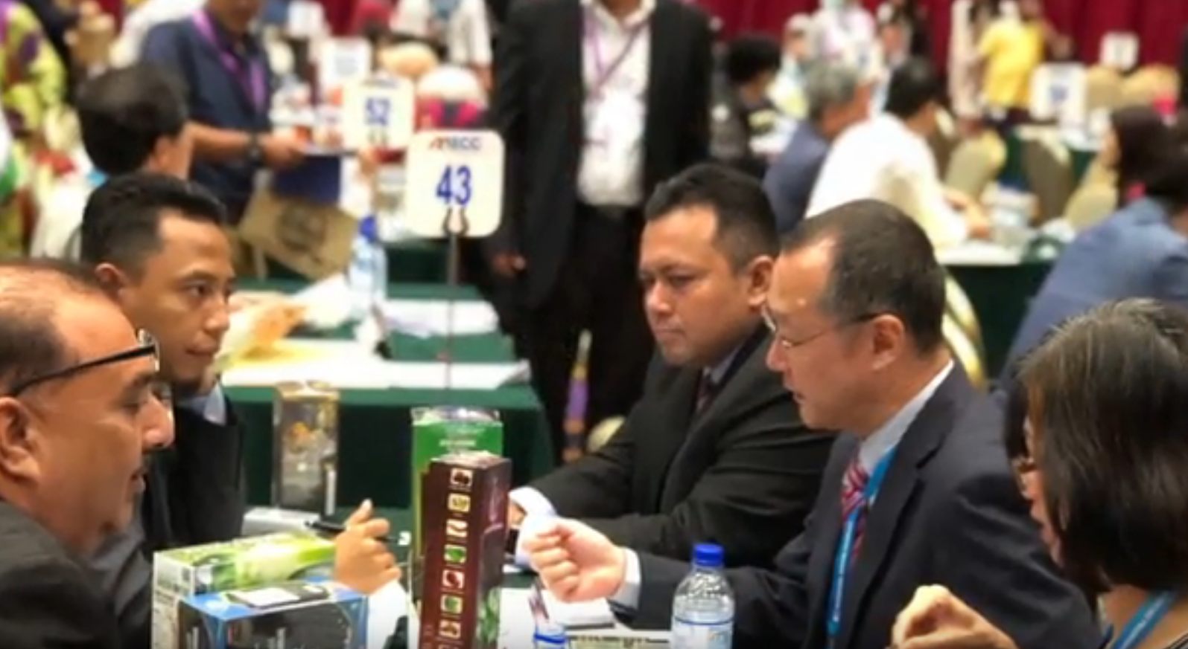
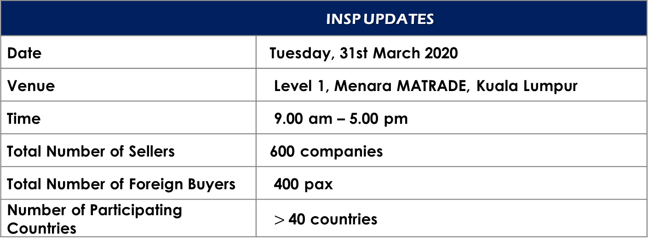
MIHAS 2020 – INTERNATIONAL SOURCING PROGRAMME (INSP)
INSP UPDATES
Date | Tuesday, 31st March 2020
Venue | Level 1, Menara MATRADE, Kuala Lumpur
Time | 9.00 am – 5.00 pm
Total Number of Sellers | 600 companies
Total Number of Foreign Buyers | 400 pax
Number of Participating Countries | $>$40 countries

Slide 13
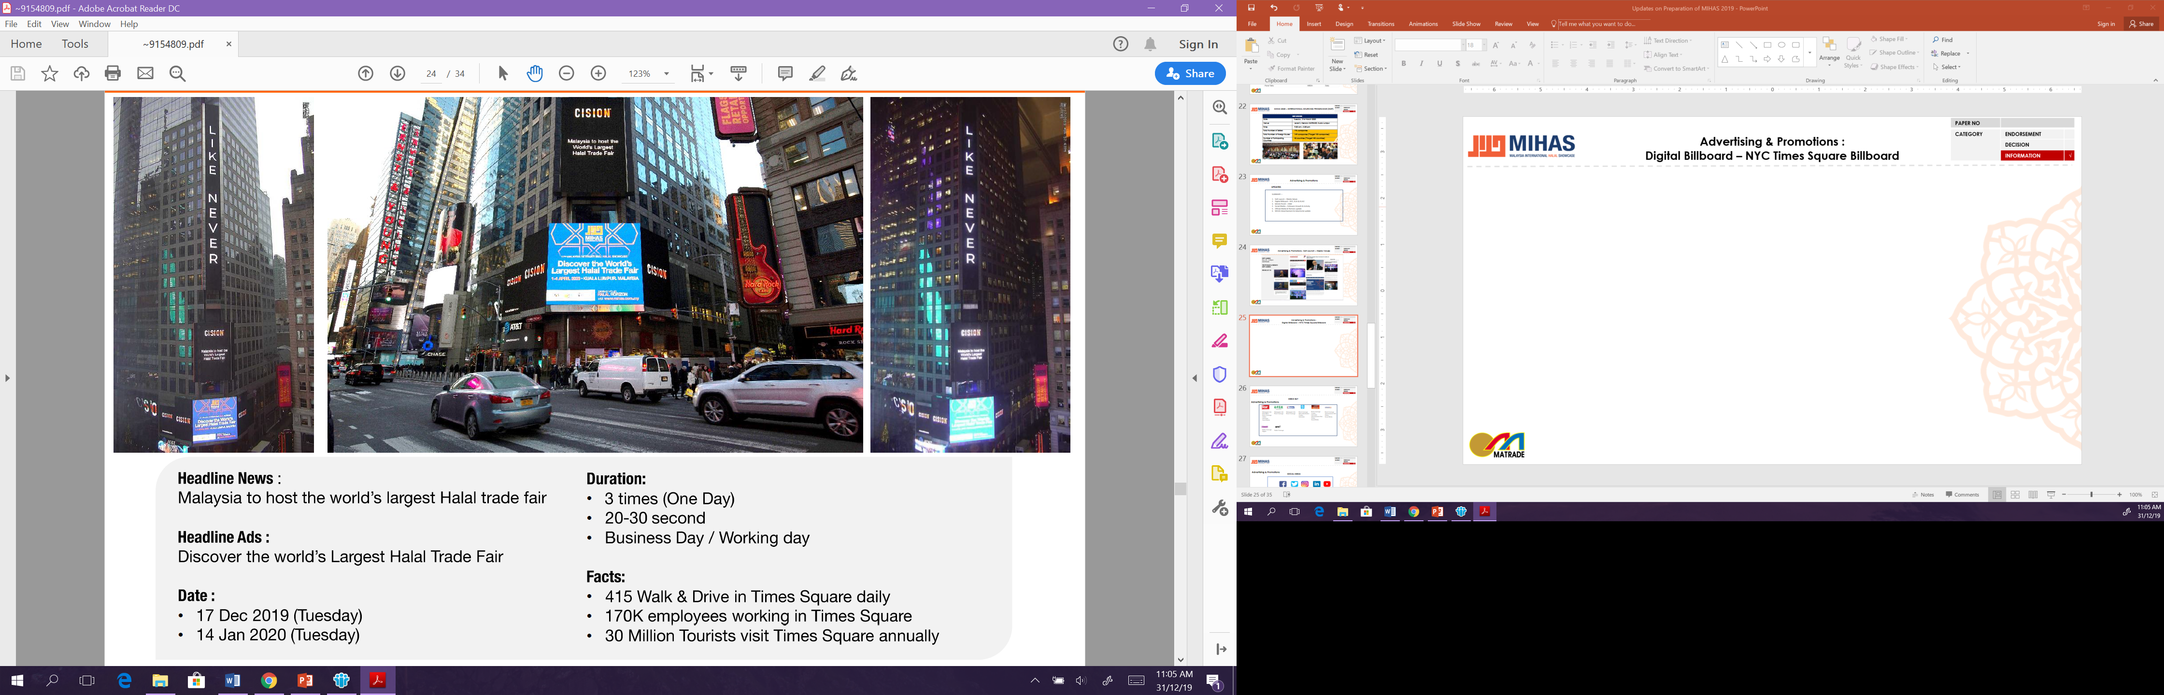
Debut at New York Times Square Billboard

Slide 14
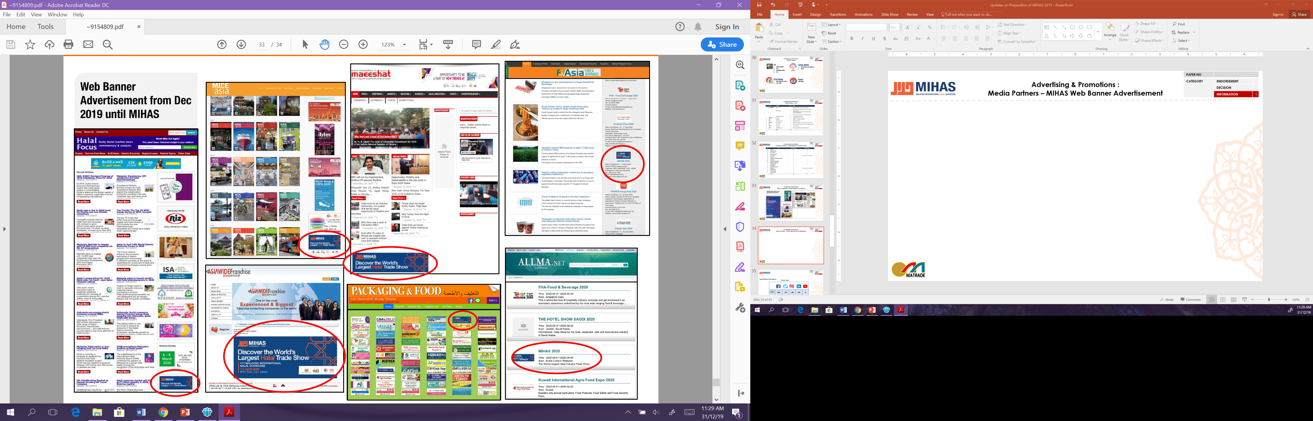
Cross promotion with global & local industry websites
- India -
- Singapore -
- Malaysia -
- UK -
- Singapore -
- UAE -
- Taiwan -

Slide 15
THANK YOU
MIHAS website : www.mihas.com.my
Think HALAL, Think MIHAS

