Slide 1
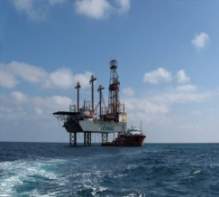
HATTAT HOLDING
YOUR SOLUTION SUPPLIER
A GLOBAL COMPETITOR
SINCE 1973
02.04.2015/ İSTANBUL
Notes:
Hema Endüstri Org şema +

Slide 3
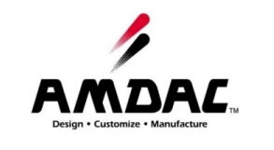
HATTAT HOLDING
CUSTOMERS
Notes:
3

Slide 4
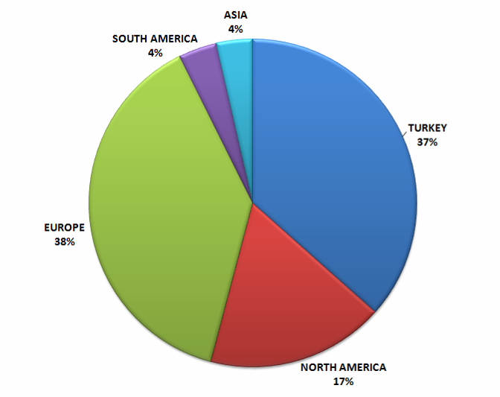
TURNOVER BY TERRITORY
2013

Slide 5
HATTAT HOLDING
WAREHOUSES & PURCHASING OFFICES
Felixstove, UK
Dortmund,GERMANY
Augusta, USA
Zhejiang (Hangzhou), China
Purch. Office
Mumbai, India
Purch. Office
Nuevo Laredo,,MEXICO
Almedia, Brasil
Notes:
5
Ömer bey den yen, harita

Slide 6
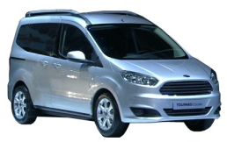
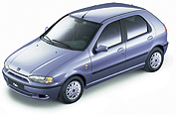
Joint Venture with TRW since 1996
TRANSIT TRANSIT CONNECT TOURNEO COURIER
MEGANE II
CLIO III BC 85
SYMBOL X 35
MEGANE III B32
FLUENCE L38
DOBLO
ALBEA
MINI CARGO
PALIO
LINEA
DUSTER
Notes:
6

Slide 7
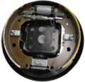
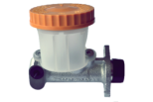
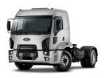
“A Breaking System Specialist” since 1996
TRANSIT CONNECT TOURNEO COURIER TRUCK
PEUGEOT J10
PALIO
DOBLO
MEGASTAR
CLIO 4
LUBLIN Z160m

Slide 8
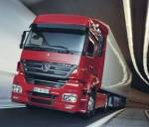
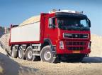
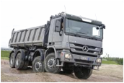
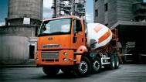
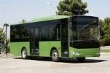
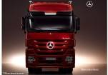
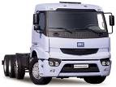
VEHICLES STEERED BY HEMA
Bus & Coach
Truck
LT & Mini Bus

Slide 9
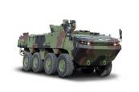
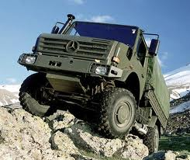
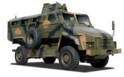
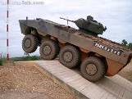
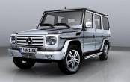
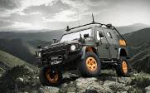
VEHICLES STEERED BY HEMA
Military and Special Purpose Trucks

Slide 10
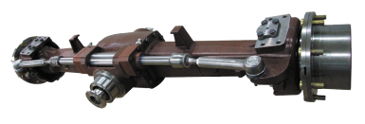
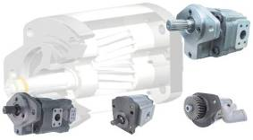
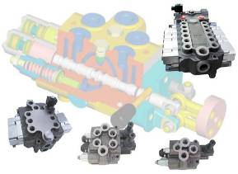
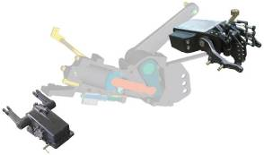
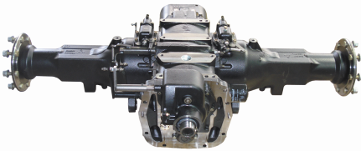
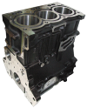
INDUSTRIAL PRODUCTS
4WD AXLES
PUMPS
LIFT COVERS
VALVES
TRANSAXLES
ENGINE COMPONENTS

Slide 11
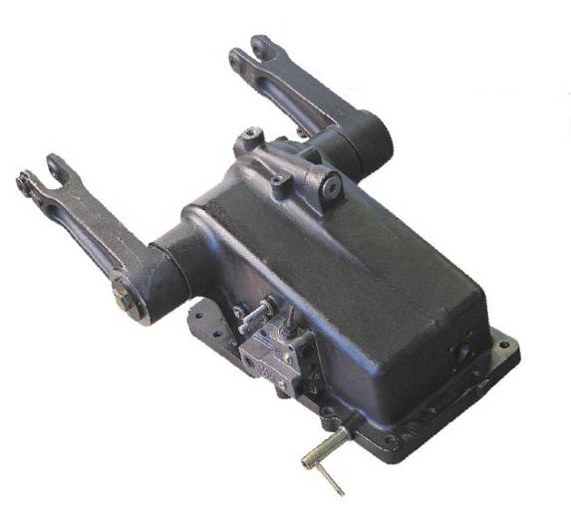
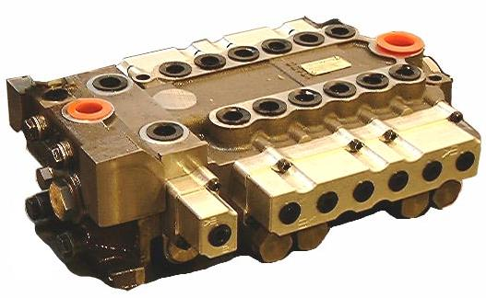
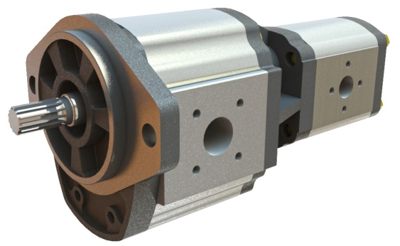
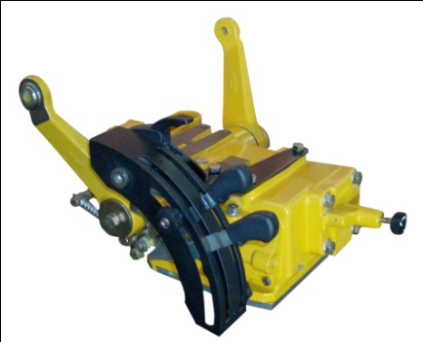
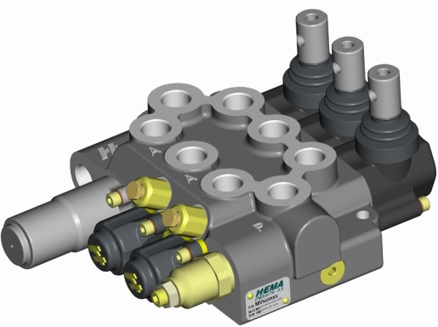
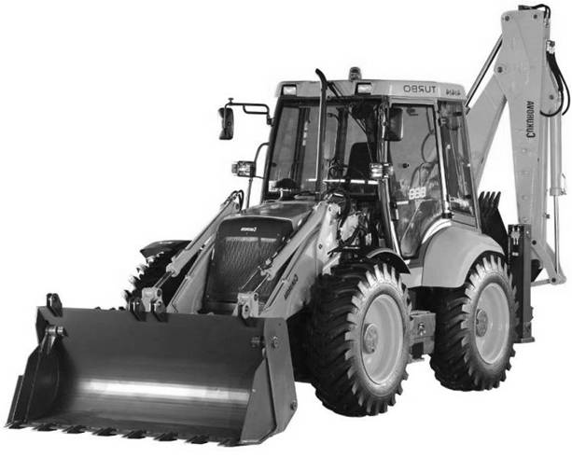
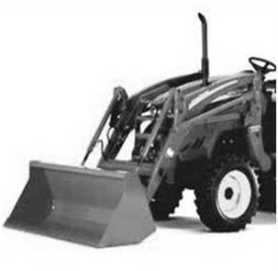
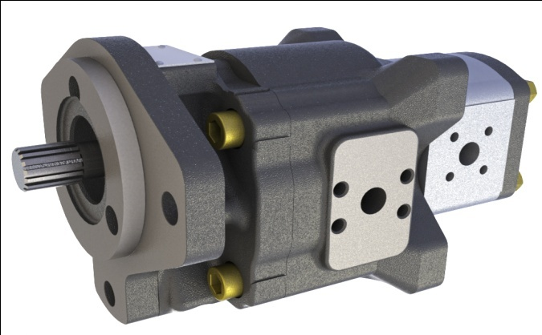
HYDRAULIC SYSTEMS & COMPONENTS

Slide 12
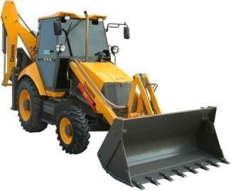
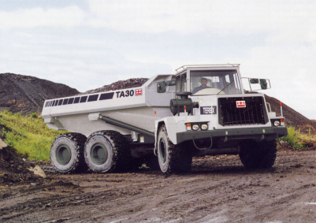
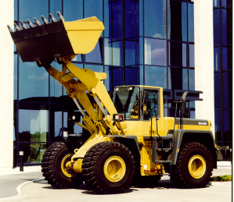
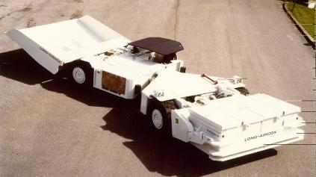
PUMP & VALVE APPLICATIONS

Slide 13
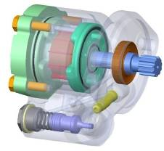
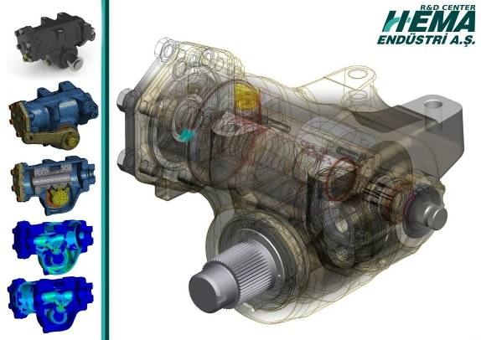
R&D
SPECIAL DESIGNS FOR CUSTOMER REQUIREMENTS
DESIGN STEPS COMPLYING WITH ISO/TS 16949 QUALITY SYSTEM REQUIREMENTS.
APPLICATION OF PROTOTYPES IN PLACE
PERFORMANCE AND DURABILITY TESTS IN HEMA
R&D Employees
PHD : 2
ENGINEER MSC. : 4
TECHNICIAN : 13
ENGINEER : 53
DRAFTMAN : 18
TOTAL : 90
Notes:
13

Slide 14
FEATURES
NEW DEVELOPMENTS
24 V Power Supply
2 CAN Interface
Different Variable ratio options:
17:1 to 20:1, 19:1 to 23:1, 22:1 to 26:1
Hydraulic output torque up to 6500 Nm

Slide 15
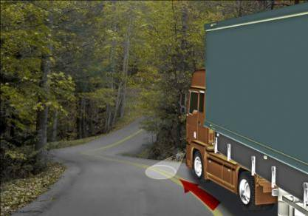
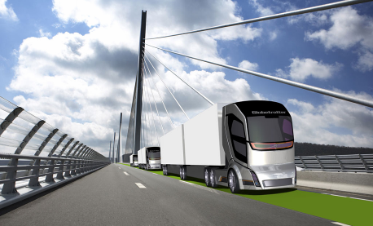
FUNCTIONS
NEW DEVELOPMENTS
Ready For Vehicle Safety or Automation System Support via CAN interface
Active Lane Keep Assist
Tracking Mode
Notes:
1. A constant side force, for example, a side wind is acting on the vehicle.
2. The driver turns the steering wheel to hold the vehicle on a straight-ahead track.
3. By evaluating the steering moment, vehicle speed, engine speed, steering angle, steering speed and characteristic curves stored in the control unit, the control unit calculates the torque required from the electric motor to correct the straight-ahead running.
4. The motor is activated. The vehicle is set to straight-ahead driving. The driver no longer has to “counter-steer”.

Slide 16
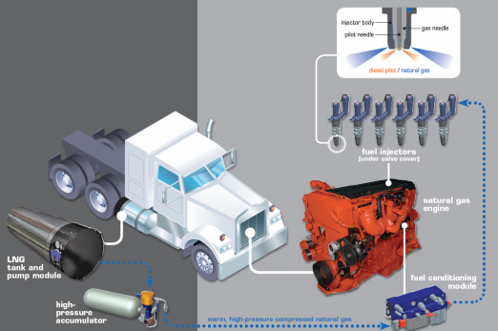
NEW PRODUCTS - LNG PUMP
Design cooperation for systems & components
Duel fuel engine applications for heavy duty cehicles
Vehicle tests and pre series deliveries for Global OEM’s like Freightliner, International, Kenworth, Mack, Peterbilt, Volvo.

Slide 17
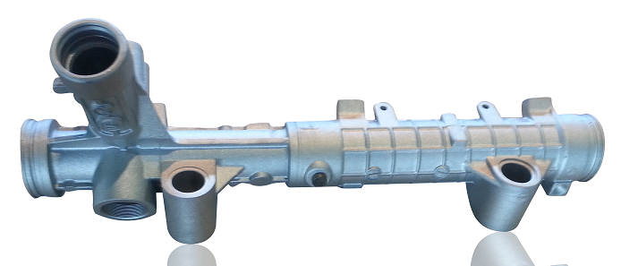
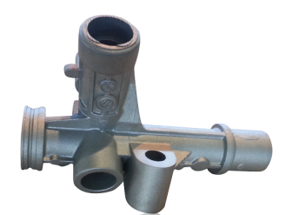
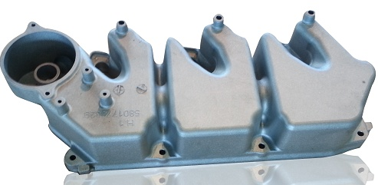
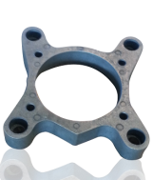
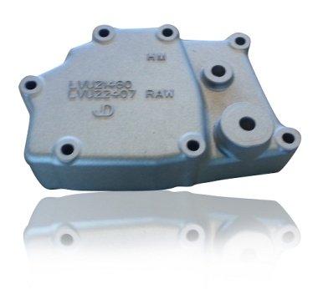
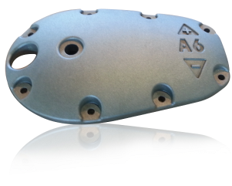
ALUMINUM INJECTION PRODUCTS

Slide 18
QUALITY CERTIFICATES
ISO 14001
ISO 16949
ALL NECESSARY CERTIFICATION
ISO-TS 16949
ISO 14001
ISO 9001
OHSAS 18001
AQAP 2110
DAIMLER-MERCEDES CATEGORY “1”
FORD Q1
CATERPILLAR SQEP SILVER MEDAL
AS9100 AVIATION QUALITY MANAGEMENT SYSTEM
ISO 9001
OHSAS 18001
Notes:
18

Slide 19
2012 KalDer EFQM NATIONAL QUALITY AWARD
RECOGNIZED FOR EXCELLENCE 5 STAR

Slide 20
AWARDS - 2015
TAYSAD
FORD OTOSAN
OSD

Slide 21
AWARDS - 2015
"Success is not a lucky coincidence. It is the result of a deliberate and consistently implemented strategy.“
Anonymous

Slide 22
THANK YOU !
İskender ULUSAY
Dept.General Manager
iskenderulusay@hattat.com.tr

