Slide 1
TTIP in the Era of New Generation Trade Agreements: What Impact for RoW and Turkey? Dr. M. Sait Akman TEPAV MUTS 13 February 2016 Istanbul Chamber of Industry, Istanbul
tepav
Türkiye Ekonomi Politikaları Araştırma Vakfı

Slide 2
TTIP?
What is it?
What it is not?
TTIP is a trade agreement, but not a typical FTA: it is a ‘new generation’ trade deal
A new generation deal, but not an ordinary one: it is a mega deal (two largest economies)
A ‘mega deal’, but also a ‘game changer’!

Slide 3

TTIP: What’s it for?
Moving beyond the financial crisis
Setting global norms & standards
Addressing global challenges
via
Market access
Regulatory coherence
Rules

Slide 4
What is likely? TTIP Stakeholder Survey: (Atlantic Council and Bertelsmann Foundation, 2013)

Slide 5
Regulatory issues as non-tariff barriers

Slide 6
What TTIP means to protagonists
It is nearly impossible to overestimate the importance of the TTIP to the US and the EU.
A mega deal will generate considerable economic benefits:
CEPR (2013) argued that the ‘GDP effect’ of an ambitious deal to the US and the EU could be as high as 95 and 199 billion euros per year, and TTIP would generate 240 and 220 billion euros in exports, respectively.
But the real value of the TTIP should not be confined to economic / commercial gains only.
It is a strategic landmark to change the rules of the game.
i.e. new global rules and practices to guide the world trading system!

Slide 7
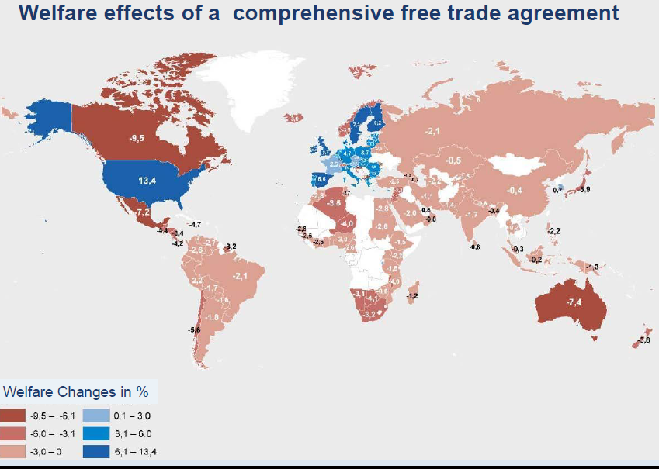
Global impact - IFO study (2013) results!

Slide 8
TTIP: What it means to Turkey
Turkey is in ‘inner circle’:
CU with the EU and in the accession process, but has no FTA with the US
TTIP impact on Turkey:
Trade diversion due to ‘preference erosion’ (shallow TTIP to cause $130 million)
Unemployment would increase 0.42%
Real wages drop by 1.94 % (Felbermayr et al. 2013)
More trade deficit with the US due to asymmetry in CU.

Slide 9
TTIP: Initial reaction in Turkey
The EU can “give away” access to Turkey’s large and growing market to the US without asking for a quid pro quo for Turkey, but only for itself.
The US, on the other hand, can gain access to the Turkish market without reciprocating.
“For the same reason, once a TTIP deal is struck, there is no incentive for the US to enter into an FTA with TUR unless Turkey’s concessions are TTIP+” (U. Dadush).

Slide 10
What motivates reaction in the RoW to TTIP?
The higher the risks and consequences of the perceived discriminatory impact.
The more restrictive/stringent is the impact of regulatory measures on extra-TTIP trade (between the EU-Rest or US-Rest).
The existing level of economic integration between the EU / US - third country.
The less remote is the possibility of finding acceptable solutions to challenges for the RoW.

Slide 11
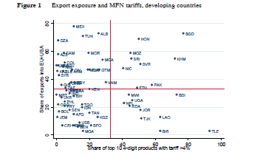
Do all outsiders face same challenges?
Source: Achiele and Felbermayr, 2015

Slide 12
12
TRADE DIVERSION: NEGATIVE
Inherently discriminatory nature of TTIP
Loss of market share
of third countries firms
in EU and US markets
Very likely, not only with tariffs, but also in regulatory cooperation
How strong?
Depends on:
relative specialization structure
height of tariffs and non-tariff barriers before TTIP between EU und USA
Notes:
Es ist nicht leicht, den Effekt von TTIP auf Entwicklungsländer abzuschätzen, denn es gibt zwei gegenläufige Effekte. Einerseits führen höhere Einkommen in EU und USA zu stärkerer Nachfrage nach Konsumgütern, Vorprodukten, Rohstoffen, und Dienstleistungen aus Entwicklungsländern. Andererseits kann das Abkommen die relative preisliche Wettbewerbsfähigkeit der Entwicklungsländer in EU und USA beeinträchtigen. Das ist bei jenen Gütern der Fall, bei denen heute zwischen EU und USA hohe Zölle existieren, die durch TTIP abgeschafft werden. Europäische Hersteller von Lederschuhen zum Beispiel können mit einem Schlag in den USA um 30% günstiger anbieten. Hohe Zölle existieren auch im Bekleidungssektor, oder bei bestimmten Früchten oder verarbeiteten Lebensmittel. Daraus resultiert begründet eine gewisse Gefahr von Marktanteilsverlusten.

Slide 13
13
INCOME EFFECT: POSITIVE
Higher incomes in EU and USA
Higher demand for consumption goods, intermediary inputs, raw materials, services, … also from third countries
Empirical evidence:
Productivity growth in one region may help other regions!
Globalization is not a zero-sum game!
Notes:
Einkommenseffekte sind keine Annahme!
Keine Viner Ambiguity! Jacob Vine, 1950, The Customs Union Issue: bei hohen Zöllen, starken Umlenkungseffekten und schwachen Handelsschaffungseffekten
Reduktion von realen Handelskosten ist wie Produktivitätsverbesserung
ALLE Studien – mittlerweile sicher ein Dutzend – finden in der langen Frist positive Effekte
Produktivitätswachstum in einer Region schadet nicht der anderen! Wachstum in marktwirtschaftlichen Ökonomien erfolgt nicht auf Lasten anderer! Die globalisierte Wirtschaft ist kein Nullsummenspiel!

Slide 14
The current situation in regulatory convergence
Texts proposed in areas:
Regulatory cooperation (EU proposal)
http://trade.ec.europa.eu/doclib/docs/2015/april/tradoc_153403.pdf
(BUSINESSEUROPE):
“A key deliverable from the Transatlantic Trade and Investment Partnership (TTIP) will be a chapter on horizontal regulatory provisions…
To realize the economic potential of TTIP, meaningful EU-U.S. regulatory cooperation is a priority.”

Slide 15
Harmonisation and the RoW: empirical evidence
Regulatory divergence:
An ambitious harmonisation program to set higher standards, tends to have negative impact on third countries.
(i.e. EU’s New Approach) (Chen and Mattoo, 2008; Baller, 2007)
Direct spillovers: (automatic)
Trade possibility for RoW without further action via MFN
Indirect spillovers: (policy-induced)
If third countries can adopt TTIP standards, it will be a scope for reduction in multiplicity costs (Lejour, Pelkmans et.al.,2014)
But: no supportive evidence and adaptation costs are high for RoW.

Slide 16
Mutual recognition/equivalence and the Rest: empirical evidence
Benefits for exporters under Mutual Recognition (MR) agreements with conformity assessment are stronger than harmonisation for developing countries…
(Chen and Mattoo, 2008; Baller, 2007; Mascus, 2009)
But, the positive impact depends on:
If TTIP is willing to recognise the standards (or at least equivalence) / recognise conformity assessment of the RoW.

Slide 17
17
WELFARE EFFECTS OF TTIP
 |  | Ifo |  | CEPR |  | Aichele et al.
Spillovers: |  | NO | YES | NO | YES | NO | YES
EU average |  | 3.9 | 7.8 | 2.3 | 3.0 | 2.1 | 2.7
US |  | 4.9 | 7.1 | 1.0 | 1.1 | 2.7 | 3.4
Germany |  | 3.5 | 7.1 | 1.4 | 2.3 | 2.6 | 3.1
Turkey |  | -1.6 | 0.1 | -0.8 | 1.8 | 0.1 | 1.2
Non-TTIP average |  | -0.9 | 0.8 |  |  | -0.1 | 1.2
World average |  | 1.6 | 3.9 |  |  | 1.3 | 2.2

Slide 18
Economic integration level
If the third country has more incentives to adopt TTIP standards:
domestic value added in final demand in EU/US is high
Trade openness is high
(Lejour, Pelkmans et.al.,2014)
More likely for closer neighbours: Canada, Mexico, EFTA, Turkey… which have carried out significant harmonisation
Turkey adopting EU acquis under CU and accession process.

Slide 19
TTIP and the Rest: existing integration level
Integration level (2004-2012)
(König & Ohr, 2013)
Index for Single Market integration
US was least integrated
Norway is highly integrated
Switzerland is the highest
Turkey relatively better than the US (but decreased slightly)
TTIP can raise US integration index (what impact for Turkey and others?)

Slide 20
More permissive TTIP for RoW
Alleviating detrimental effects:
Accession for third countries,
Docking only appeals to ‘inner circle’ having RTAs with TTIP parties.
More transparency and openness,
less retrictive rules and standards,
more permissive RoO

Slide 21
Minimising the damage for RoW
Accession clause:
TTIP reflects only EU-US trade & investment and mutual trade agenda. Inclusion of third nations makes no sense for either side.
TTIP is not an IO with a proper accession procedure.
Docking only appeals to ‘inner circle’ having RTAs with TTIP parties.
Rules of Origin (RoO):
Less restrictive RoO with lower thersholds (i.e. “cumulation of origin”). This is essential also for Transatlantic firms to protect their production networks/supply chains
Regulatory convergence and standards:
Regulatory cooperation should extend to third countries…
Harmonisation is a contested issue with cost-raising impact on the Rest.
Mutual recognition is offered to be an easier method.

Slide 22
TTIP and Turkey
TTIP with:
liberal rules of origin and,
a system of mutual recognition of quality standards,
Turkey through the CUSTOMS UNION with the EU could obtain significantly improved access to the US market, compensating for the losses from the preference erosion.
TTIP with:
‘a regulatory harmonization, without recognising Turkish quality certificates’ Turkey’s losses would be far greater…
(M. Raiser, World Bank)
If Turkey cannot adapt to TTIP regulations/standards…

Slide 23
Domestic reforms
TTIP may induce domestic reforms:
Regulatory issue is the area where most of the gains accrue to Turkey
Turkey should adapt to TTIP regulations as a stimulus to innovation, industrial upgrading, and economic transformation…
Reallocation of resources from inefficient to efficient firms (productivity gains)…

Slide 24
Benefit to industry via tariff and NTB elimination
Direct impact through tariff elimination
Impact through non-tariff barrier reduction
Textile & Apparel
Highest tariff rate: 9.4% in US imports
elimination of high tariffs and tariff escalation will be key points
Textile & Apparel survey respondents’ average expected export increase to US due to FTA
Automotive: Different product standards between EU and US; with highest NTB impact
Steel: Anti-dumping and CVD actions are the major concerns
Machinery: NTB is the main issue in electrical and electronic equipment, in customs procedures and product standards
Aerospace: As a strategic industry, protected by various regulations (ITAR, DFAR, FAR etc.)
Electronics: NTBs are common
source: Turkish Exporters Assembly

Slide 25
Turkish exports in US market
US total Sectors import ($ bn) | Turkey’s share in US imports-2012
701 Chemicals 356 Electronics 315 Automotive 185 Machinery | 0.1% 0.0% Turkey has very limited shares 0.3% in leading US import indutries 0.2%
98 Aero&Defense 98 Apparel 57 Steel 19 Textile | 0.6% 0.6% Turkey has sizeable shares in 1.8% medium-sized US import ind. 1.7%
2 Carpet 2 Tobacco 0.3 Hazelnut | 9.2% 9.8% Turkey is in leading position 83.4% in some small-sized US imp.ind.

Slide 26
Conclusive remarks
In the case of Turkey:
antithetic initiatives (i.e. rival RTAs, refuting the CU) may not work.
Domestic reforms to provide regulatory convergence are important for their competitiveness and a welfare increase.
Business community can become the most important actor to support domestic reforms at home.
Upgrading the Customs Union is essential.

Slide 27
Thank you,
sait.akman@tepav.org.tr

