Slide 1
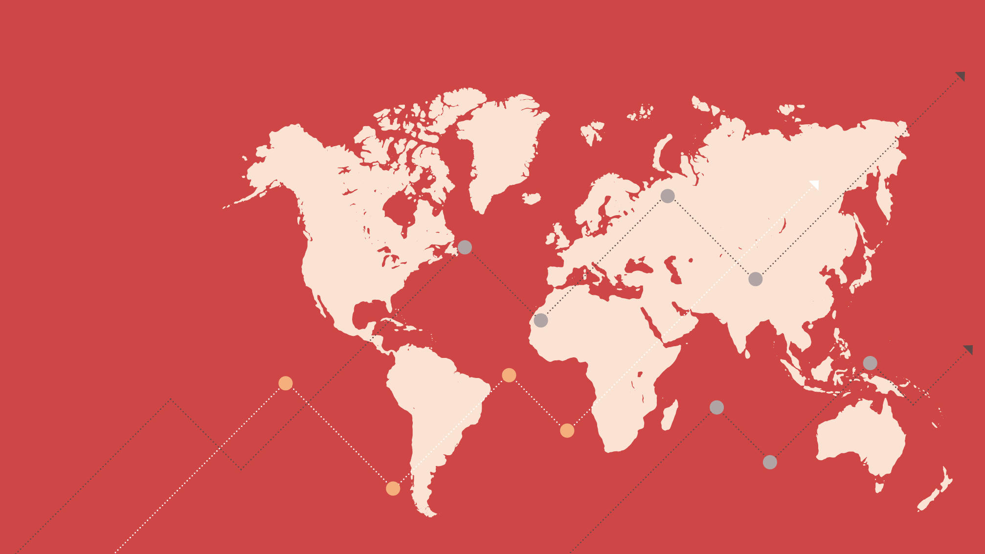
Developments in the World Manufacturing PMI®
August 2023

Slide 2
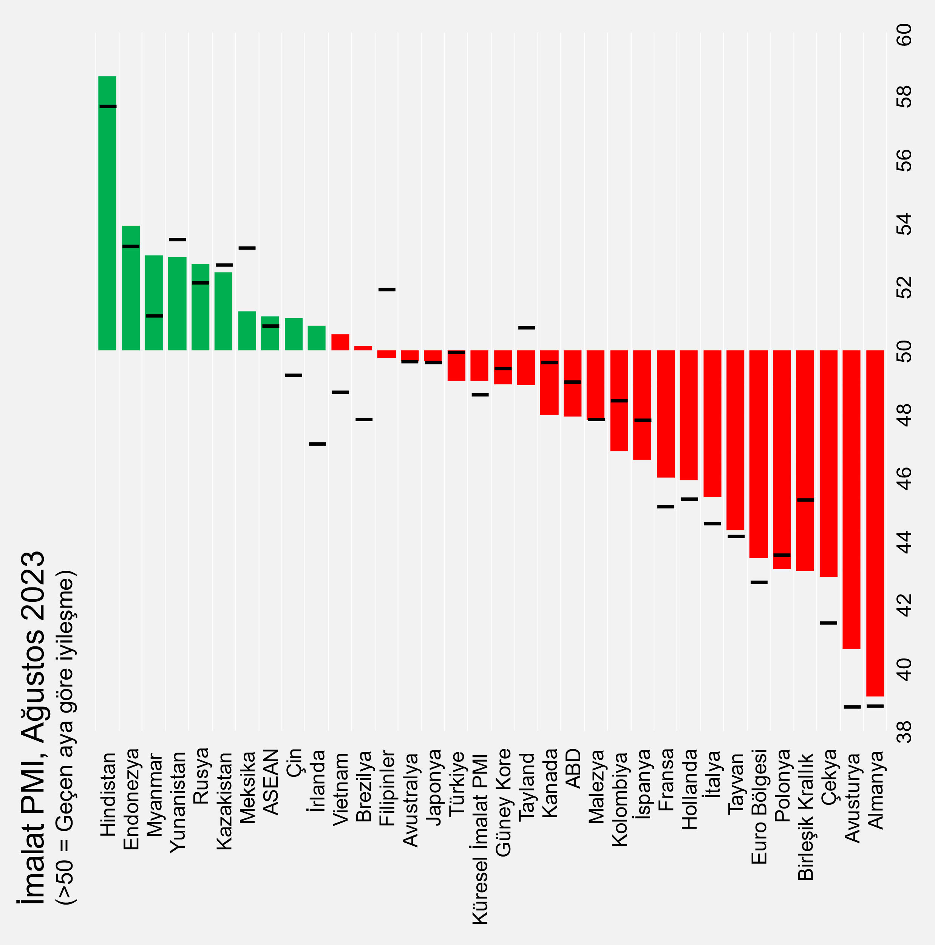
General Outlook
Rates of contraction in global manufacturing sector eased,
prices edged higher.
The global manufacturing purchasing managers' index (PMI) posted 49.0 in August. The index rose slightly from 48.6 in July, signalling that the downturn in business conditions slowed.
Output in global manufacturing sector fell for the third straight month, Underlying the latest scaling back of global manufacturing production was a decrease in new orders. On the other hand, contraction in production slowed thanks to the relative improvement in consumer goods manufacturing, and employment edged higher.
And prices increased during August, after they had signalled decreases in each of the prior three months. Renewed cost inflationary pressure was mainly building in emerging markets in contrast to a further decrease among developed nations.
Of the 31 nations for which Global PMI data are available, 20 reported deteriorating business conditions compared to the previous month. That number was 22 in July.
Istanbul Chamber of Industry Türkiye Manufacturing PMI posted 49.0 in August, 0.9 points down from July, and below the 50.0 no-change mark for the second consecutive month. Increased inflationary pressures negatively affted the output and new order volumes of the sector. As the main positive note for August, job creation continued rise.
Global Manufacturing PMI
August
49.0
July: 48.6
Source: S&P Global.
Note: The index values of the previous month are illustrated with vertical black lines to indicate the rises or drops of the index compared to the previous month.
2

Slide 3
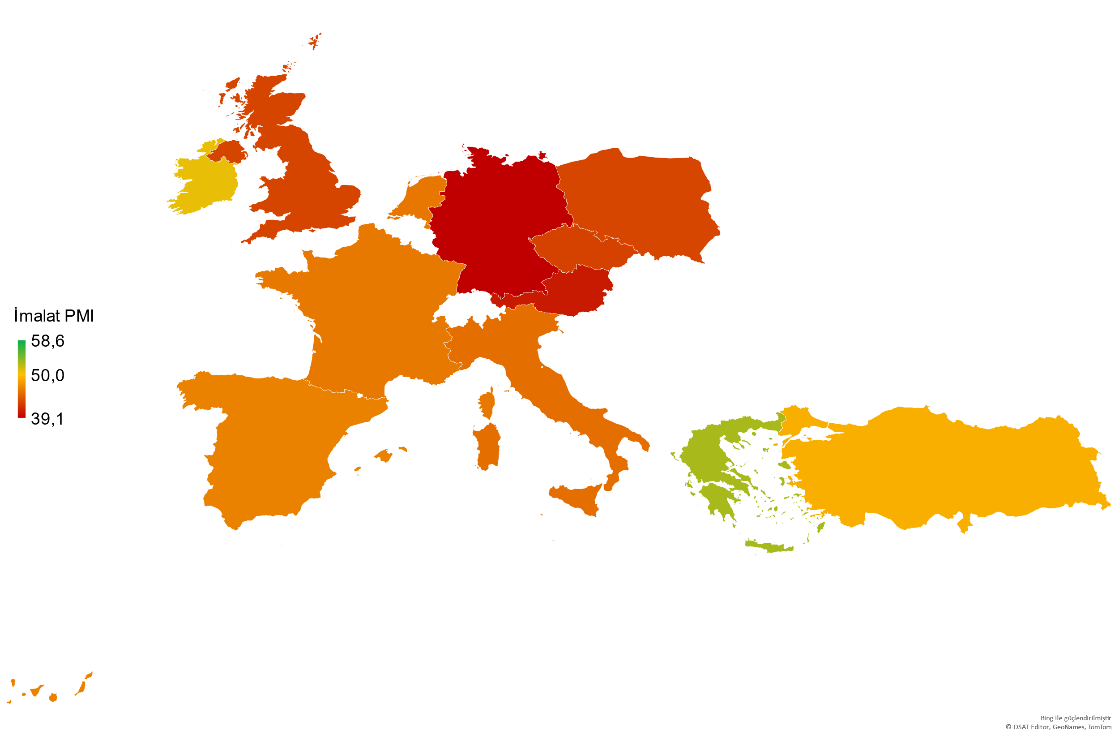
Europe
Contraction in manufacturing sector continued in most part of the Europe amid weak demand.
The Eurozone Manufacturing PMI posted 43.5 in August from 42,7 in July, signalling again a significant contraction. Pressure on output increased with the low demand and decrease in backlogs and firms continued to finish their raw material and finished product stocks. Decreasing trend in prices also continued due to these developments.
Manufacturing sector performances varied in Eurozone. Business conditions in Greece and Ireland improved in August, while 4 major countries, namely Germany, France, Italy and Spain remained in the contraction zone. Germany and Austria continued to be the fastest contracting countries.
The UK Manufacturing PMI posted 43.0, the lowest value of last 39 months. This was one of the fastest decrease in output and new orders, except for the one during the 2008 crisis and the pandemic, and the sharpest decrease since January 2016.
The manufacturing sectors in Poland and Czechia continued to remain in contraction zone with low domestic and foreign demand.
Manufacturing PMI | July 2023 | August 2023
Greece | 53.5 | 52.9
Ireland | 47.0 | 50.8
Türkiye | 49.9 | 49.0
Spain | 47.8 | 46.5
France | 45.1 | 46.0
The Netherlands | 45.3 | 45.9
Italy | 44.5 | 45.4
Poland | 43.5 | 43.1
United Kingdom | 45.3 | 43.0
Czech Republic | 41.4 | 42.9
Austria | 38.8 | 40.6
Germany | 38.8 | 39.1
Eurozone (*)
Manufacturing PMI
August
43.5
July: 42.7
Source: S&P Global.
(*) In PMI methodology, “Suppliers’ Delivery Times” index above 50.0 points to shorter delivery times. The said index is included inversely in the headline PMI calculation. Therefore, an increase in this index decreases the headline PMI.
(**) The countries included in the Euro Zone index: Germany, Austria, France, Italy, Ireland, Spain, the Netherlands and Greece.
3

Slide 4
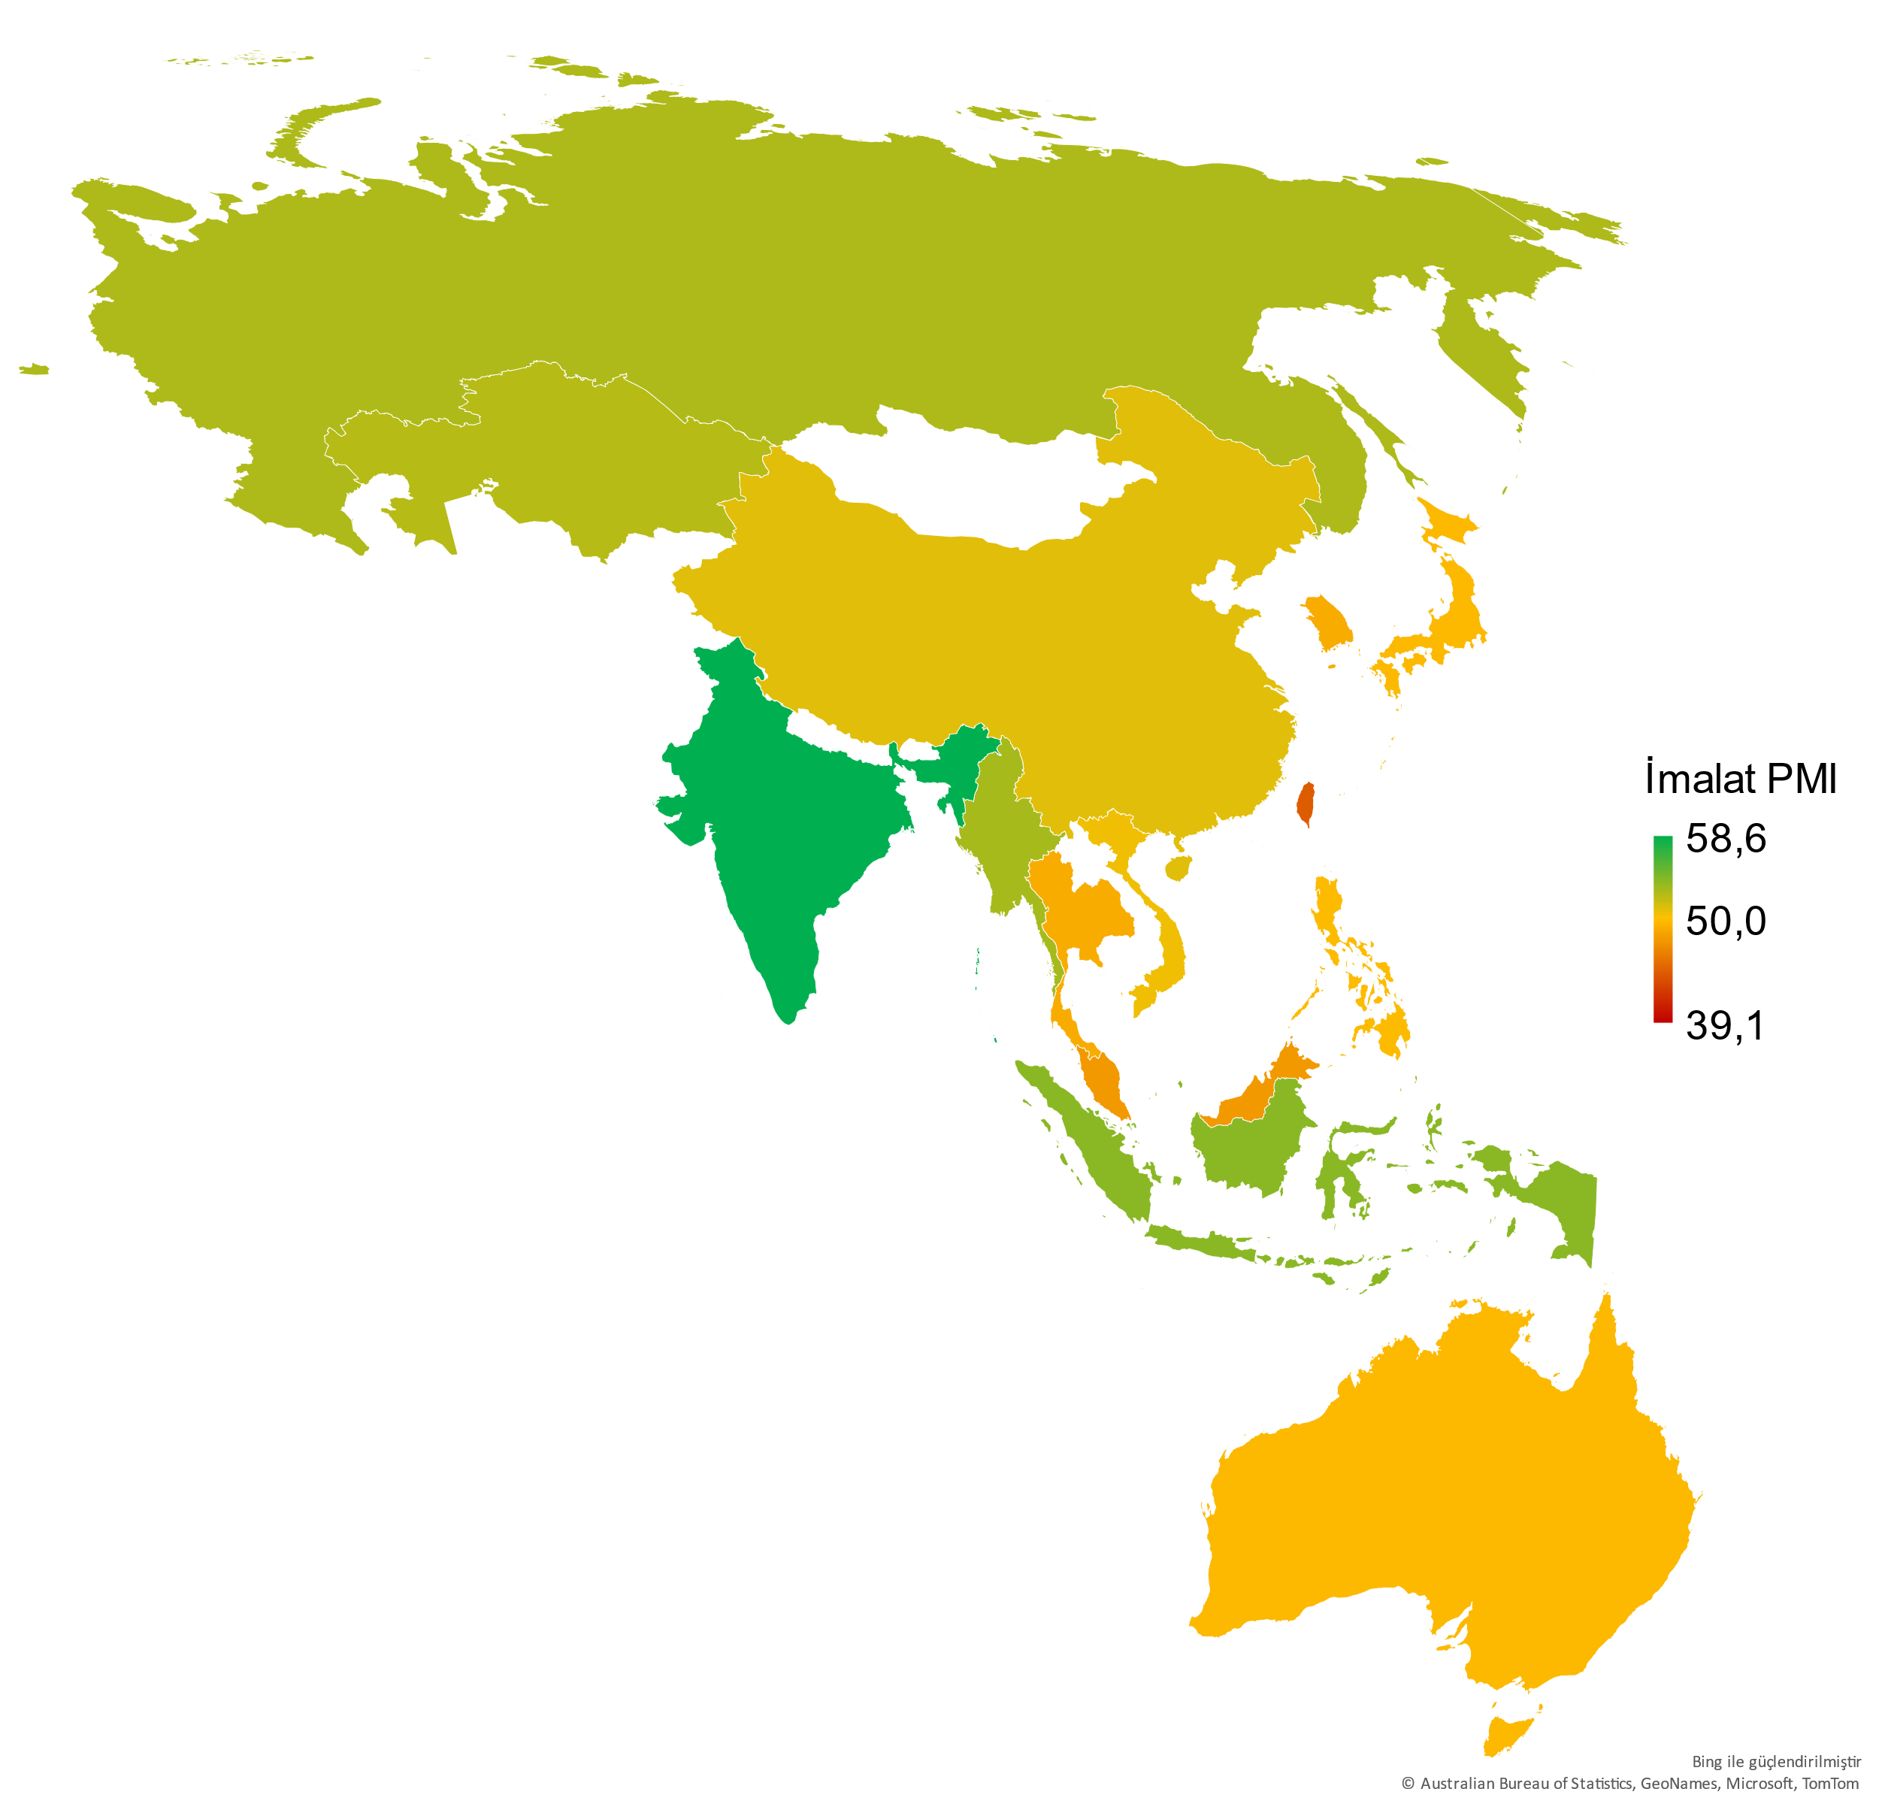
Asia-Pacific
China’s manufacturing performance exceeded expectations in August; India continued to grow.
PMI data for Asia-Pacific region was better than the other regions even though they felt the weak global trade pressures, too.
Output and new orders increased in China with a relative improvement in domestic market conditions despite weak foreign demand.
Japan’s manufacturing sector recorded a mild deterioration amid price increases as well as stable domestic and foreign demand.
In South Korea, output and new orders continued to drop and the sector remained in the contraction zone in August, too.
The world’s high Manufacturing PMI was recorded in India. The growth accelerated despite the increased cost inflation in the country.
Strong new orders in Russia supported output volume. But the input prices inflation marked a 17-month high figure.
In Taiwan, contraction trend in manufacturing sector output continued with the weak global demand.
And in Australia, the manufacturing sector maintained its almost stagnant outlook. New orders dropped slightly, and output showed a horizontal trend.
ASEAN Manufacturing PMI increased slightly in August, but with significant differences in the region. Vietnam recorded a mild recovery while the Philippines and Thailand dropped below the 50.0 no-change mark. The fastest growing countries in the region were Indonesia and Myanmar.
Manufacturing PMI | July 2023 | August 2023
India | 57.7 | 58.6
Indonesia | 53.3 | 53.9
Myanmar | 51.1 | 53.0
Russia | 52.1 | 52.7
Kazakhstan | 52.7 | 52.4
China | 49.2 | 51.0
Vietnam | 48.7 | 50.5
Philippines | 51.9 | 49.7
Australia | 49.6 | 49.6
Japan | 49.6 | 49.6
South Korea | 49.4 | 48.9
Thailand | 50.7 | 48.9
Malaysia | 47.8 | 47.8
Taiwan | 44.1 | 44.3
ASEAN (*)
Manufacturing PMI
August:
51.0
July: 50.8
Source: S&P Global.
(*) The countries included in the ASEAN PMI index: Indonesia, Philippines, Malaysia, Myanmar, Singapore, Thailand, Vietnam.
4

Slide 5
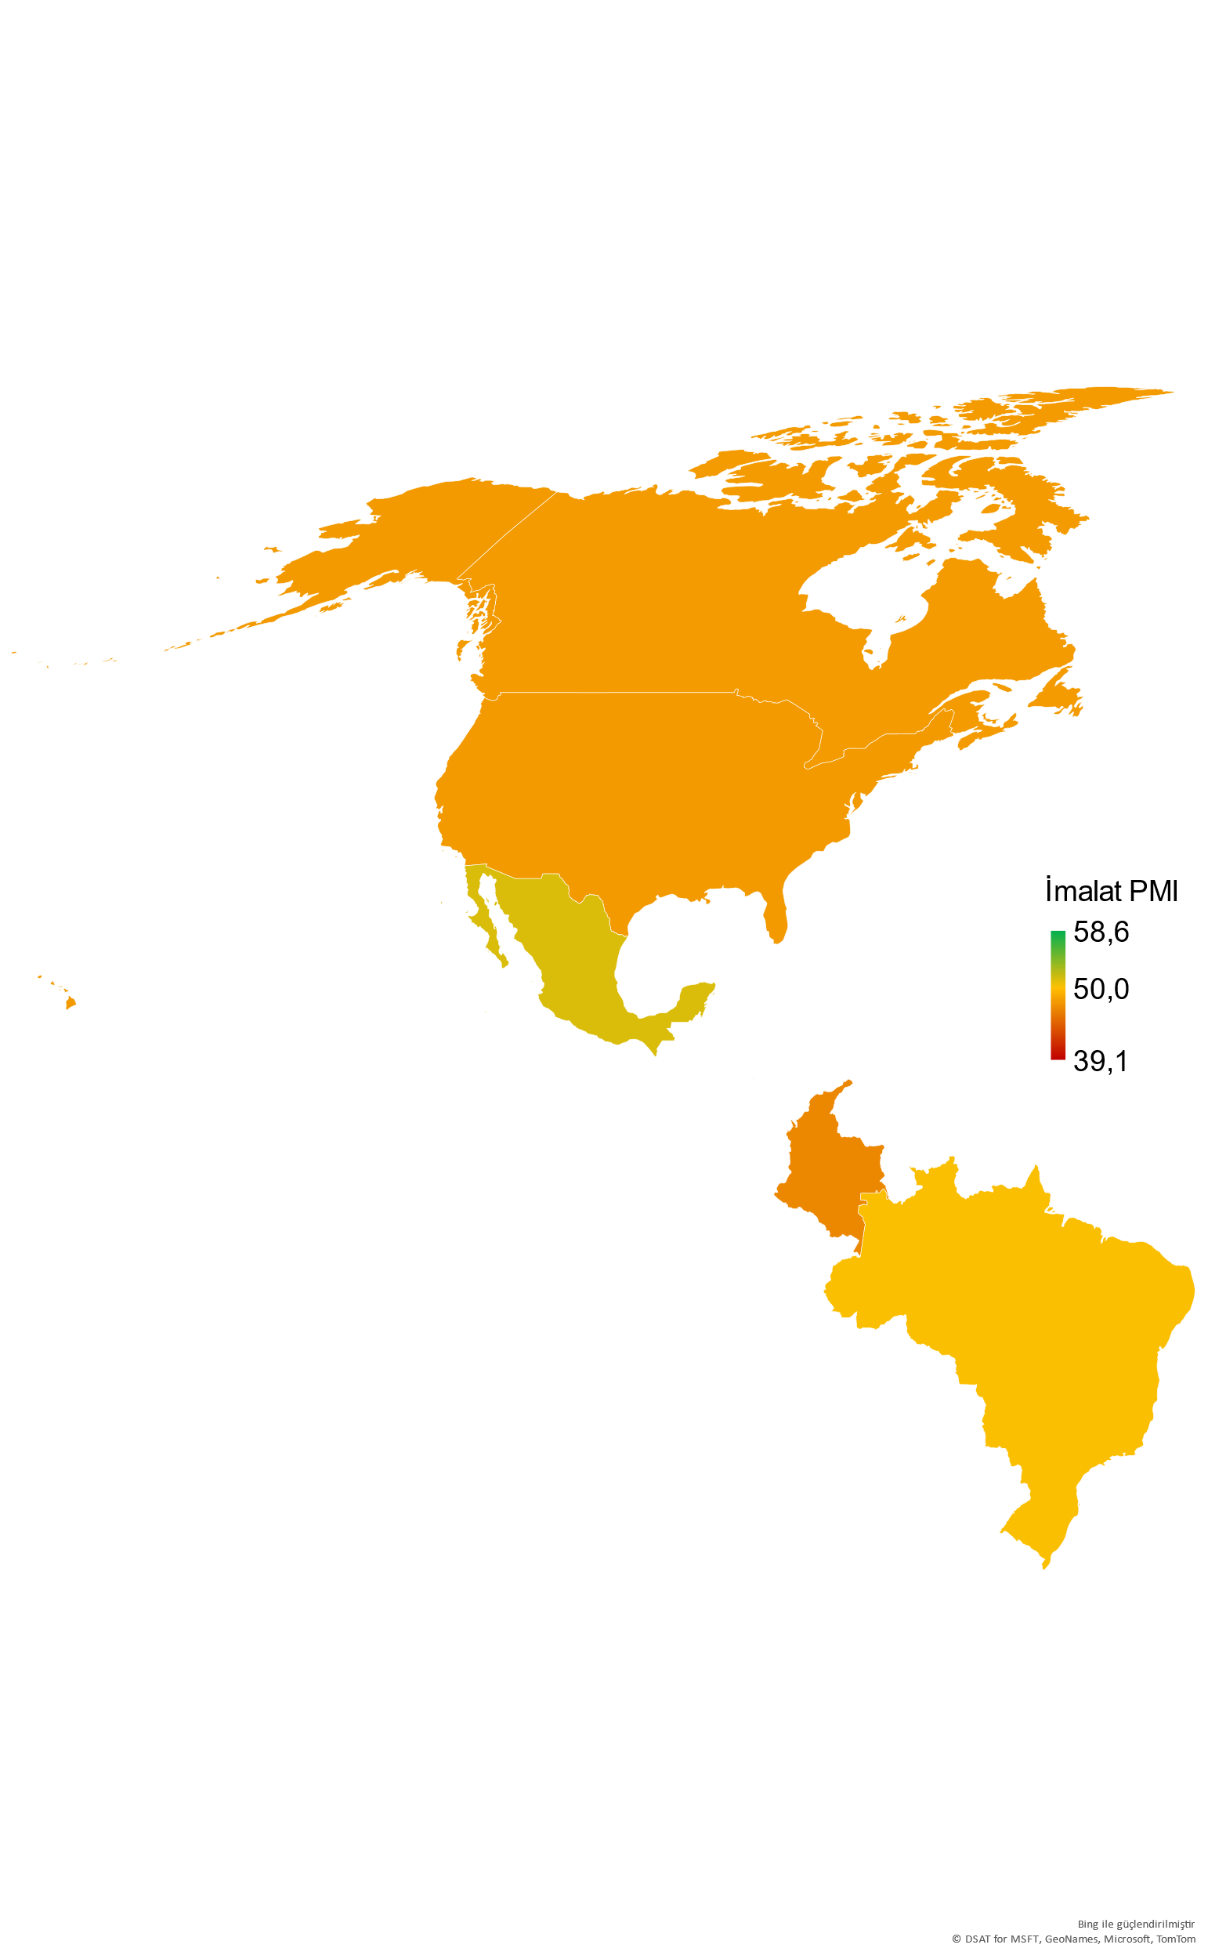
America
Slowing demand in the U.S. and Canada affected the manufacturing sector’s activity conditions negatively.
The US Manufacturing PMI dropped to 47.9 in August from 49.0 in July, remaining below the 50.0 no-change mark for nine consecutive months. New orders decreased at a faster pace, affecting output in the same direction. Employment saw the most limited increase since January. Inflation increased but mildly.
Canada PMI recorded its lowest value in more than three years, posting 48.0 in August. Weak domestic demand negatively affected output and employment of the manufacturing sector, and the inflationary pressures got stronger.
In Brazil, output and sales showed a slight increase, signalling a recovery in the sector. Employment also increased in the country and both input costs and sales prices continued to drop.
Mexico managed to remain above the 50.0 no-change mark thanks to the increased orders, but still had a complex outlook. The increase in demand slowed down, leading to a decrease in output and increase in inflation.
And in Columbia, output started to decrease with the accelerated decrease in orders. Firms decreased their staffing levels and record high decreased were observed in input and product prices.
Manufacturing PMI | July 2023 | August 2023
Mexico | 53.2 | 51.2
Brazil | 47.8 | 50.1
Canada | 49.6 | 48.0
USA | 49.0 | 47.9
Colombia | 48.4 | 46.8
Source: S&P Global.
5

Slide 6
Methodology
What is PMI, how to interpret it?
Purchasing Managers Index (PMI®) is a pioneer indicator produced by S&P Global and used for measuring the activity conditions of the respective economy/industry.
Any figure greater than 50.0 indicates overall improvement, while the figures below 50.0 indicate deterioration.
How is the manufacturing PMI calculated?
The index is based on 5 sub-indexes: New Orders, Output, Employment, Suppliers’ Delivery Times, Stock of Items Purchased.
The report features survey data collected from a panel of around 400 companies based in the Turkish manufacturing sector.
All indexes are seasonally adjusted.
Why is PMI critical?
Calculated by a set of methods in more than 40 countries^{(*)}, PMI provides a fast, reliable, and comparable data set for the current activity conditions of the industries and economies.
They are the most closely-watched business surveys in the world, favoured by central banks, financial markets and business decision makers.
(*) S&P Global produces PMI indexes for the manufacturing industry in a total of 31 countries, including Turkey. PMI indexes in other countries are composite indexees that also cover non-manufacturing sectors. Therefore, for a smooth comparison by country, the scope of the presentation was limited to 31 countries and 3 regions (World, Eurozone, ASEAN) where the manufacturing industry-specific PMI indexes were produced.
1 Grew
2 Grew at a higher rate
3 Grew at the same rate
4 Grew at a lower rate
5 No change after a growth in the previous month
6 Growth dropped after the previous month with no change
7 Dropped at a higher rate
8 Dropped at the same rate
9 Dropped at a lower rate
10 No change after a drop in the previous month
Manufacturing PMI Individual Index Weights
6

Slide 7
Economic Research and Corporate Finance Branch
/istanbulsanayiodasi
/ist_sanayiodasi
Phone: (212) 252 29 00
Fax: (212) 249 50 84
E-mail: arastirma@iso.org.tr
Meşrutiyet Cad. No. 63 Odakule
34430 Beyoğlu/İstanbul
www.iso.org.tr
/istanbulsanayiodasi
/istanbulsanayiodasi
/company/istanbulsanayiodasi
This presentation is prepared to inform the ICI members, using the information obtained from S&P Global.
All intellectual property rights related to the data used belong to S&P Global.

