Slide 1
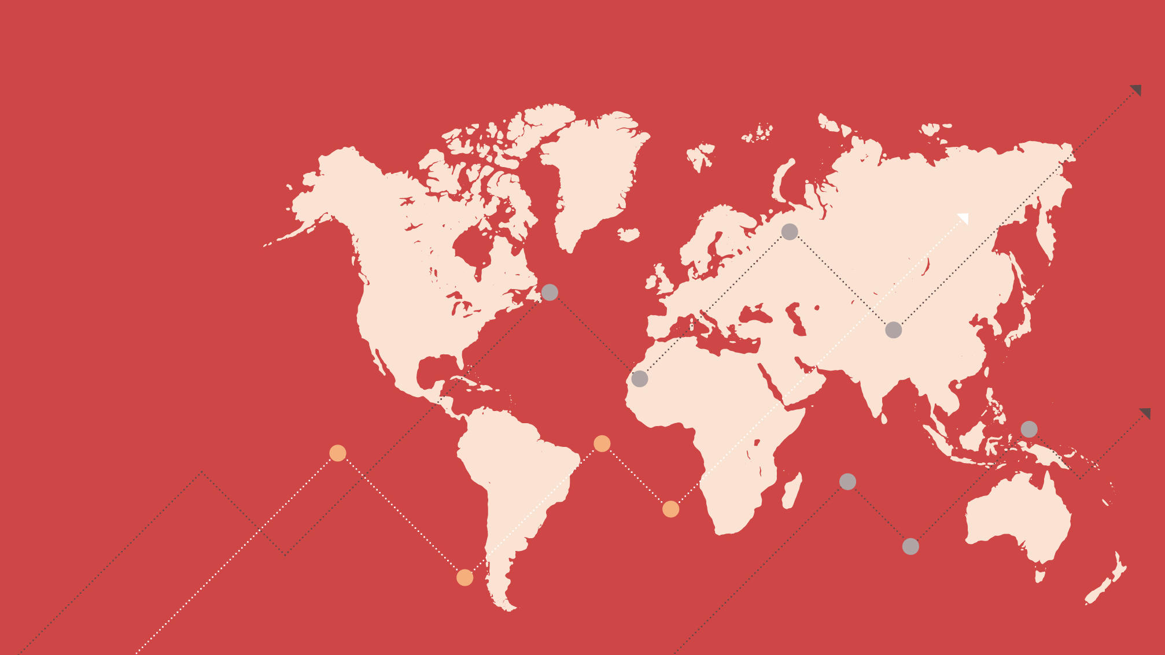
Developments in the Global Manufacturing PMI®
August 2024

Slide 2
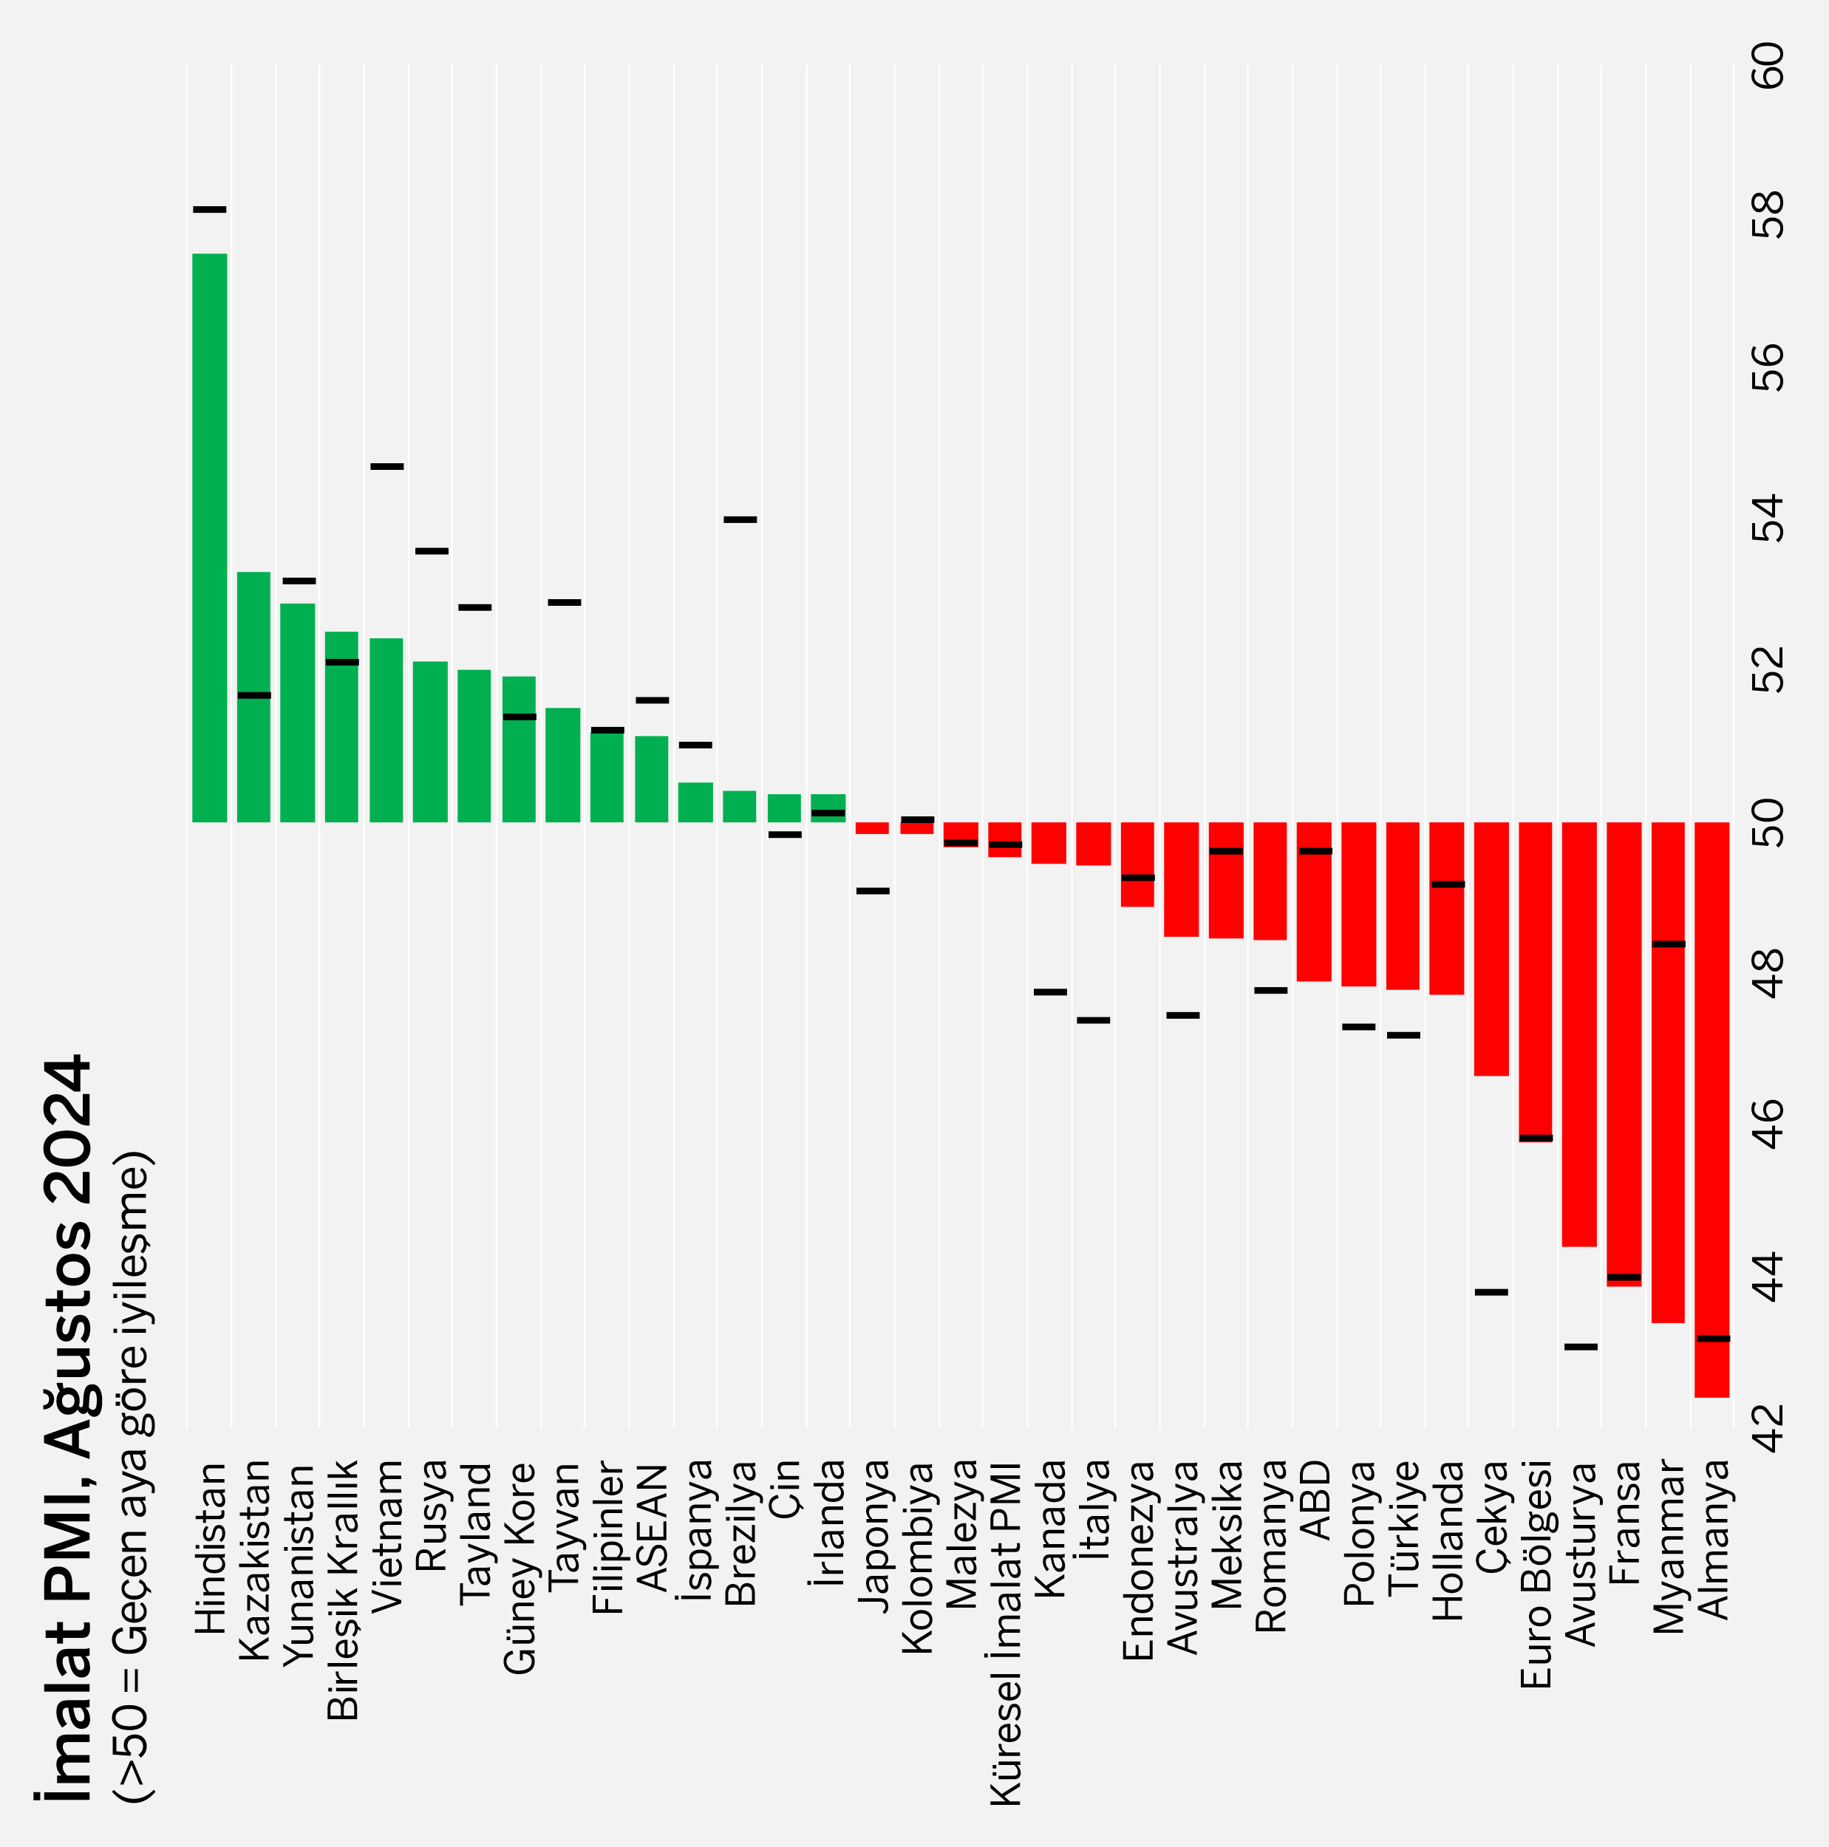
General Outlook
Global Manufacturing PMI signaled a monthly contraction for the second consecutive month in August.
The Global Manufacturing Purchasing Managers' Index® (PMI), which dropped below the 50.0 threshold level (49.7) in July for the first time in 2024, further dropped to 49.5 in August, signaling a slight contraction in the sector for the second consecutive month. It was also the lowest level in the last 8 months.
Among the 32 national economies for which the manufacturing PMI is available, the number of those recording a monthly deterioration fell to 18 in August from 19 in July. In 9 economies, the contraction eased compared to the previous month. In 8 of the 14 economies that showed improvement, the pace of growth weakened.
Global manufacturing industry output contracted slightly in August for the first time in 2024. The output of investment (capital) goods and intermediate goods declined, and the increase in the output of consumer goods was realized at the lowest rate in the last 13 months.
New orders decreased in August as in July, driven by the decline in new export orders for the third consecutive month due to the weakness in global trade flows. In August, global manufacturing employment also declined for the first time in 6 months.
Although Istanbul Chamber of Industry Türkiye Manufacturing PMI rose by 0.6 points to 47.8 in August, it signaled a deterioration in business conditions for the 5th consecutive month. Output saw the sharpest contraction of the last 21 months, while the decline in new orders slowed down due to the slight recovery in external demand. Higher electricity and transportation costs put additional pressure on product prices.
Global Manufacturing PMI
August
49.5 July: 49.7
Source: S&P Global PMI.
Note: The index values of the previous month are illustrated with vertical black lines to indicate the rises or drops of the index compared to the previous month.
2

Slide 3
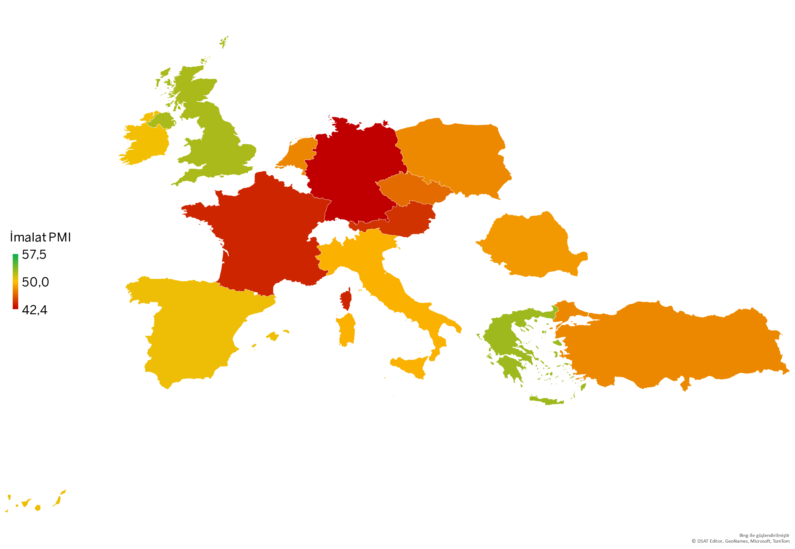
Europe
The Eurozone continued to be the center of industrial weakness, particularly in Germany and France.
Eurozone Manufacturing PMI continued to signal a significant deterioration in the sector with a reading of 45.8 in August, as in June and July. The sharpest contraction in output since the beginning of the year was realized due to the accelerating drop in new orders. Weakening expectations led to a further contraction in employment.
Three Eurozone economies (Greece, Spain and Ireland), where the manufacturing industry recorded growth in July, continued this trend in August. The contraction accelerated in Germany and France, the two largest economies in the region, while Italy moved closer to the recovery zone with a 2-point increase in the Manufacturing PMI.
In the UK, the ongoing recovery in output, new orders and employment pushed the Manufacturing PMI to a 26-month high of 52.5 in August.
In Eastern European countries Romania, Poland and the Czech Republic, manufacturing remained weak but the contraction eased.
Manufacturing PMI | July 2024 | August 2024
Greece | 53.2 | 52.9
United Kingdom | 52.1 | 52.5
Spain | 51.0 | 50.5
Ireland | 50.1 | 50.4
Italy | 47.4 | 49.4
Romania | 47.8 | 48.4
Poland | 47.3 | 47.8
Türkiye | 47.2 | 47.8
The Netherlands | 49.2 | 47.7
Czech Republic | 43.8 | 46.7
Austria | 43.1 | 44.4
France | 44.0 | 43.9
Germany | 43.2 | 42.4
Eurozone (*)
Manufacturing PMI
August
45.8
July: 45.8
Source: S&P Global PMI.
(*) The countries included in the Euro Zone index: Germany, Austria, France, Italy, Ireland, Spain, the Netherlands and Greece.
3

Slide 4
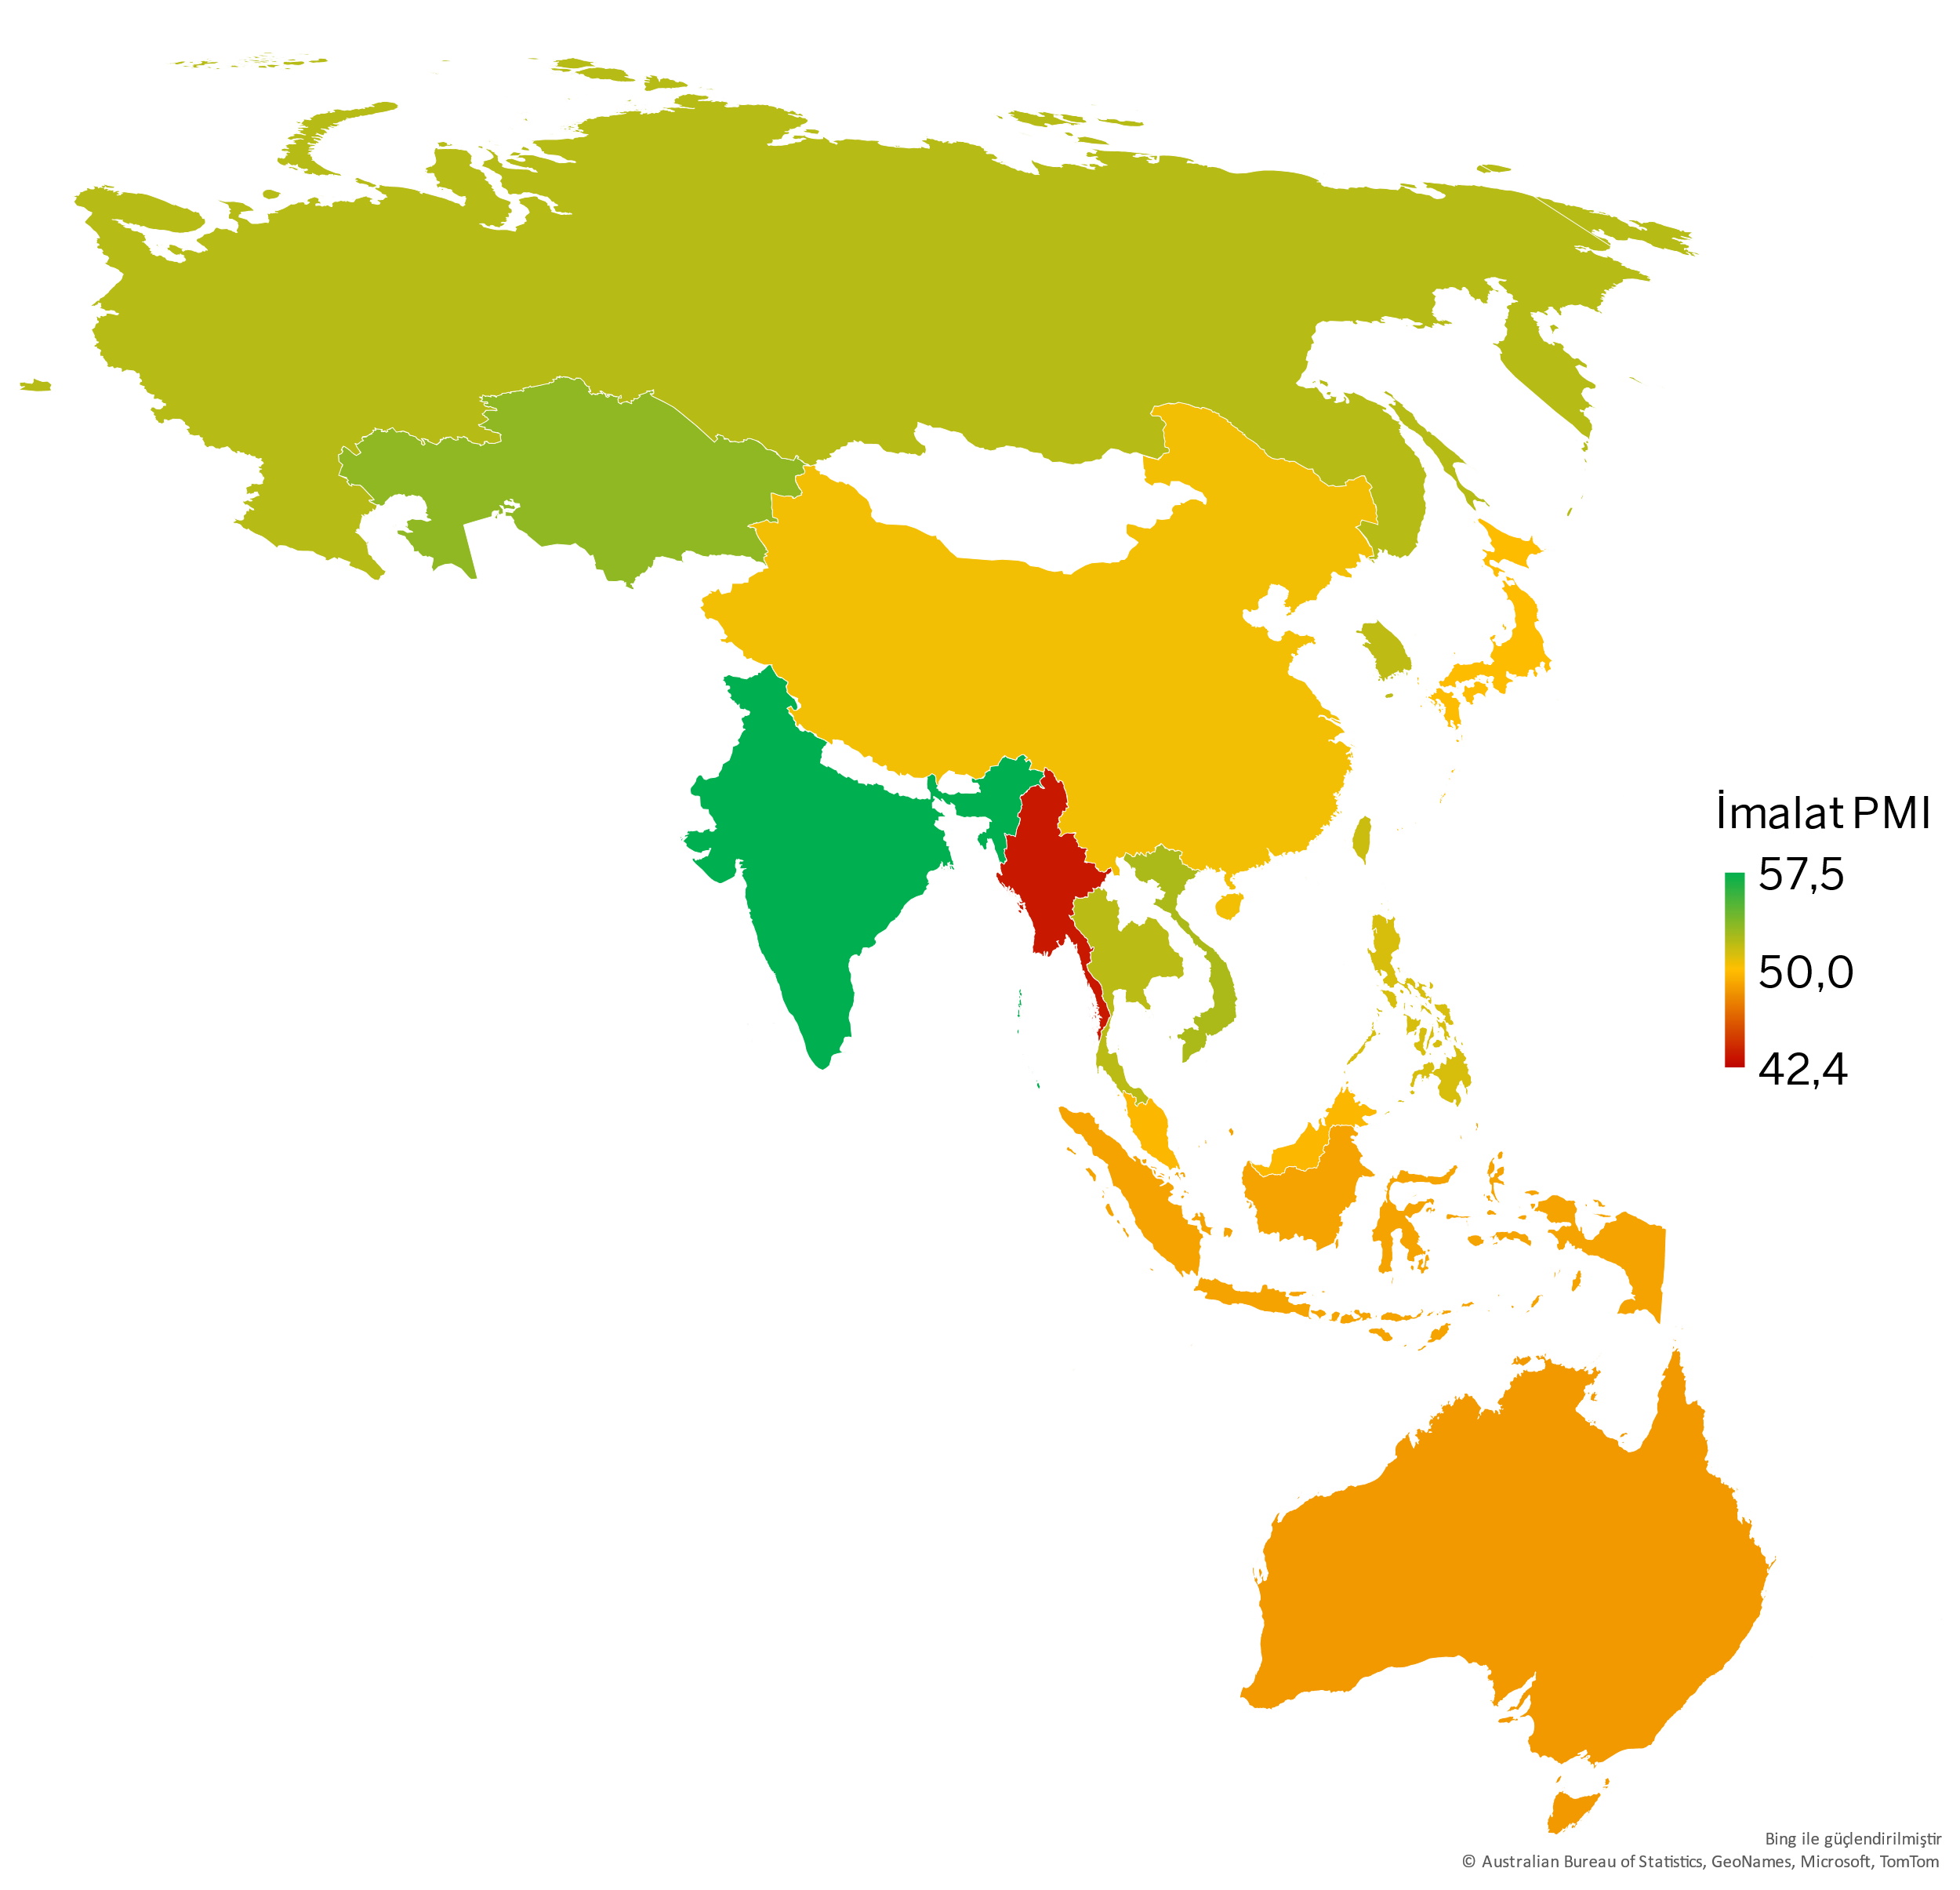
Asia-Pacific
China recovered; India again recorded the fastest growth.
The Asia-Pacific region continued to diverge positively from the rest of the world despite signs of slowdown in some economies.
China Manufacturing PMI signalled a moderate recovery in August after a slight decline in July. Output growth also gained momentum due to the resumed improvement in orders.
In Japan, the recovery in output as well as the slowdown in the decline in orders pushed the Manufacturing PMI closer to the threshold value of 50.
In August, India recorded by far the fastest growth among the 32 economies monitored under the Manufacturing PMI index.
In South Korea, output growth hit a 40-month high on stronger demand, while input price inflation signaled a decline.
Taiwan's manufacturing sector maintained its growth trend in August, albeit with a slight deceleration compared to the previous month.
In Russia, PMI dropped to its lowest level in more than a year, signaling a slowdown in the sector for the second month in a row.
Australian Manufacturing PMI, which has been below 50 since February, remained weak despite a slight increase in August.
Manufacturing PMI in the ASEAN (*) region remained above 50 for the first 8 months of 2024, but fell to a 4-month low (51.1) in August. Deterioration accelerated in Myanmar and Indonesia, while Vietnam, Thailand and the Philippines maintained their growth.
Manufacturing PMI | July 2024 | August 2024
India | 58.1 | 57.5
Kazakhstan | 51.7 | 53.3
Vietnam | 54.7 | 52.4
Russia | 53.6 | 52.1
Thailand | 52.8 | 52.0
South Korea | 51.4 | 51.9
Taiwan | 52.9 | 51.5
Philippines | 51.2 | 51.2
China | 49.8 | 50.4
Japan | 49.1 | 49.8
Malaysia | 49.7 | 49.7
Indonesia | 49.3 | 48.9
Australia | 47.5 | 48.5
Myanmar | 48.4 | 43.4
ASEAN (*)
Manufacturing PMI
August
51.1
July: 51.6
Source: S&P Global PMI.
(*) The countries included in the ASEAN PMI index: Indonesia, Philippines, Malaysia, Myanmar, Singapore, Thailand, Vietnam.
4

Slide 5
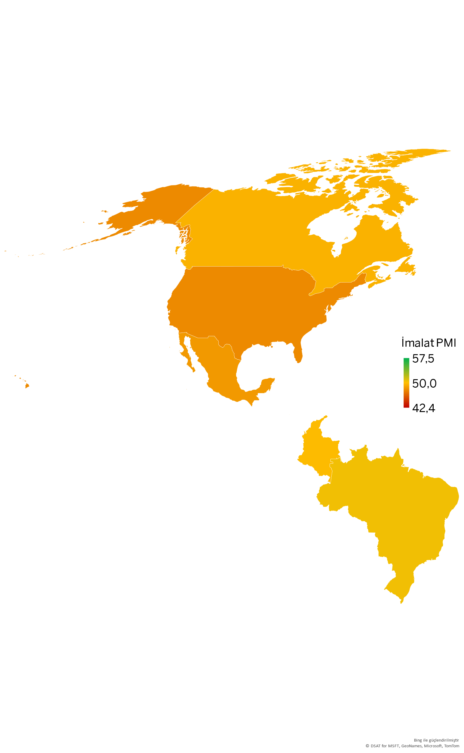
America
Weak demand in the US and strengthening cost pressures negatively affected industry across the continent.
Output in the US slowed down for the first time in 7 months due to weakening demand. New orders saw the sharpest contraction since June 2023. Firms reduced their staffing levels due to idle capacity. The increase in raw material, labor and transportation costs led to stronger price pressures.
In Canada, the Manufacturing PMI edged closer to the 50.0 threshold value as declines in output, new orders and employment eased significantly. On the other hand, inflation indicators increased.
In Mexico, where the contraction in demand and output accelerated, the Manufacturing PMI posted 48.5, signaling the weakest business conditions in 2 years. Cost pressures reached the highest level since November 2022.
In Brazil, output contracted due to the sharpest loss of orders in 8 months and cost pressures reaching a more than 2-year high. Manufacturing PMI fell 3.6 points to 50.4, indicating a significant loss of momentum.
In Colombia, despite the first increase in output since March, the Manufacturing PMI dropped back into mild contraction zone due to the deterioration in new orders.
Manufacturing PMI | July 2024 | August 2024
Brazil | 54.0 | 50.4
Colombia | 50.0 | 49.8
Canada | 47.8 | 49.5
Mexico | 49.6 | 48.5
USA | 49.6 | 47.9
Source: S&P Global PMI.
5

Slide 6
Methodology
What is PMI, how to interpret it?
Purchasing Managers Index (PMI®) is a pioneer indicator produced by S&P Global and used for measuring the activity conditions of the respective economy/industry.
Any figure greater than 50.0 indicates overall improvement, while the figures below 50.0 indicate deterioration.
How is the manufacturing PMI calculated?
The index is based on 5 sub-indexes: New Orders, Output, Employment, Suppliers’ Delivery Times, Stock of Items Purchased.
The report features survey data collected from a panel of around 400 companies based in the Turkish manufacturing sector.
All indexes are seasonally adjusted.
Why is PMI critical?
Calculated by a set of methods in more than 40 countries^{(*)}, PMI provides a fast, reliable, and comparable data set for the current activity conditions of the industries and economies.
They are the most closely-watched business surveys in the world, favoured by central banks, financial markets and business decision makers.
(*) | S&P Global produces PMI indexes for the manufacturing industry in a total of 32 countries, including Turkey. PMI indexes in other countries are composite indexes that also cover some non-manufacturing sectors. Therefore, for a smooth comparison by country, the scope of the presentation was limited to 32 countries and 3 regions (World, Eurozone, ASEAN) where the manufacturing industry-specific PMI indexes were produced.
1 Grew
2 Grew at a higher rate
3 Grew at the same rate
4 Grew at a lower rate
5 No change after a growth in the previous month
6 Growth dropped after the previous month with no change
7 Dropped at a higher rate
8 Dropped at the same rate
9 Dropped at a lower rate
10 No change after a drop in the previous month
Manufacturing PMI Individual Index Weights
6

Slide 7
Economic Research and Corporate Finance Branch
/istanbulsanayiodasi
/ist_sanayiodasi
Phone: (212) 252 29 00
Fax: (212) 249 50 84
E-mail: arastirma@iso.org.tr
Meşrutiyet Cad. No. 63 Odakule
34430 Beyoğlu/İstanbul
www.iso.org.tr
/istanbulsanayiodasi
/istanbulsanayiodasi
/company/istanbulsanayiodasi
This presentation is prepared to inform the ICI members, using the information obtained from S&P Global.
All intellectual property rights related to the data used belong to S&P Global.

