Slide 1
Developments in the Global Manufacturing PMI®
September 2024

Slide 2
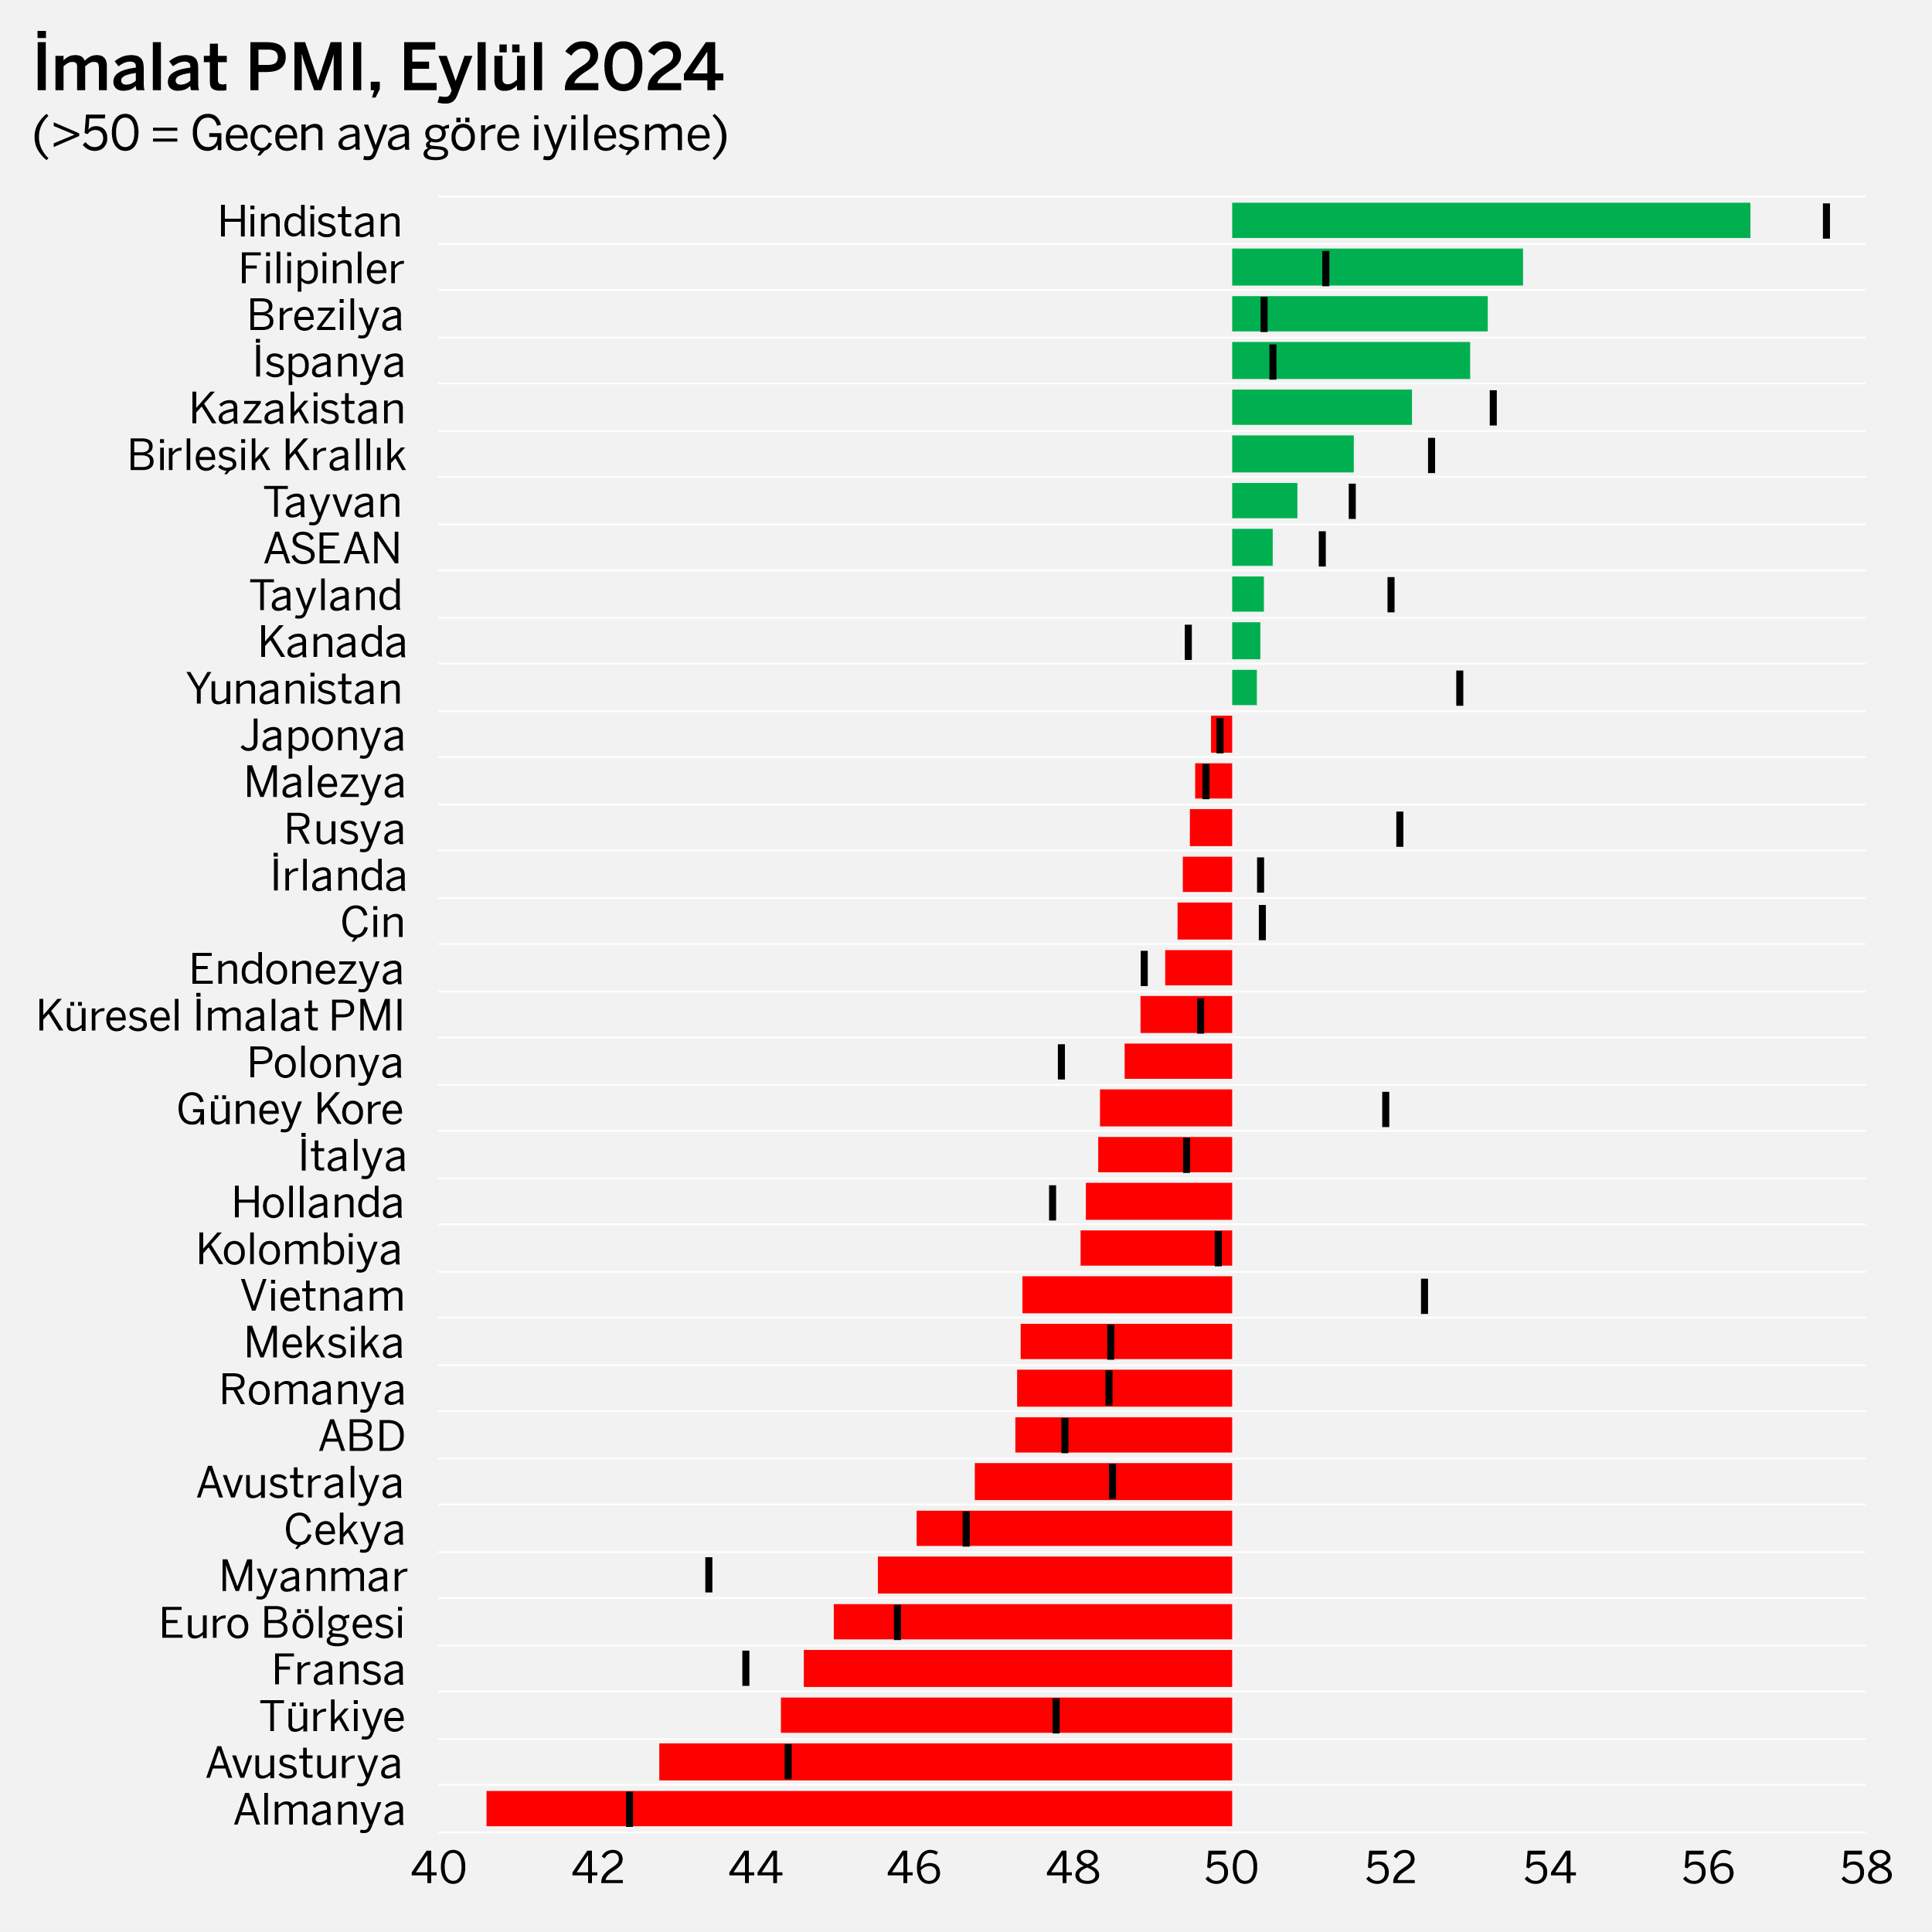
General Outlook
Global Manufacturing PMI remained below the 50.0 no-change mark for the third quarter.
The Global Manufacturing Purchasing Managers' Index® (PMI), which was 49.6 in August, hit an 11-month low of 48.8 in September. After averaging 50.3 and 50.7 in the first and second quarters of 2024, respectively, the index remained below 50 throughout the third quarter, averaging 49.4.
Among the 32 national economies for which the manufacturing PMI is available, the number of those with deteriorated business conditions rose to 22 in September from 18 in August. On the other hand, 6 out of 10 economies in the growth zone lost momentum compared to the previous month.
Global manufacturing industry output dropped in September after a flat course in August. The output of investment (capital) goods and intermediate goods declined, while there was a very limited increase in the output of consumer goods. New orders, including exports, declined across the sector.
Global manufacturing employment fell for the second consecutive month in September. The sector's expectations for the future also signaled the weakest optimism in the last 22 months. On the other hand, increases in input costs and finished goods prices slowed down.
Istanbul Chamber of Industry Türkiye Manufacturing PMI dropped to 44.3 in September from 47.8 in August, signalling a deterioration in business conditions for the 6th consecutive month. The quarterly average of the index dropped to 46.6 in the 3Q from 48.6 in the 2Q. Output, new orders, employment and the volume of purchases experienced the sharpest declines since the first period of the pandemic (second quarter of 2020).
Global Manufacturing PMI
September
48.8
August: 49.6
Source: S&P Global PMI.
Note: The index values of the previous month are illustrated with vertical black lines to indicate the rises or drops of the index compared to the previous month.
2

Slide 3
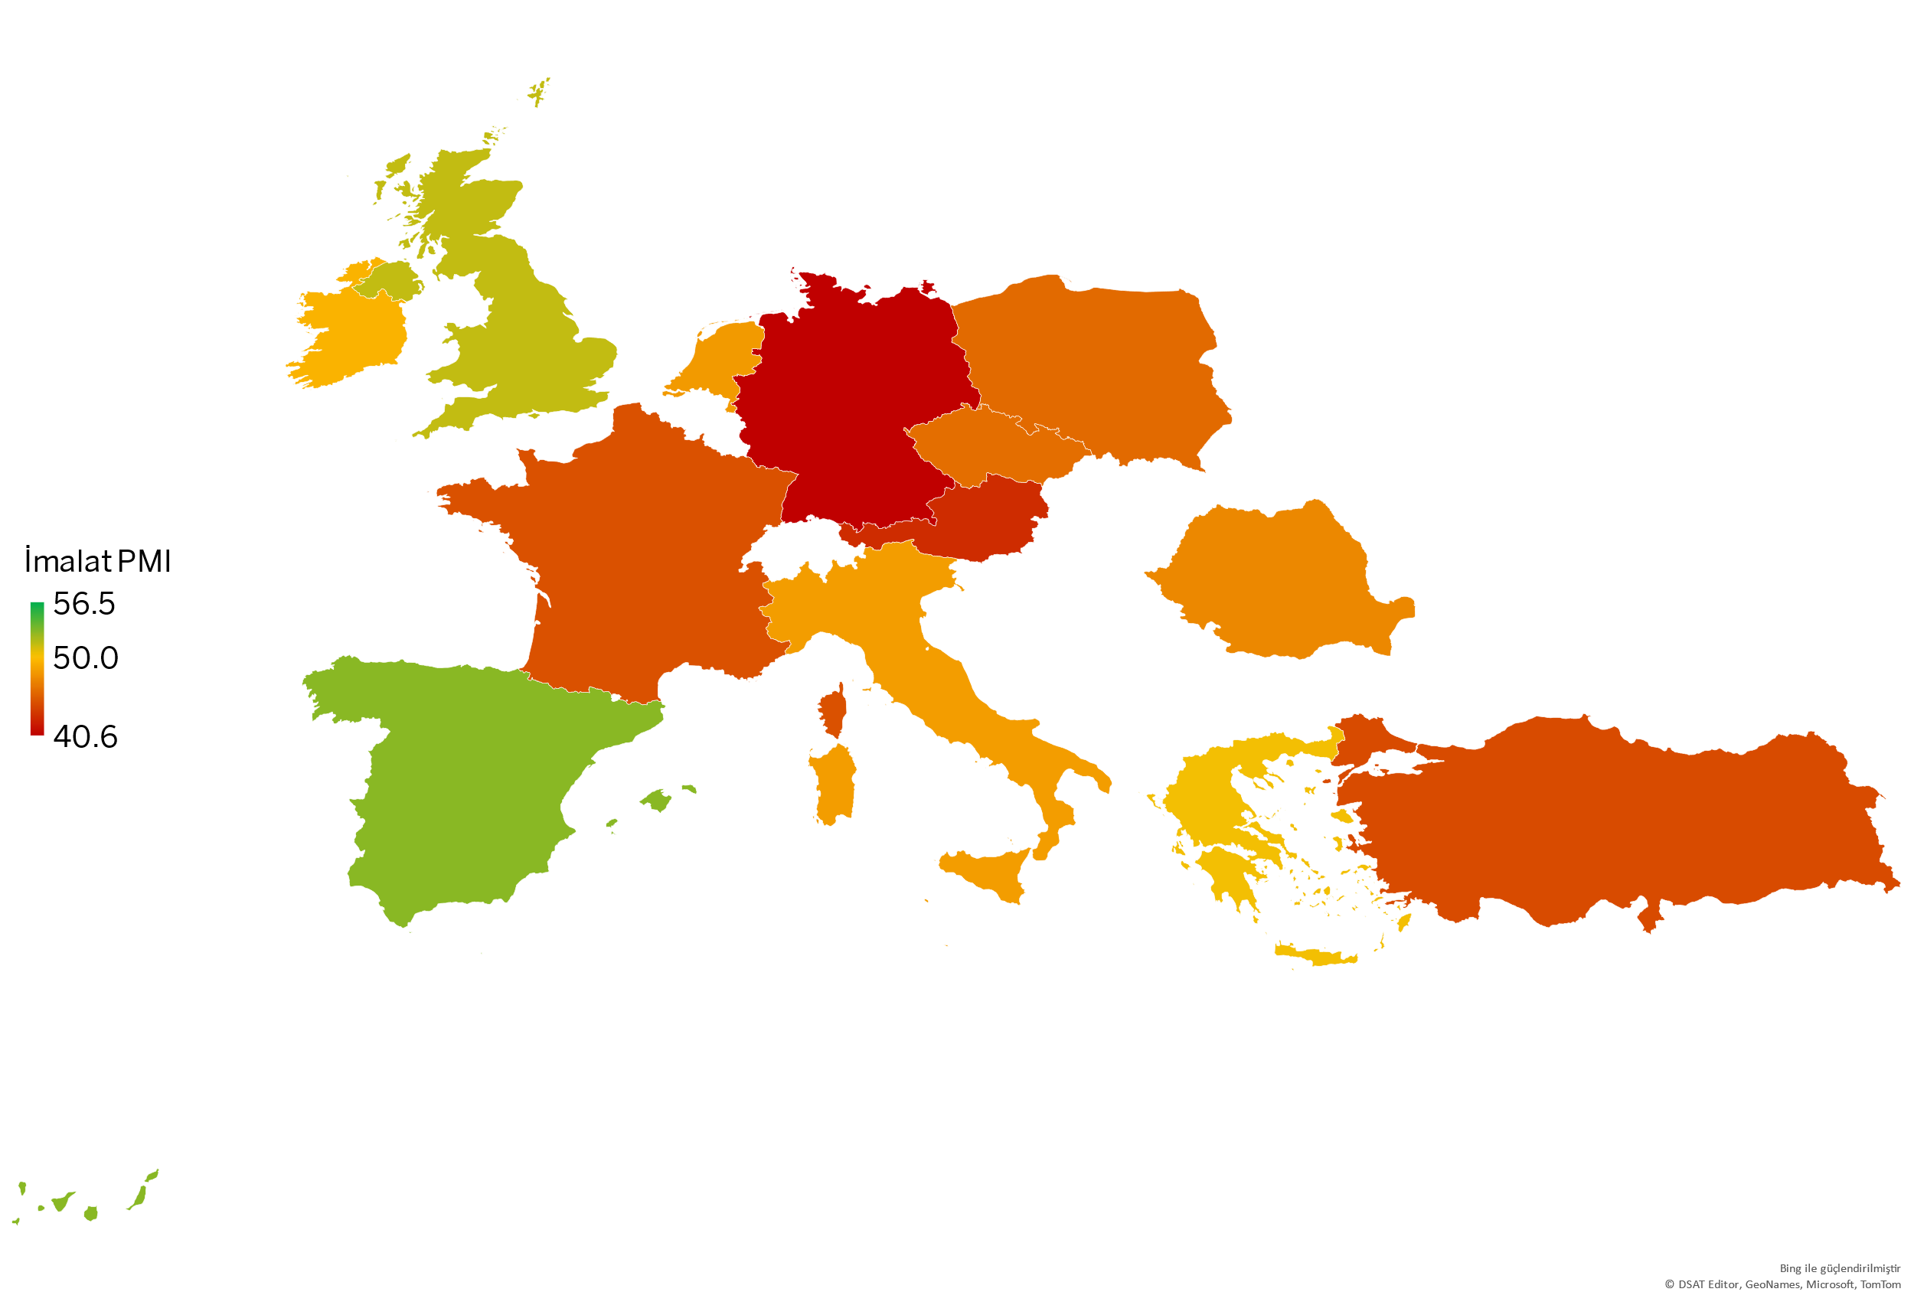
Europe
Eurozone output recorded its most significant decline since the beginning of the year.
Eurozone Manufacturing PMI fell to 45 in September from 45.8 in June, July and August, marking the weakest reading in 2024. Output and new orders contracted at the fastest pace in the last 9 months. The decline in staffing numbers and purchasing also accelerated. On the other hand, both input and finished goods prices declined.
Improvement was seen in only 2 of the 8 Eurozone economies for which manufacturing PMI is available. Growth strengthened in Spain but lost momentum in Greece. Deterioration deepened in Germany, Italy and Austria, while contraction slowed down in France and the Netherlands. Ireland moved back to contraction zone in September.
In the UK, Manufacturing PMI fell to 51.5 in September after hitting a 26-month high in August with 52.5, as output and demand slowed.
In three Eastern European countries for which manufacturing PMIs were calculated, the index remained below 50. The contraction was moderate in Poland compared to Czechia and Romania.
Manufacturing PMI | August 2024 | September 2024
Spain | 50.5 | 53.0
United Kingdom | 52.5 | 51.5
Greece | 52.9 | 50.3
Ireland | 50.4 | 49.4
Poland | 47.8 | 48.6
Italy | 49.4 | 48.3
The Netherlands | 47.7 | 48.2
Romania | 48.4 | 47.3
Czech Republic | 46.7 | 46.0
France | 43.9 | 44.6
Türkiye | 47.8 | 44.3
Austria | 44.4 | 42.8
Germany | 42.4 | 40.6
Eurozone (*)
Manufacturing PMI
September
45.0
August: 45.8
Source: S&P Global PMI.
(*) The countries included in the Euro Zone index: Germany, Austria, France, Italy, Ireland, Spain, the Netherlands and Greece.
3

Slide 4
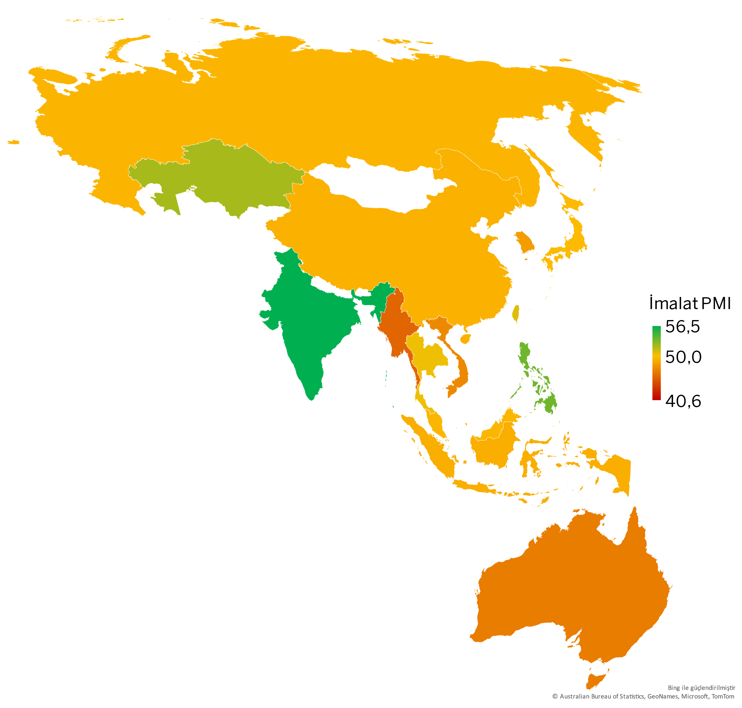
Asia-Pacific
China, Russia, South Korea and Vietnam contracted in September.
In most parts of the Asia-Pacific region, the manufacturing sector demonstrated a weaker performance compared to August.
After a slight recovery in August, China's manufacturing sector was negatively affected by the weakening in both domestic and external demand in September. Manufacturing PMI fell to 49.3 from 50.4 in August.
In Japan, Manufacturing PMI remained slightly below 50 due to the decline in output and the ongoing contraction in orders.
Among the 32 economies for which the Manufacturing PMI is available, the fastest growth was again measured in India, despite a slight loss of momentum.
South Korea's manufacturing sector suffered its steepest output loss in 11 months in September as it faced a sudden contraction in demand.
In Taiwan, growth decelerated during the third quarter. Employment levels fell for the first time in 3 months as demand and output slowed.
In Russia, output fell for the first time since June 2022 due to weakening demand and supply chain issues.
Deterioration in Australia's manufacturing sector also became evident. Output and orders fell the most sharply in 53 months.
ASEAN (*) Manufacturing PMI fell to 50.5 in September, signaling a continued loss of momentum in growth. Output decreased for the first time in 3 years due to slowdown in demand. The most striking development in the region was the sharp contraction in Vietnam.
Manufacturing PMI | August 2024 | September 2024
India | 57.5 | 56.5
Philippines | 51.2 | 53.7
Kazakhstan | 53.3 | 52.3
Taiwan | 51.5 | 50.8
Thailand | 52.0 | 50.4
Japan | 49.8 | 49.7
Malaysia | 49.7 | 49.5
Russia | 52.1 | 49.5
China | 50.4 | 49.3
Indonesia | 48.9 | 49.2
South Korea | 51.9 | 48.3
Vietnam | 52.4 | 47.3
Australia | 48.5 | 46.7
Myanmar | 43.4 | 45.5
ASEAN (*)
Manufacturing PMI
September
50.5
August: 51.1
Source: S&P Global PMI.
(*) The countries included in the ASEAN PMI index: Indonesia, Philippines, Malaysia, Myanmar, Singapore, Thailand, Vietnam.
4

Slide 5
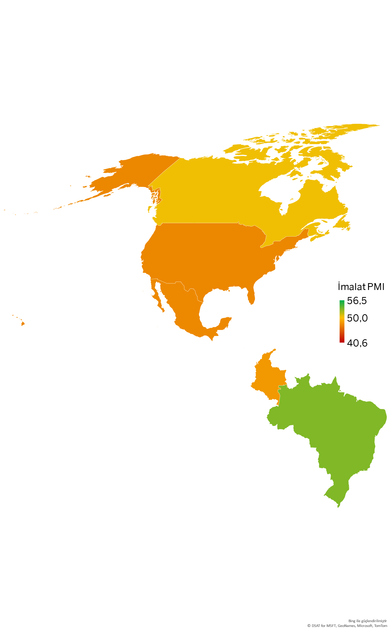
America
The US manufacturing sector recorded the most significant contraction since mid-2023.
The US Manufacturing PMI fell to 47.3 in September, the lowest level in the last 15 months. The deterioration was led by heightened political uncertainty ahead of the presidential elections, weakening demand and the general slowdown in the economy. Declines in output, new orders and staffing numbers accelerated.
Canada's manufacturing sector showed signs of recovery at the end of the third quarter. New orders and staffing numbers increased slightly, while the decline in output almost came to a halt.
Manufacturing PMI in Mexico recorded its weakest reading in 32 months. It saw the sharpest decline in output and demand in more than 2 years. Weak demand, the uncertainties regarding the US elections, Chinese competition and cost pressures negatively affected the sector.
In Brazil, output shifted from contraction to growth zone due to the acceleration in orders and the Manufacturing PMI rose strongly by 2.8 points to 53.2, the highest level in the last 5 months.
In Colombia, on the other hand, weak demand led to a contraction in output and the business conditions in the manufacturing sector deteriorated the most markedly in the last 11 months.
Manufacturing PMI | August 2024 | September 2024
Brazil | 50.4 | 53.2
Canada | 49.5 | 50.4
Colombia | 49.8 | 48.1
Mexico | 48.5 | 47.3
USA | 47.9 | 47.3
Source: S&P Global PMI.
5

Slide 6
Methodology
What is PMI, how to interpret it?
Purchasing Managers Index (PMI®) is a pioneer indicator produced by S&P Global and used for measuring the activity conditions of the respective economy/industry.
Any figure greater than 50.0 indicates overall improvement, while the figures below 50.0 indicate deterioration.
How is the manufacturing PMI calculated?
The index is based on 5 sub-indexes: New Orders, Output, Employment, Suppliers’ Delivery Times, Stock of Items Purchased.
The report features survey data collected from a panel of around 400 companies based in the Turkish manufacturing sector.
All indexes are seasonally adjusted.
Why is PMI critical?
Calculated by a set of methods in more than 40 countries^{(*)}, PMI provides a fast, reliable, and comparable data set for the current activity conditions of the industries and economies.
They are the most closely-watched business surveys in the world, favoured by central banks, financial markets and business decision makers.
(*) | S&P Global produces PMI indexes for the manufacturing industry in a total of 32 countries, including Turkey. PMI indexes in other countries are composite indexes that also cover some non-manufacturing sectors. Therefore, for a smooth comparison by country, the scope of the presentation was limited to 32 countries and 3 regions (World, Eurozone, ASEAN) where the manufacturing industry-specific PMI indexes were produced.
1 Grew
2 Grew at a higher rate
3 Grew at the same rate
4 Grew at a lower rate
5 No change after a growth in the previous month
6 Growth dropped after the previous month with no change
7 Dropped at a higher rate
8 Dropped at the same rate
9 Dropped at a lower rate
10 No change after a drop in the previous month
Manufacturing PMI Individual Index Weights
6

Slide 7
Economic Research and Corporate Finance Branch
/istanbulsanayiodasi
/ist_sanayiodasi
Phone: (212) 252 29 00
Fax: (212) 249 50 84
E-mail: arastirma@iso.org.tr
Meşrutiyet Cad. No. 63 Odakule
34430 Beyoğlu/İstanbul
www.iso.org.tr
/istanbulsanayiodasi
/istanbulsanayiodasi
/company/istanbulsanayiodasi
This presentation is prepared to inform the ICI members, using the information obtained from S&P Global.
All intellectual property rights related to the data used belong to S&P Global.

