Slide 1

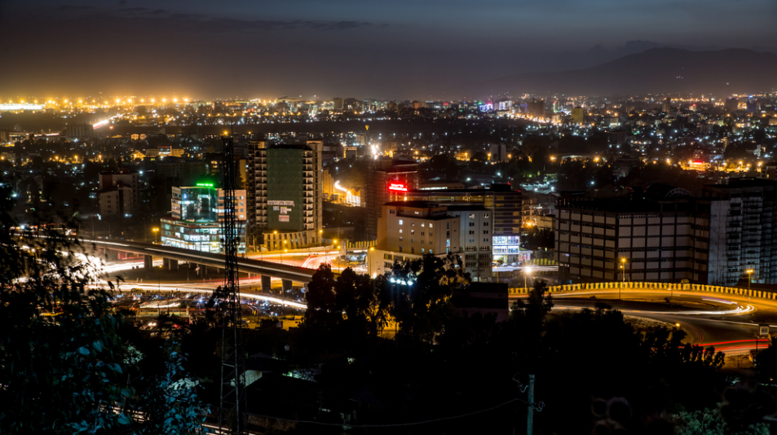
E T H I O P I A
A New Horizon of Hope

Slide 2
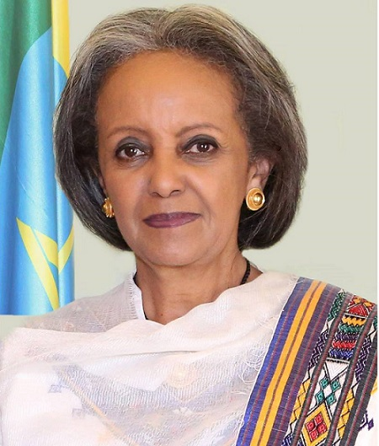
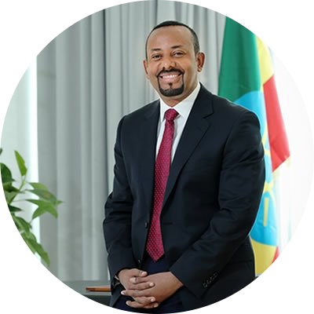
Federal Democratic Republic of Ethiopia
  President: Sehale-Work Zewde
  Head of State
  Prime Minister: Dr Abiy Ahmed
  Head of Government
Federal government structure
9 regions; 2 chartered cities
Parliamentary system
GDP: 84.35 USD Bn
GDP growth rate: 10%
Area: 1.1 million square kilometers
Population: ~105 Mn (2017)
Population growth (annual %): 2.5%
Life expectancy: 65 years
Notes:
“Stellar FDI performance” (World Bank)
Led by investment in manufacturing sector
Top 3 FDI destination in Africa (UNCTAD 2017)
2nd largest recipient of FDI in the apparel & textile industry (UNCTAD 2017)

Slide 3








Strong economic growth and investment performance with an impressive and growing FDI regional performance
4th
One of the world’s fastest growing economy with double digit growth
The investment to GDP ratio has averaged 37.5% over the last 5 years
1st
5th
3rd
Four-folds increase in FDI flow over the last 5 years (from 1 billion USD to more than 4.2 billion USD);
2nd
Much of increase in FDI inflow is attributable to investment in light manufacturing in Ethiopia’s Industrial Parks
Source: World Investment Report 2019
Notes:
“Stellar FDI performance” (World Bank)
Led by investment in manufacturing sector
Top 3 FDI destination in Africa (UNCTAD 2017)
2nd largest recipient of FDI in the apparel & textile industry (UNCTAD 2017)

Slide 4












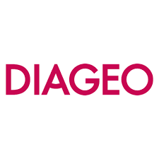









As one of the largest recipient of FDI in Africa, Ethiopia has attracted several global brands highlighting competitive investment opportunities
So what efforts is the country taking to sustain this momentum?
Notes:
“Stellar FDI performance” (World Bank)
Led by investment in manufacturing sector
Top 3 FDI destination in Africa (UNCTAD 2017)
2nd largest recipient of FDI in the apparel & textile industry (UNCTAD 2017)

Slide 5

Key government strategies have been undertaken building on the success of the past
Economic and Investment Reforms
Creating a conducive and enabling environment
Targeted investment in priority areas
5

Slide 6
A home-grown reform agenda with a set of comprehensive and well-synchronized measures has been designed
Correct FX imbalances
Jobs
Inclusive growth
Poverty reduction
Creating a path to prosperity
Macroeconomic reforms
Control inflation
Macroeconomic reforms
Improve access to finance
Build confidence
Ensure debt sustainability
Macroeconomic reforms
Rebalance growth and enhance productivity
Structural reforms
Ease business constraints
\
Macroeconomic reforms
Address sector-specific institutional and market failures
Sectoral reforms
To sustain the success of the past decade, address emerging challenges and create new opportunities created for private sector development
Notes:
“Stellar FDI performance” (World Bank)
Led by investment in manufacturing sector
Top 3 FDI destination in Africa (UNCTAD 2017)
2nd largest recipient of FDI in the apparel & textile industry (UNCTAD 2017)

Slide 7
Opening up of the country economy is currently underway through key macro-economic, trade and regional integration reforms
  MACROECONOMIC REFORM
  REGULATORY FRAMEWORKS REFORM
  TRADE AND REGIONAL INTEGRATION REFORMS
  INVESTMENT CLIMATE REFORM
7
Notes:
“Stellar FDI performance” (World Bank)
Led by investment in manufacturing sector
Top 3 FDI destination in Africa (UNCTAD 2017)
2nd largest recipient of FDI in the apparel & textile industry (UNCTAD 2017)

Slide 8
    Signature and ratification
    Public finance reforms
  MACROECONOMIC REFORM
  Aimed at correcting imbalances and safeguarding macro-financial stability which requires
    Strengthening public sector finances
    Correcting FX imbalances
    Controlling inflation
    Safeguarding financial stability
    Improving access to finance
    Developing capital markets
    Mobilization of resources
    Increasing investment & competition
    Enhancing Public Private Partnerships
8
Notes:
Public finance reforms: public spending restraint; new external commercial borrowing is temporarily restricted, and financing limited to grant and highly concessional official loans.
Effective mobilization of support/resources from various sources: including development partners (multilateral and bilateral) and Ethiopian diaspora community.
Increasing investment and competition in critical sectors: Privatization of state-owned enterprises, liberalization of sectors that were previously closed for private sector or foreign investors.
Enhancing public private partnerships – legal and institutional framework for PPP devised; pipeline of infrastructural projects are identified.

Slide 9
    Signature and ratification
  African Continental Free Trade Area (AfCFTA)
  Aim to create a single continental market for goods and services, with free movement of business persons and investments, while accelerating the establishment of a continental-wide customs union
  Signature and ratification of the AfCFTA
  Unlocks market access potential of 1.2 billion people
  TRADE AND REGIONAL INTEGRATION REFORMS
    African Continental Free Trade Area (AfCFTA)
    World Trade Organization
  World Trade Organization
  Re-initiate the negotiation for accession Join WTO accession
  Key points:
    Bilateral market access/negotiations (goods and services)
    Multilateral negotiations
9

Slide 10
    Signature and ratification
  REGULATORY FRAMEWORKS REFORM
    Revision of the law was dictated by the need to:
    Modernize the investment regulatory & administrative framework
    Align the investment legal regime with recent changes in economic policy priorities
    Revisit investment areas open to the private sector
    Consolidate protracted rules on investment
    Adopt best practices for efficient investment administration/service provision, including OSS
    Devise a faster and more transparent investor grievance handling mechanism
NEW INVESTMENT PROCLAMATION AND REGULATION LAW
  Efficient, transparent, predictable and modern investment regulatory and administrative framework
  Further open up investment areas to private sector (Positive to negative listing)
  Improving investment attraction and retention
OTHER REGULATORY FRAMEWORKS REFORMS
  Revision of Commercial Code underway – To cater to prevailing market realities
  Development of a comprehensive Alternative Dispute Resolution law (ADR) – to place Ethiopia as a regional arbitration hub
  Strengthening the legal and institutional framework for enforcement of foreign awards
10

Slide 11
Investment areas moving from a positive to a negative listing
Reserved for Joint Investment with Government
Manufacturing of weapons, ammunition and explosives
Import & export of electrical energy
International air transport services
Bus rapid transit
Postal services excluding courier services
Investment Areas
Freight forwarding and shipping agency services
Domestic air transport service
Cross-country public transport service (seating capacity > 45)
Urban mass transport service (large carrying capacity)
Advertisement and promotion services
Audiovisual services – Motion picture and video recording, production and distribution
Accounting and Auditing services
Joint Investment with Domestic Investors
Note: Foreign investor share capital not more than 49%
Reserved for Domestic Investors
Banking, insurance & microfinance excl. capital goods finance business
Whole sale trade, petroleum & products, wholesale of own products excluding whole of electronic commerce
Retail trade excl. retail of & electronic commerce
Import trade, excl. liquefied petroleum gas and bitumen
Export trade of raw coffee, khat, oil seeds, pulses, minerals, hides & skins, products of natural forest, chicken, & livestock
Hotel, lodge, resort, motel, guesthouse & pension service excl star-designated
Travel agency, travel ticket sales & trade auxiliary, tour operation
Operating lease of equipment, machineries & vehicles excluding industry-specific
Transport services, excl Railway, cable-car, cold-chain, freight transport,
11
Note: Refer to Investment Regulation No. 474/2020 for detailed and exhaustive list

Slide 12

National initiative to improve ease of doing business launched and over 80 reforms undertaken
Starting a Business
Registering Property
Dealing with construction permit
Getting Electricity
Vision
Placing Ethiopia among the TOP 100 DB ranking Countries in 2021
Getting Credit
Protecting Minority Investors
Paying Taxes
Resolving Insolvency
Trading Across Boarders
Enforcing Contracts
Cross Cutting Reforms: Multi-Agency
  Vital reforms to date include
  Elimination of requirements of newspaper publications of trade name
  Lease agreement for business registration and licensing removed
  Implementation of an OSS service delivery at the Ministry of Trade & Industry;
  Expansion of credit registry information
  Introduction of modern and web-based customs clearance and tax administration systems;
  Online permit application launched, statutory time limit for construction permit set,
  Electronic single window on pilot; new web-based customs management system implemented; service delivery on main dry ports extended from 8 hours to 16 hours a day; e-certificate of origin implemented
12

Slide 13
  Committees to oversee reforms forging an enabling environment to create a productive & competitive private sector
REFORM AND INVESTMENT COMMITTEES
Macroeconomic Committee
Economic Reform Steering Committee
Private Sector and Investment
Reform Sub-Committee
Job Creation and Investment Reform National Steering Committee
National Doing Business Steering Committee
  Aimed to identify the enabling conditions necessary for the private sector to take a lead role in driving the growth & transformation agenda of the country in the coming yrs
  Aimed at facilitating policy and institutional coordination and alignment to create sustainable and decent job creation
  Aimed at identifying and implementing structural reforms to be address challenges of time, cost and procedural hurdles businesses face in their lifecycle
13

Slide 14





Reforms are further supplemented with sectoral interventions focused on key productive sectors that Ethiopia has great potentials
Agriculture
Manufacturing
ICT & Creative industries
Mining
Tourism
14

Slide 15

With the above strategy and reforms, targeted investment in priority sectors are being promoted
Priority Sectors
Newly Opened Priority Sectors
Textile and Apparel
Transport: Freight, cold-chain, railway &
cable
Leather & Leather Products
Pharmaceuticals
Health
Agro-processing
Management Consulting
Tourism
Advertisements and Promotion Services
ICT
Electronic commerce wholesale
Mining & Energy

Slide 16

Investment priority sectors: Manufacturing sector
1
TEXTILE AND APPAREL
2
LEATHER & LEATHER PRODUCTS
Booming industry that grew 7-fold since 2008 with 3 Mill hectares of land suitable for cotton production
Opportunity: Commercial cotton production; textile manufacturing (ginning, spinning, weaving and/or knitting, dyeing, printing); Garments manufacturing, Trim manufacturing (zippers, buttons, etc)
Ethiopia accounts for 2.5 % of the world livestock population with ~57.83 mill cattle; 28.04 mill sheep and 28.61 mill heads of goat. Every year, the nation produces 5 million tons of hides, 8.1 million tons of sheepskins and 7.5 million tons of goat skins
Opportunity: Tanning of hides & skins; leather garments, footwear, accessories – gloves, handbags, etc;

Slide 17

Investment priority sectors: Manufacturing sector
3
PHARMACEUTICALS
4
AGRO-PROCESSING & HORTICULTURE
Abundant natural resources – rich arable land, agro-climatic zones,
Agro-processing sector growth at 60% CAGR with an increased local demand for processed foods
4th largest non-EU exporter to the EU cut-flower market and the 2nd largest flower exporter from Africa
Opportunity: Fruits & vegetables (Fruit crops, juice, tomato); poultry, dairy and red meat; cereals (barley, wheat, maize, oil seeds, edible oil), industrial crops (sugar, coffee), floriculture, herbs, etc
Ethiopia has the potential to serve as an export hub for the > $ 20 billion pharmaceutical markets in Africa
High local demand, only a few local manufacturers covering < 20% of the demand with its pharma market expected to grow by 15% annually
Opportunity: Finished pharmaceutical products, Generic drugs, etc
17

Slide 18

Investment priority sectors: Service sector
5
Tourism
6
ICT
Origin of mankind and one of the oldest civilizations
Home to several cultural and historical heritage sites, nine of which are included in the UNESCO list of world heritage
As political capital of Africa, Addis Ababa brings high representation of international and regional organizations
GoE focus on building an inclusive digital economy
Key in creating an enabling environment for creative industries and innovation
Opportunity: IT applications, e-commerce, IT infrastructure, IT equipment manufacturing
18

Slide 19


Investment priority sectors: Energy and Mining
ENERGY
MINING
Low electricity access provides opportunity for off-grid solutions; Over 95% of rural areas and over 14.3 million households are without the access to power.
Rapidly growing electricity demand at 30-35% annually;
Opportunity: Power generation, off-grid solutions, renewable energy sources, etc
Only producer of opal in Africa and emerging country for oil and natural gas exploration
Opportunity: mining potentials for gold, potash, platinum, opal, iron, tantalum, marble, granite, limestone
19

Slide 20


Why do business in Ethiopia?
Growing & dynamic economy
Active Labor Force
Abundant natural resources
Geographic advantages
Conducive & enabling environment
Strong and effective government support
Tailored Incentives
Specialized Industrial Parks
Expanding Infrastructures
20

Slide 21
Growing and dynamic economy
Abundant natural resources
Active & trainable labor force
(<45 mill)
Preferential duty treatment to markets such as China, India, Japan, Canada and Australia
Fastest growing economy with annual GDP growth rate of 11%
Duty-free market access to USA and EU through AGOA and EBA
Geographic proximity to EU, USA, Middle East and Asia
21

Slide 22
Committed and strong government
Regional Administrations
Industrial Park Development Corporation
National Bank of Ethiopia
Ethiopian Investment Board
Main Department of Immigration & Nationality Affairs
Ethiopian Investment Commission
Ministry of Trade and Industry
Ethiopian Customs Commission
Ministry of Foreign Affair
Ministry of Labour and Social Affairs
22

Slide 23
Tailored incentives and support
FISCAL
Income Tax exemptions
Custom tax exemptions
Loss carry forward
Full export duty exemption
NON-FISCAL
Guarantee against expropriation
Guarantee for repatriation of funds
Customs facilitation through bonded export factory and similar other schemes
Relaxed Industrial park land regime
OTHER
One-Stop Shop Service
Expedited procedure for securing visa, work permit & certificate of residency
Facilitation of market linkages
23

Slide 24
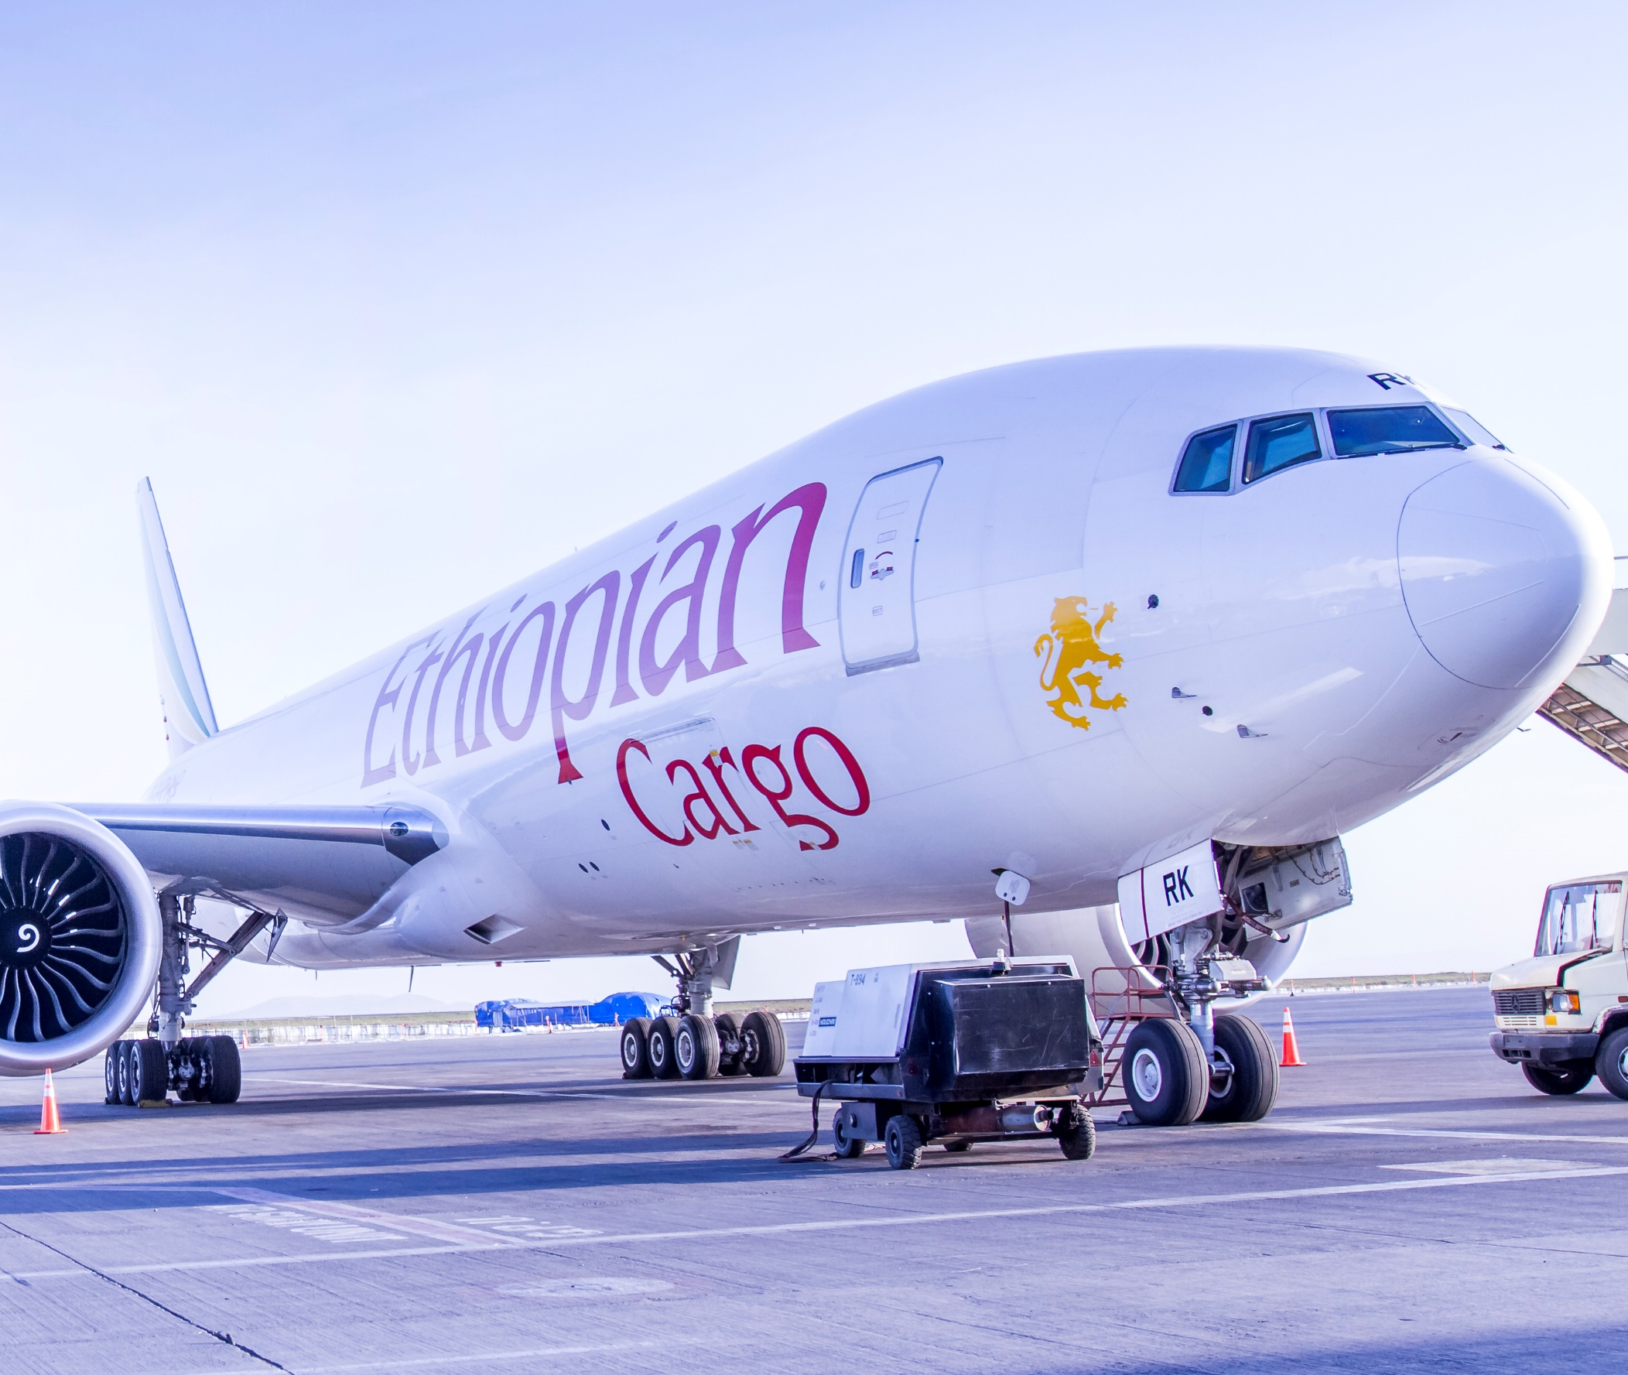
Sustainable infrastructures built to suit global standards and requirements
AIR
Largest cargo network and terminal in Africa
Destinations
98 – International
35 – Cargo
AIR
RAIL
24

Slide 25
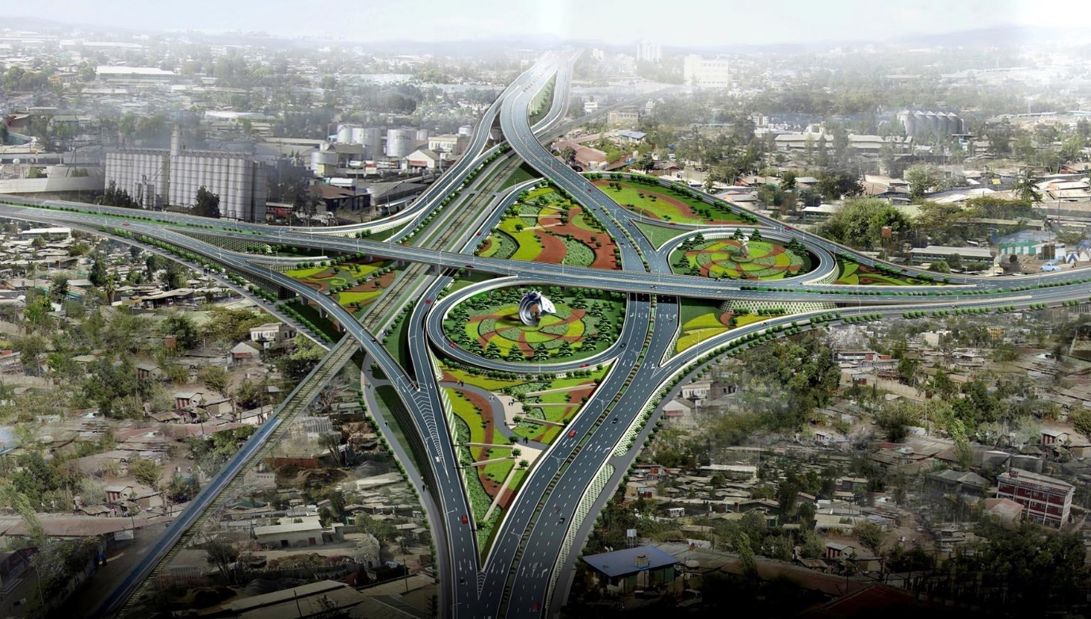
Sustainable infrastructures
Nation-wide connectivity
ROAD
All-weather roads nation-wide
Currently 113,066 KMs and expanding to 220,000 KMs
AIR
RAIL
25

Slide 26
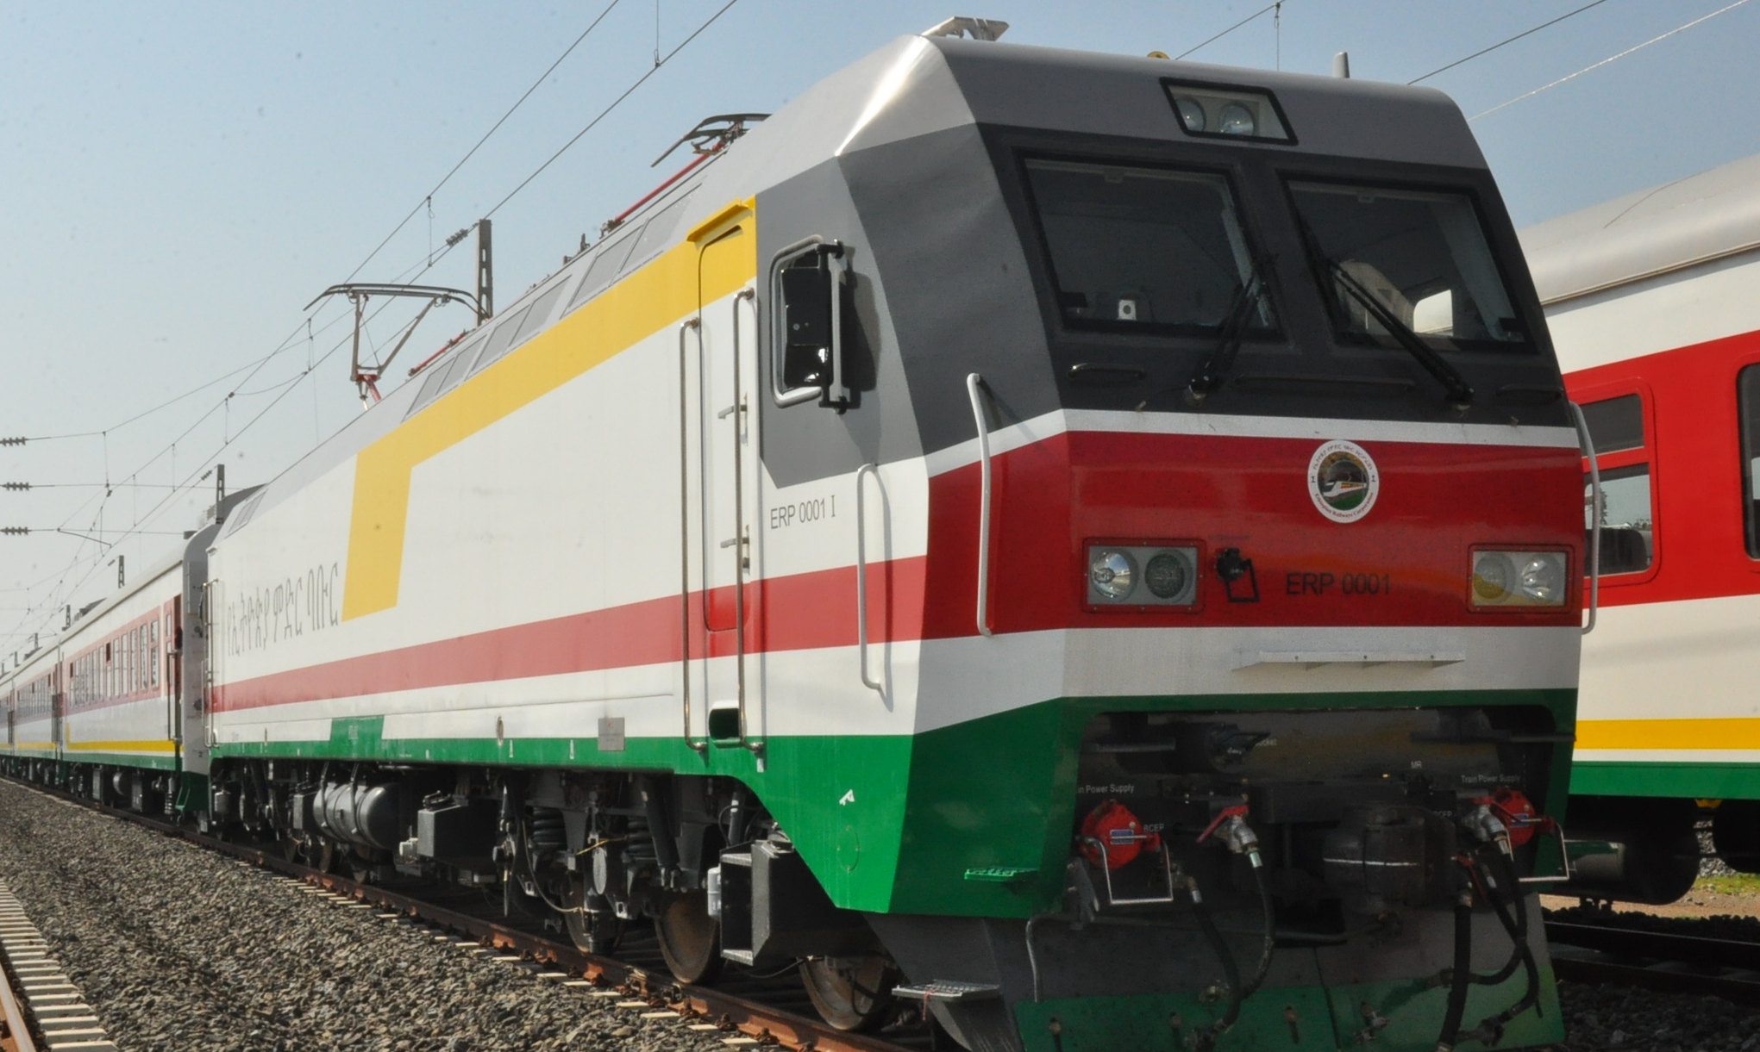
Sustainable infrastructures
Africa’s Electric-powered railway
RAILWAY
Djibouti to Modjo (dry port city 70 kms from the capital city) cut from 84 hours to under 10 hours
Cargo trains operating with capacity of 3500 - 4000 tons of freight per day
AIR
RAIL
26

Slide 27
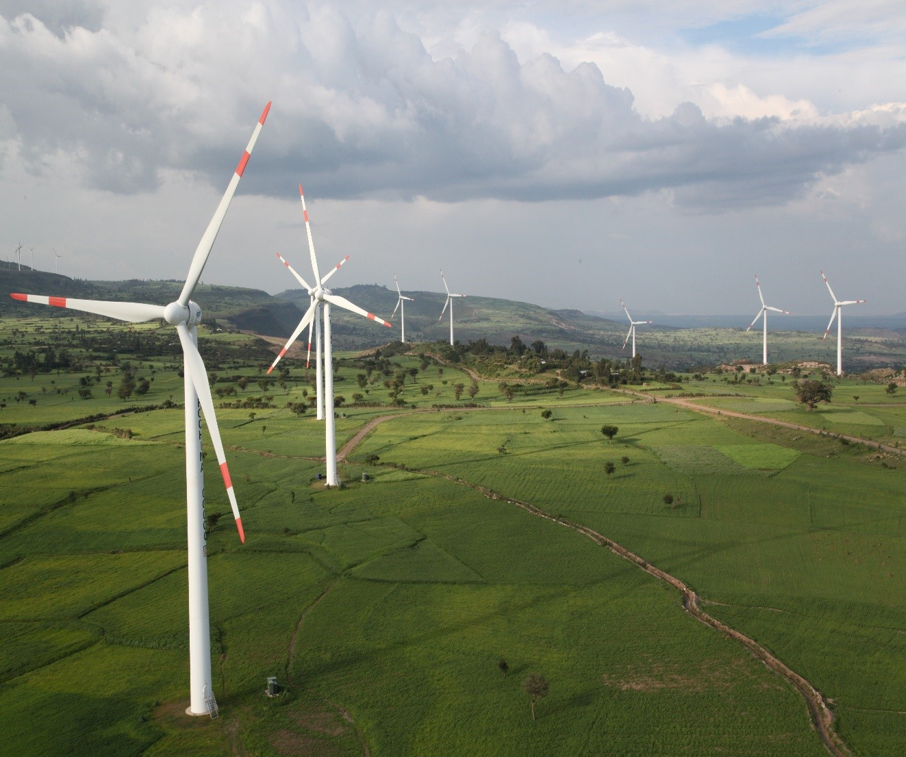
Sustainable infrastructures
Green electricity generation
ELECTRICITY
Low cost green electricity rate at 3 US cents/KWH – Cheapest in Africa
Country power generation capacity - 2,421 MW to 17,000 MW
  Hydro-electric power capacity: 17,000 MW
  Hydro power: 45,000 MW
AIR
RAIL
ELECTRICITY
ROAD
27

Slide 28
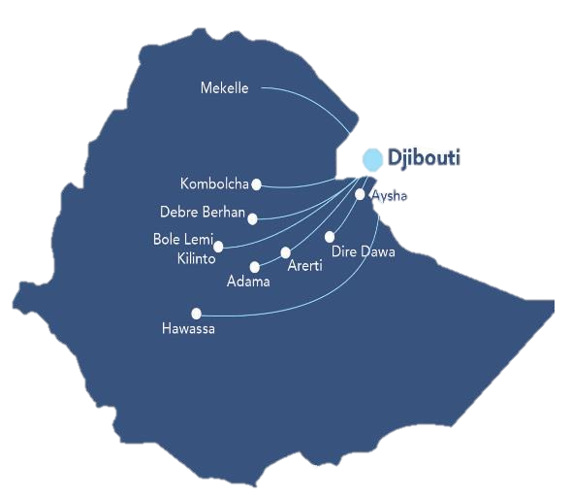
Sustainable infrastructures
Specialized industrial parks
27
Total planned Industrial Parks
9
Government owned IPs operational Bole Lemi I, Hawassa I, Mekelle and Kombolcha
Bahir Dar
23
Government Industrial Parks
4
Private IPs fully operational
Eastern and Hujian Industry Parks
Jimma
4
Private Industrial Parks
10
IPs (State and private) under construction
Construction not started
Under construction
Operational
28

Slide 29
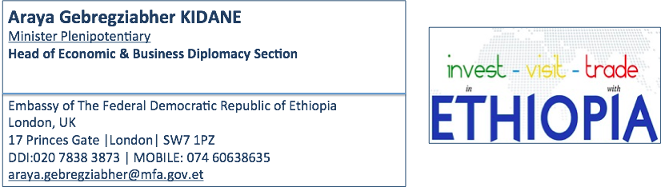
Key government contact based in London UK
29

Slide 30
