Slide 1
TTIP & TPP’s Risks: From China’s Perspectivs
没有中国参与，TTIP和TPP将犯历史错误
――在伊斯坦布尔工业协会年会上的主旨发言
WANG Wen
王 文
Executive Dean, Chongyang Institute for Financial Studies, Renmin University of China (RDCY)
中国人民大学重阳金融研究院执行院长
土耳其伊斯坦布尔
Istanbul, Turkey
February 13, 2016

Slide 3
In fact, while analyzing international trade pattern changes, Chinese scholars tend to parallel TTIP with the US-led Trans-Pacific Partnership Agreement, which aims to establish a more exclusive and more favorable free trade alliance than that forms under WTO rules.

Slide 4
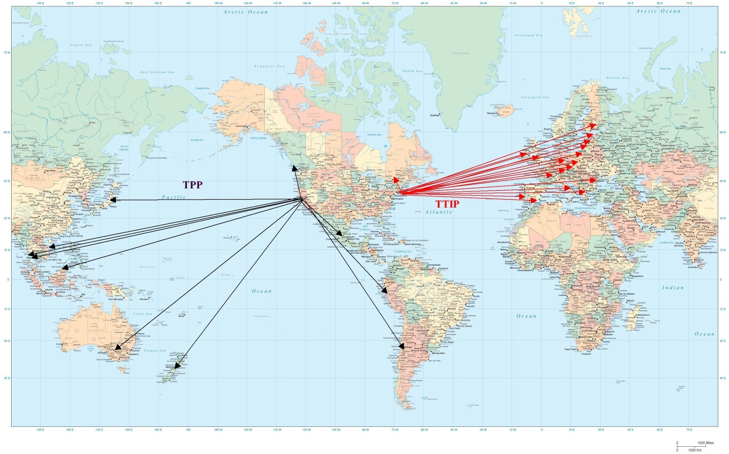
TTIP and TPP: WTO 2.0?
More exclusive and more favorable free trade alliance?
To start a new revolution in the international economic and trade system?

Slide 5
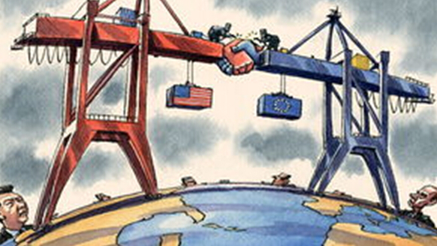
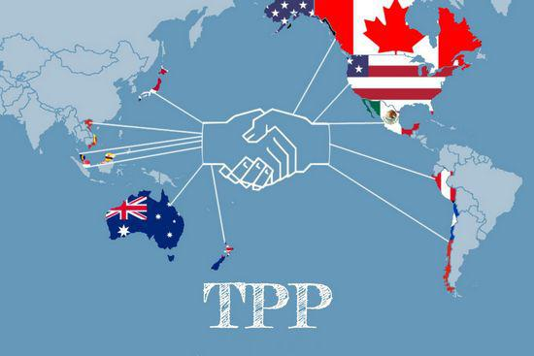
A Chinese think tank’s perception on TTIP and TPP
However, the current development trend indicates that this so-called revolution has not brought about positive global progress, but a big influence on the global order evolution process that has embraced a linear development model. New trade protectionism is taking shape in new forms. And the unnecessary internal frictions in competition between developed countries and emerging economies grow. These negative influences of TPP and TTIP can cause larger scale of strategic misjudgment, and increase the tension and uncertainties of global economic and political systems.

Slide 6
Firstly, TPP and TTIP go against the strategic intentions of the US.
The US hopes to use a new set of world trade rules to sideway WTO Doha Round Negotiation, and make up loopholes exposed in the protracted negotiations on international economy and trade.

Slide 7
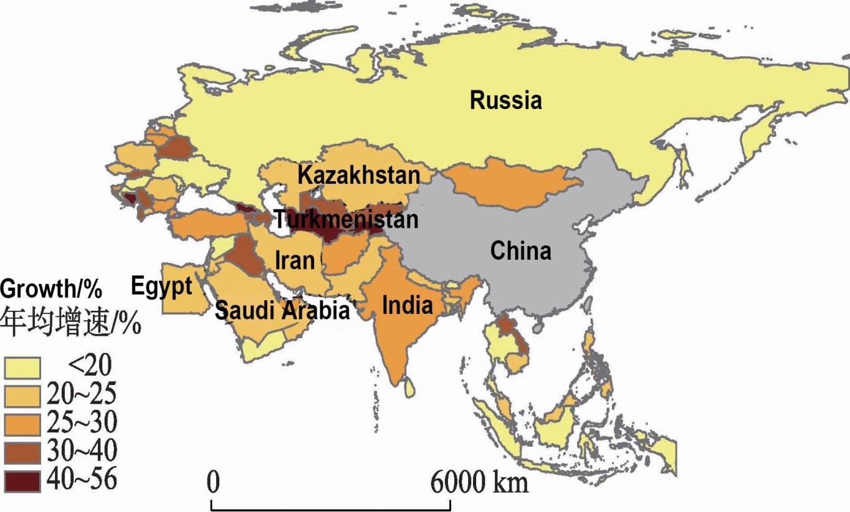
Secondly, TTIP and TPP almost exclude all emerging economies
such as China, India, Russia, Brazil, Indonesia, the Middle East and the whole Africa. Whether Turkey can enter TTIP depends on its relations with the European Union.

Slide 8
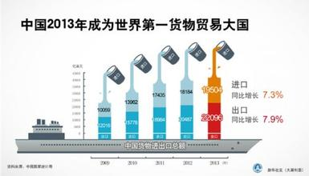
Thirdly, as the world’s largest trader and consumption market, China is not in TTIP and TPP. Chinese scholars take it as a kind of strategic provocation.
In 2013, China became the world's largest trading nation

Slide 9
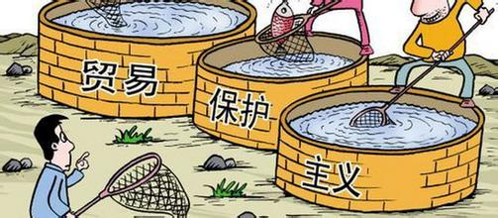
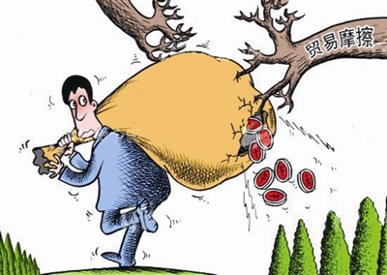
TTIP and TPP are exclusive, not inclusive;
they helps the developed countries, not the world;
they are regional, not global;
they return to trade protectionism, not free trade;
they are anti-globalization, not pro-globalization;
they will escalate trade frictions, not help to find solutions.
Trade protectionism
Trade friction

Slide 10
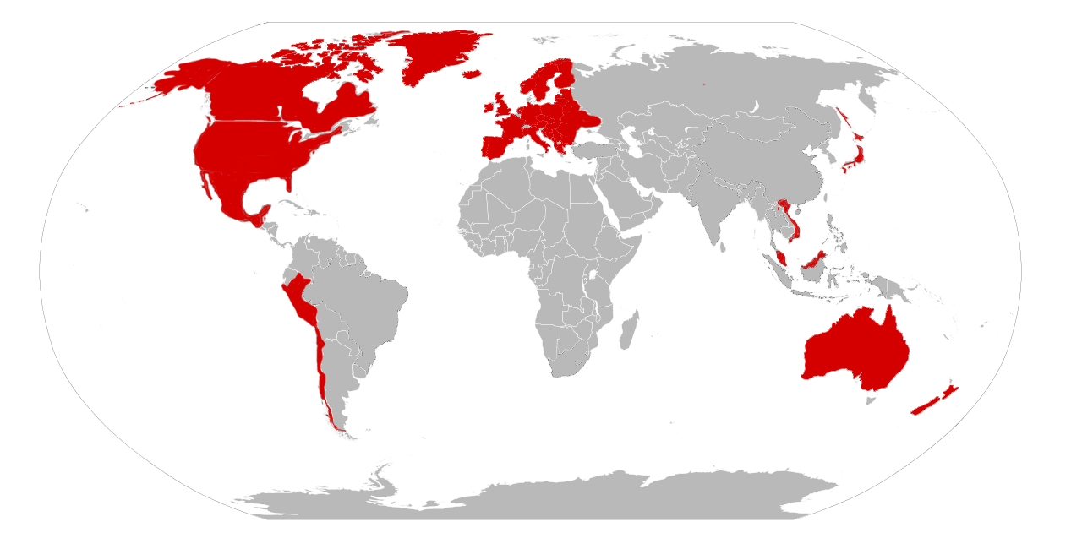
New Two World

Slide 11
Concluded Suggestion:
International community should carefully consider the TTIP and TPP’s chances of success or failure, as well as corresponding risks, and make necessary adjustments in time.

Slide 12
First of all
the international community should maintain communications on global trade, especially through the institutionalization of the trade minister conference of G20.

Slide 13
Secondly
the international community should cherish the results attained in free trade negotiations under WTO framework.

Slide 14
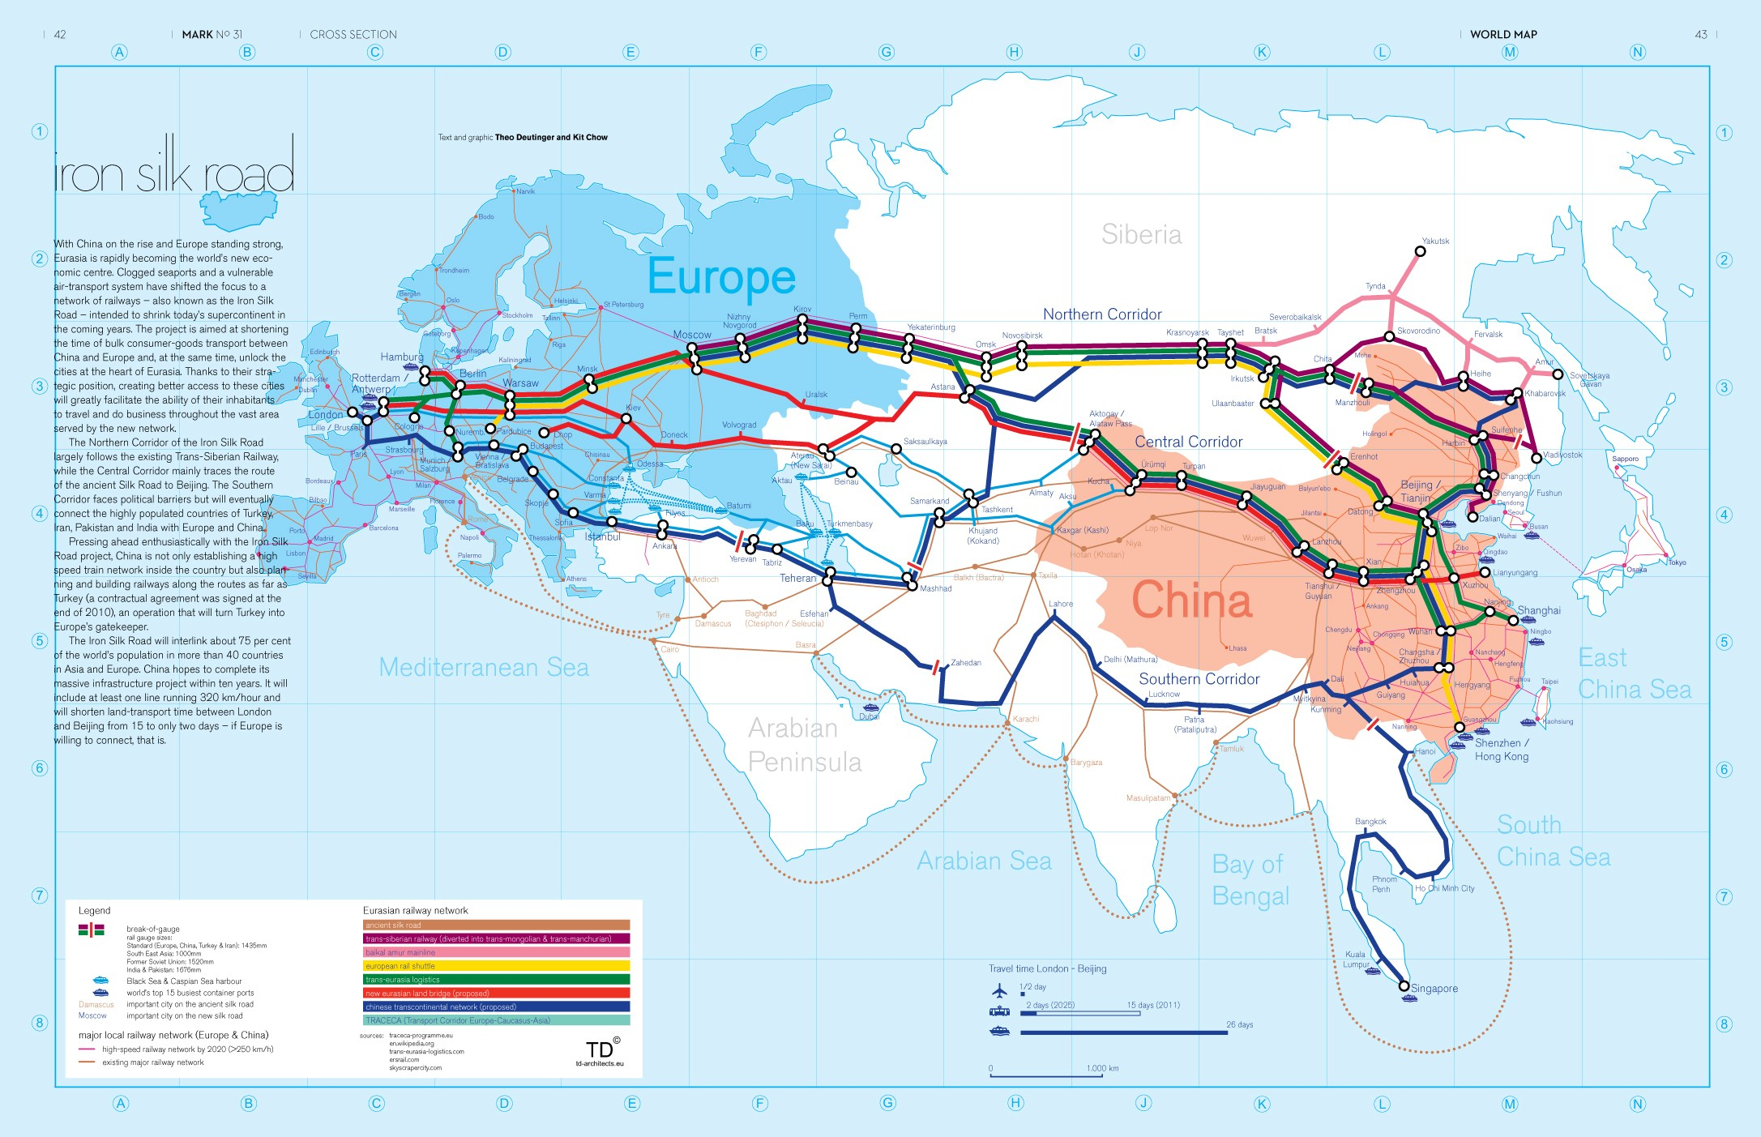
Last but not least, the international community should pay attention to and support the regional economic and trade cooperation net that forms under the Belt and Road proposals of China.

Slide 15
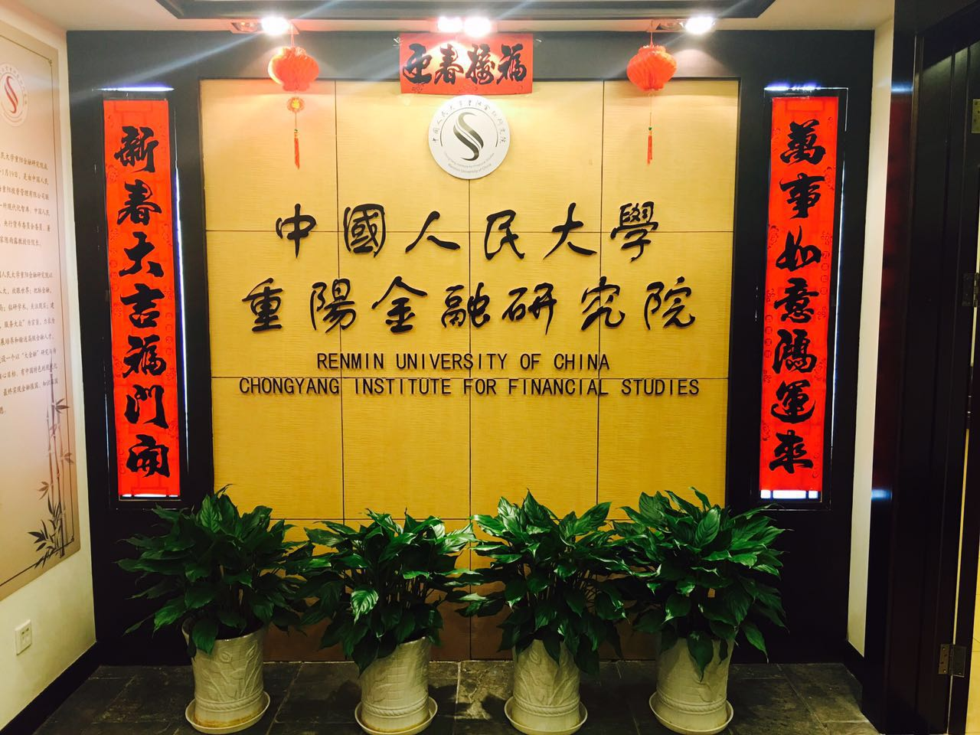
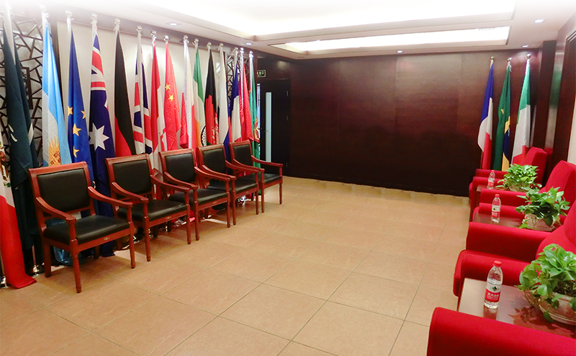
中国人民大学重阳金融研究院
Chongyang Institute for Financial Studies,
Renmin University of China (RDCY)

Slide 16
Thank you !
WeChat：rdcy2013(人大重阳)
Weibo：@人大重阳
@王文评论
Email：wangwen2013@ruc.edu.cn

