Slide 1
Investment Opportunities
in Morocco

Slide 2
https://www.youtube.com/watch?v=IlGKCsFTnYk

Slide 3
AGENDA
--- MOROCCO OVERVIEW
--- FDI IN MOROCCO
--- MOROCCO VALUE PROPOSITON
--- MOROCCO: A GATEWAY TO AFRICA

Slide 4
MOROCCO OVERVIEW
Capital
Rabat
Institutional System
Democratic and social Constitutional Monarchy
Area
710 850 km²
N° of inhabitants
33.8 million
64% of Moroccans are aged under 34 years
Time Zone
GMT (GMT+1 in summer)
Arabic and Amazigh (oﬃcial) French, Spanish, English
Languages
GDP (2015)
982 Billion MAD
GDP per capita
2015
29 184 MAD
GDP growth (2015)
Growth +4.5% Vs 2014
Primary Sector
Secondary Sector
Tertiary Sector
15%
29%
56%
GDP Distribution (2015)
Inﬂation Rate
(2015)
1.6%
FDI growth (2015)
5.8%

Slide 5
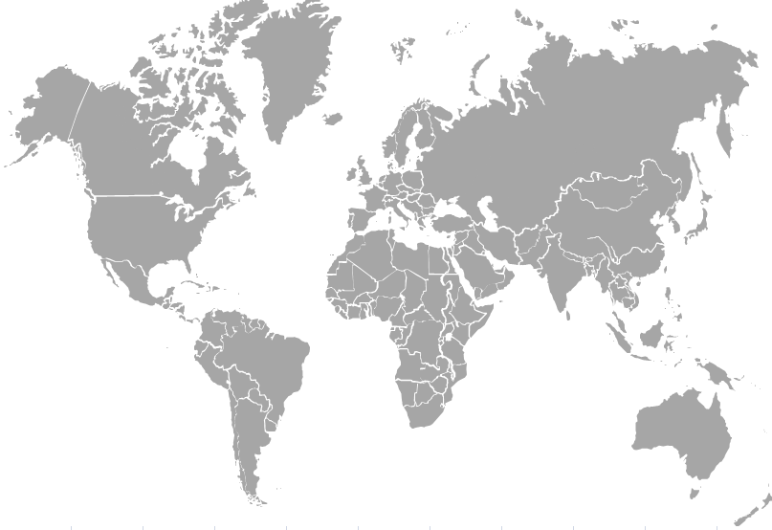
FDI IN MOROCCO
REGIONAL MARKET SHARE
Share of Morocco in inward FDI in Africa
Share of Morocco in inward FDI in North Africa
1ST DESTINATION IN TERMS OF PROJECTS IN NORTH AFRICA OVER THE LAST 5 YEARS-FDI INTELLIGENCE
Source: CNUCED

Slide 6
FDI BY SECTOR
FDI BY SECTOR OF ACTIVITY
(In M MAD)
MANUFACTURING INDUSTRIES
(In M MAD)
Source: Office des Changes

Slide 7
FDI BY COUNTRY OF ORIGIN
Segmentation of FDI by country
–2015–
(In M MAD et %)
Source: Office des Changes

Slide 8
MOROCCO VALUE PROPOSITION

Slide 9
A BUSINESS ENVIRONMENT CONDUCIVE TO INVESTMENT
2014
2015
2016
No restrictions on capital for non-residents
USA
LOW
LOW
LOW
Control Risks is a British consulting ﬁrm specialized in geopolitical and economic risks
for businesses and people since 1975, with operations in 36 countries.
BRAZIL
Medium
Medium
Medium
FRANCE
LOW
LOW
LOW
PORTUGAL
LOW
LOW
LOW
ROMANIA
LOW
Medium
Medium
More than 100 non double taxation and investment protection agreements
SPAIN
Medium
Medium
Medium
QATAR
LOW
LOW
LOW
JORDAN
Medium
Medium
Medium
MOROCCO
LOW
LOW
LOW
SOUTH AFRICA
Medium
Medium
Medium
TUNISIA
Medium
Medium
Medium
Free repatriation of profit and capital for non-residents
ALG%ERIA
HIGH
HIGH
HIGH
EGYPT
HIGH
HIGH
HIGH
Stable political environment o' ver the last 10 years

Slide 10
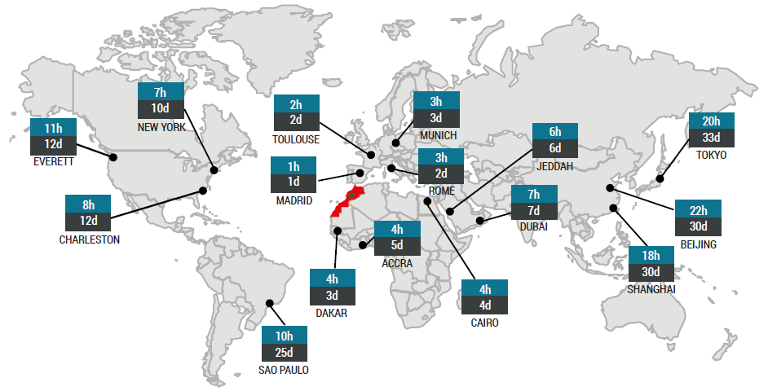
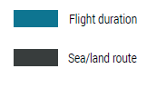
GEOSTRATEGIC LOCATION
AT THE CROSSROADS OF THE CONTINENTS
Due to its political stability, solid infrastructure,
and strategic location, Morocco is rapidly becoming a regional manufacturing and export base for international companies.
Sources : Royal Air Maroc; , TMPA, Shipping company

Slide 11
UNIQUE SET OF FREE TRADE AGREEMENTS GIVING ACCESS TO 1.3 BILLION CONSUMERS
BILATERAL AGREEMENTS
UAE – JORDAN - TURKEY
Agreement under negotiations with Canada
Association Agreement with the European Union (1996)
Advanced status granted in 2008
MULTILATERAL AGREEMENTS MEDITERRANEAN ARAB COUNTRIES (AGADIR DECLARATION)
TRADE FACILITATION AND DEVELOPMENT AGREEMENT BETWEEN ARAB COUNTRIES
Agreement with Turkey (2003)
Agreement with United States of America (2005)
Agadir Agreement (2004)
United Arab Emirates Agreement (2003) Arab League Agreement (1998)
ECONOMIC GROUPS FTA MOROCCO – STATES OF THE EUROPEAN
ASSOCIATION OF FREE TRADE ASSOCIATION AGREEMENT WITH THE EU
Agreement under negotiations with the Economic Community of West African States (ECOWAS & CEMAC)
In order to foster investment in Morocco, Moroccan Government implemented key administrative, fiscal, real estate incentives along with several trade agreements

Slide 12
EXCELLENT INFRASTRUCTURES
Airports
16 international airoports
Casablanca #1 hub between Europe and Africa
TANGIER MED: 5th largest port of the Mediterranean sea
Highways
Network multiplied by 12 in 15 years Connecting 70% of the population
. Ideal platform to serve Mediterranean and Western African countries
. Connections to 170 international ports in 67 countries
. Capacity of 8,5 million containers in 2018
. Target : Top 15 worldwide
Ports
2 shorelines (Mediterranean and Atlantic)
38 ports among which 13 dedicated to foreign trade.
Trains
1st high-speed train (Tangier- Casablanca) available in 2018
1.8 Billion EUR investment
Morocco ranks 16th on the liner shipping connectivity index (# 1in Africa)
23
77
18 18 19
16 16
Tramways
Rabat and Casablanca
1 Billion EUR investment
33
83 84
80
2004 2006 2008 2010 2012 2014
Source : Autoroutes du Maroc, AMDI, UNCTAD report 2014

Slide 13
HIGH-END INTEGRATED INDUSTRIAL PLATFORMS
TANGER AUTOMOTIVE CITY
TETOUAN SHORE
NOUASSEUR AEROSPACE
PARK «MIDPARC»
TECHNOPOLIS
ATLANTIC FREE ZONE
OFFSHORING P2I
AERONAUTICS P2I GENERAL P2I
AUTOMOBILE P2I AGRICULTURAL P2I
TANGER TETOUAN
CASANEARSHORE
KENITRA
FES
BERKANE
OUJDA
RABAT
MEKNES
MIDPARC
CASABLANCA
MARRAKECH
AGROPOLIS
FES SHORE
OUJDA SHORE
CLEANTECH
AGADIR
MARRAKECH SHORE
LAAYOUNE
DAKHLA
Morocco has developed a comprehensive range of actions to support the investor
and let it focus on its core business
Source : AMDI

Slide 14
AMBITIOUS SECTORAL STRATEGIES
INDUSTRY : Performant Clusters Strategy 2020
Launched in 2014
. Industrial GDP to reach 23% of global GDP
. Creation of 500 000 jobs
. Creation of Industrial Development Fund:
$2.5 Bn
. Allocation of 1 000 hectars of land for rent
TOURISM : 2020 VISION
Launched in 2010
. 20 million tourists in 2020
. 200 000 new beds
. Tourism GDP: from US$6 billion in 2010 to US$17 billion in 2020
ENERGY : MOROCCAN SOLAR PLAN 2020
Launched in 2009 (Solar) and in 2010 (Wind)
. Renewable energy > 40% of national production by 2020
. Capacity : 2 000 MW of solar power + 2 000 MW of wind power
MINING SECTOR 2025
. Turnover x3 1.5 Bn USD
. Investment x10 0.4 Bn USD
. Jobs x2 30 000
AGRICULTURE : GREEN MOROCCO PLAN 2020
. To modernize the agricultural sector
. US$10 billion in additional GDP from agriculture
. US$15 billion in public and private investments
LOGISTICS PLAN 2016
. To improve the country’s supply chain competitiveness
. To reduce logstics costs from 20% to 15% of GDP
. An integrated national network of 70 multi- flow logistics zones
IT : MAROC NUMERIC
. Generalized access to broadband
. Encourage IT use by SMEs
. Development of government e-services
Launched in 2008
Launched in 2010
Launched in 2009
LIQUIFIED NATURAL GAS
. 4,6 MM USD investment
. Gas terminal
. 400 km gazoduc
. Combined cycle power plant

Slide 15
INDUSTRIAL ACCELERATION PLAN 2014-2020 :
CREATE THE MOMENTUM FOR THE INDUSTRIALIZATION OF MOROCCO
Succeed in boosting our industrialization...
...through the development of competitive clusters (ecosystems)
500 000
Jobs created in the industry, half of them
through foreign investments
JOB CREATION
. Cornerstone of the IAP
. Competitive clusters as a key to modernize and integrate each industry
INDUSTRIAL CLUSTER STRATEGY
. Industrial fund : 20 Billion MAD
. Land : 1000 hectars
. Dedicated financial products
. Coordinated training programs
. Offsets and imports substitution
ADDED VALUE
SUPPORTIVE MEASURES
+9pts
Raise the share of industry in the GDP To 23%
Rebalance our trade accounts by promoting exports and substituting local sourcing to imports
TRADE BALANCE
Cross-functional aims of the IAP :
BALANCE OF TRADE
AND INCLUSIVE DEVELOPMENT
0
. Rebalance trade
. Include informal economy
. Increase vertical integration MNC/SMB

Slide 16
PRESENTATION OF ECOSYSTEMS’ PRINCIPLES
Tier 2 suppliers
5 to 10 jobs
Job creation
Tier 1 suppliers
2 to 3 jobs
Structuration of sectorial hubs of industrial leaders and SMEs :
Dedicated industrial parks
Specific strategies per branch to complete sectorial industrial maps
Targeted programs of cooperation
Long-term supply contracts and technological transfers
Value addition
New crafts developped
Subcontracting
Industrial powerhouse
1 Job
Trade balance
Technological transfers
Quality upgrading
New export powerhouses
Increased export capacities
Development of substitution
Objective is to benefit from an ecosystem-wide ripple effect to accelerate local integration and industrialization

Slide 17
INDUSTRIAL ACCELERATION PLAN :
10 PERFORMANCE CONTRACTS ALREADY SIGNED
Automotive
Aerospace
Textile
Leather
Chemical & Para-Chemical
Heavy Trucks
Mechanical and Metalworking industries
Building Material
Pharmaceuticals
Offshoring

Slide 18
KEY INVESTMENT INCENTIVES
HASSAN II FUND
INDUSTRIAL DEVELOPMENT AND INVESTMENT FUND
Eligibiliy criteria:
• Total Investment: 10 million MAD /900 000 €
• Investment in capital goods: 5 million MAD /450 000 €
(excluding import fees and taxes)
Package includes:
Aid of up to 15% of the total amount of the investment capped at 30 million MAD/2.7 million € covering purchasing or renting of real estate and professional buildings and acquisition of industrial equipment.
Eligibility criteria:
The project should meet one of the following criteria:
• Total Investment: 100 million MAD /9 million €.
• Jobs created: 250 direct, permanent jobs
• Setup in a priority area
• Technology transfer
• Environmental Protection
Package includes:
Aid of up to 5% of the total amount of the investment (10% if the project is implemented in a suburban or rural area) as follows:
• Land: Support for up to 20% of the acquisition costs
• External Infrastructure: support up to 5% of the total investment program
• Training: Support for up to 20% of the professional
training costs
VAT EXEMPTION & CUSTOMS DUTIES EXEMPTION
FREE ZONE STATUS
Eligibility criteria:
Investment ≥ 100 million MAD
Incentives include:
Exemption of VAT on imports for capital goods, equipment and tools for a duration of 36 months from start of operations.
This exemption is also given on parts, spare parts and accessories that are imported at the same time as capital goods, machinery and equipment for which they are intended.
Exemption of customs duties on capital goods, equipment and tools for a duration of 36 months from the signature of a an investment agreement.
Eligibility criteria:
Export turnover ≥ 85%
Offering includes:
•Full exemption from corporate tax for the first 5 years, followed by a rate capped at 8.75% for the next 20 years
•Custom fee exemptions on imported goods and products
• VAT exemption on imported goods
• Exemption from license fees and urban tax during 15 years
+ Made to measure help for large scale projects

Slide 19
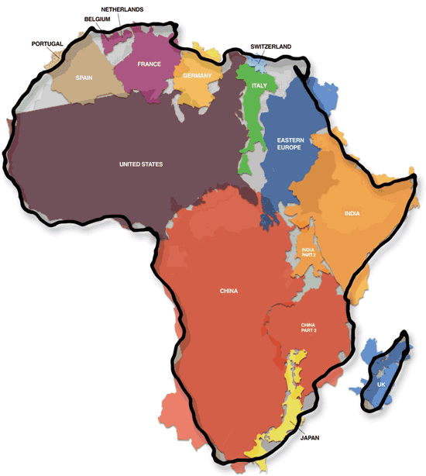
MOROCCO: A GATEWAY TO AFRICA
Morocco is considered as a platform for foreign companies to project their activities in sub-Saharian Africa due to:
5,000 bilateral agreements
Deep knowledge of African markets
Very frequent airline connections
A strong Moroccan banking sector present in Africa
Impact of the many African Royal Tours
By 2050, Africa's economy would be close to 10 times bigger than it is today.
Six of the world’s ten fastest-growing economies in the world over the last decade were in Africa. It is expected to be seven by 2020.
There is a rise of a consumer society, which increases demand, boosts local production and amplifies middle class.
The true size of Africa embraces China, the US, India, Eastern Europe and the most important Western European countries
CFC is the 1st financial centre in Africa and the 33rd worldwide (global Financial centers index)
Source: Bloomberg
Notes:
With $800 millions of investments, Morocco is the 2nd African investor in the continent
In 2016, 62% of Moroccan FDIs went to African countries

Slide 20
. Helps you build your business case
. Answers your information requests
. Helps you settle and thrive
. Facilitates the integration of your business into the local economy
. Helps you carry out your project
. Assists you in accelerating procedures and guides you in the contacts with government services
. With you along the way
. Ensures the satisfaction of investors thanks to its after care service

Slide 21
Thank you for your attention
www.invest.gov.ma

